Slide 1
Pipelining
CIS 5710
Computer Organization and Design

Slide 2
This Unit: Pipelining
App
App
App
Processor performance
  Latency vs throughput
Single-cycle & multi-cycle datapaths
Basic pipelining
Data hazards
  Software interlocks and scheduling
  Hardware interlocks and stalling
  Bypassing
  Load-use stalling
Pipelined multi-cycle operations
Control hazards
  Branch prediction
System software
Mem
CPU
I/O

Slide 3
Readings
P&H
  Chapter 4

Slide 4

Notes:
other pipelining examples?

Slide 5
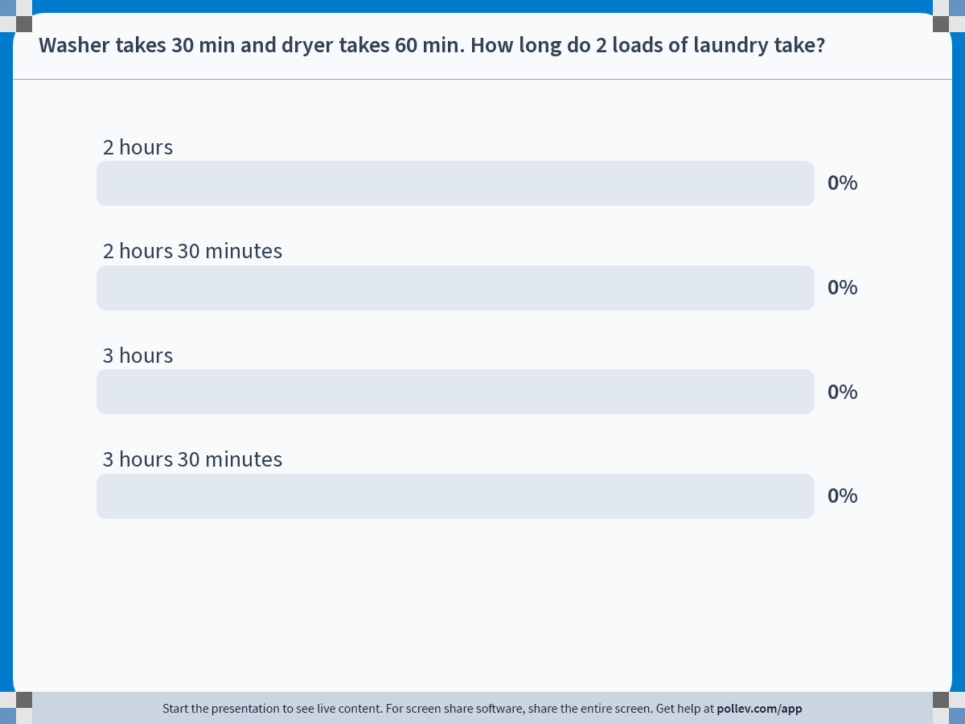
Notes:
Do not modify the notes in this section to avoid tampering with the Poll Everywhere activity.
More info at polleverywhere.com/support
Washer takes 30 min and dryer takes 60 min. How long do 2 loads of laundry take?
https://www.polleverywhere.com/multiple_choice_polls/kiM7zfdM1ev5x6GbzqnP4?state=opened&flow=Default&onscreen=persist

Slide 6
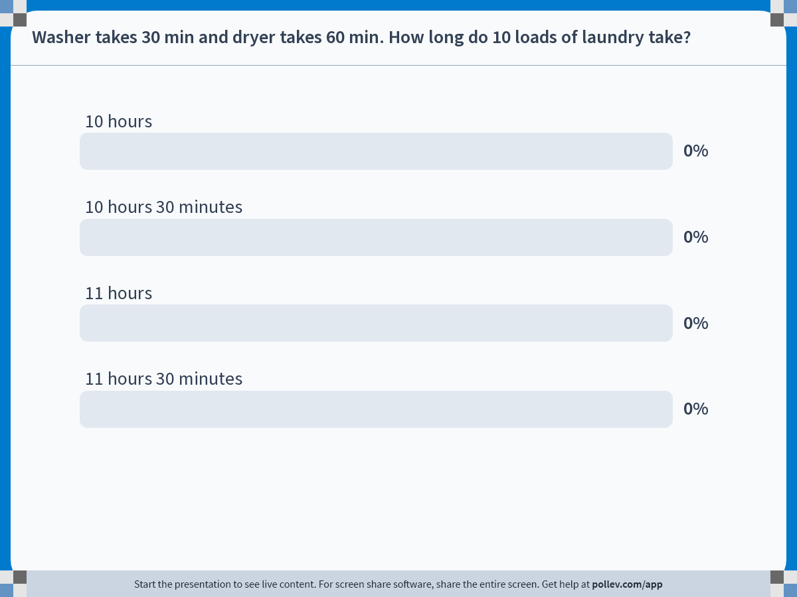
Notes:
Do not modify the notes in this section to avoid tampering with the Poll Everywhere activity.
More info at polleverywhere.com/support
Washer takes 30 min and dryer takes 60 min. How long do 10 loads of laundry take?
https://www.polleverywhere.com/multiple_choice_polls/I0KBLNa8Xn4BYpUbEL8yB?state=opened&flow=Default&onscreen=persist

Slide 7
How can we do laundry faster?
What is the bottleneck?

Slide 8

Notes:
other examples: food service is highly pipelined
joke: “this Chipotle is backwards”, usually tortilla stage is on the left

Slide 9
Processor Performance

Slide 10
Processor Performance Equation
  Execution time = “seconds per program” =
  (instructions/program) * (seconds/cycle) * (cycles/instruction)
Instructions per program: “dynamic insn count”
  Runtime count of instructions executed by the program
  Determined by program, compiler, ISA
Cycles per instruction: “CPI” (2 to 0.5)
    On average, how many cycles does an insn take?
  Determined by program, compiler, ISA, micro-architecture
Sec. per cycle: “clock period” (2ns to 0.25ns)
  Reciprocal is frequency: 0.5 Ghz to 4 Ghz
  Determined by micro-architecture, technology parameters
For minimum execution time, minimize each term
  Difficult: often pull against one another

Slide 11
Improving Clock Frequency
Faster transistors
Micro-architectural techniques
  Multi-cycle processors (HW4)
    Break each instruction into small bits
    Less logic delay -> improved clock frequency
    Different instructions take different number of cycles
      CPI > 1
  Pipelined processors (HW5)
    As above, but overlap parts of instruction (parallelism!)
    Faster clock, but CPI can still be around 1

Slide 12
Single-Cycle Datapath
+
4
PC
Register
File
Insn
Mem
Data
Mem
s1
s2
d
T_{singlecycle}
Single-cycle datapath: fetch/execute loop
  Fetch, decode, execute one complete insn each cycle
  CPI is 1
  Slow frequency: determined by slowest instruction
Notes:
Frequency is fixed, cannot change at insn-granularity. Can change at millisecond scale, though.

Slide 13
Latency versus Throughput
Latency (execution time): time to finish a task
Throughput (bandwidth): tasks per fixed time
  exploit parallelism for throughput, not latency (e.g., bread)
  Often contradictory (latency vs. throughput)
Executing a program requires high throughput
  programs have billions of insns
  typically don’t care about latency of just a few insns

Slide 14
Multi-cycle Datapath

Slide 15
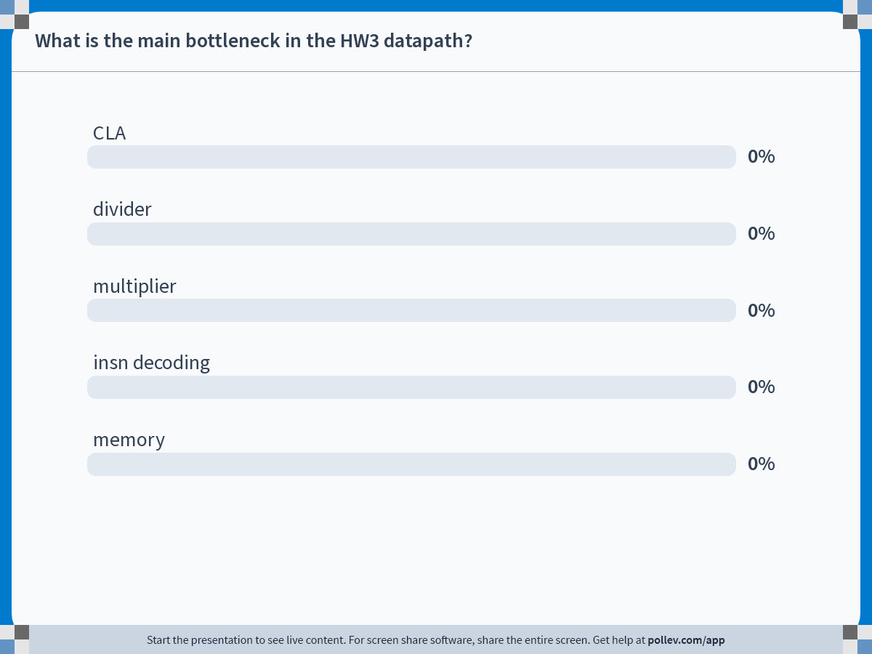
Notes:
Do not modify the notes in this section to avoid tampering with the Poll Everywhere activity.
More info at polleverywhere.com/support
What is the main bottleneck in the HW3 datapath?
https://www.polleverywhere.com/multiple_choice_polls/2bx5d7DBGKhD9TDTpDsGT?state=opened&flow=Default&onscreen=persist

Slide 16
Single-cycle datapath bottleneck
critical path is through the divider

Slide 17
How to improve divider speed?
Critical path is max-delay path between two registers
  Adding more registers can help!
  Reduces critical path, boosts frequency and throughput
  Extra register hurts latency of a single divide instruction
single-cycle divider
2-stage pipelined divider
div
div
reg
div
div
div
div
div
div
div
div
div
div
div
div
div
div

Slide 18
Pipelined division
Can start a new division operation each cycle
div
reg
div
div
div
div
div
div
div
div x1,x2,x3
div x7,x8,x9
div x4,x5,x6

Slide 19
Pipeline diagrams
Table representation of insns moving through the pipeline stages
  Cycles in columns, oldest on the left
  Insns in rows, oldest at the top
exploit parallelism across stages
 | 1 | 2 | 3 | 4 | 5
div x1,x2,x3 | D1 | D2
div x4,x5,x6 |  | D1 | D2
div x7,x8,x9 |  |  | D1 | D2

Slide 20
Data dependences
Pipelining is easy if insns are independent
  no reading and writing to the same register
But what about dependencies?
  an insn that depends on the immediately preceding insn
 | 1 | 2 | 3 | 4 | 5
div x1,x2,x3 | D1 | D2
div x4,x5,x1 |  | D1?
div x4,x5,x1 |  |  | D1 | D2
Notes:
loads of laundry are always independent

Slide 21
Multi-cycle datapath
In HW4, we pipeline the divider solely for the frequency benefits
  we won’t worry about CPI at all
Datapath takes 2 cycles for each div[u]/rem[u] insn
  takes 1 cycle for all other insns
  back-to-back div insns take 4 cycles
    avoid problems with data dependencies
 | 1 | 2 | 3 | 4 | 5
lui x1,0 | X
div x1,x2,x3 |  | D1 | D2
div x4,x5,x6 |  |  |  | D1 | D2
addi x4,x4,3 |  |  |  |  |  | X
Notes:
wasted opportunity in cycle 3 – can we do better?

Slide 22
Pipelined Datapath

Slide 23
Pipelining
insn0.fetch
insn0.dec
insn0.exec
insn1.fetch
insn1.dec
insn1.exec
Important performance technique
  Improves instruction throughput, not instruction latency
Break instruction execution into stages
  When insn advances from stage 1 to 2, next insn enters at stage 1
  exploits “stage-level parallelism”
  Maintains illusion of sequential fetch/execute loop
  Individual instruction takes the same number of stages
  But instructions enter and leave at a much faster rate
Just like the laundromat

Slide 24
5 Stage Pipeline: Inter-Insn Parallelism
+
4
Register
File
PC
Insn
Mem
Data
Mem
s1
s2
d
T_{insn-mem}
T_{regfile}
T_{ALU}
T_{data-mem}
T_{regfile}
T_{singlecycle}
Pipelining: cut datapath into N stages (here 5)
  Clock period = MAX(T_{insn-mem}, T_{regfile}, T_{ALU}, T_{data-mem}, T_{writeback})
  Base CPI = 1: insn enters and leaves every cycle
  Actual CPI > 1: pipeline must often “stall”
  Individual insn latency increases (pipeline overhead)
Notes:
Note feedback paths for PC and from Writeback stage into register file.

Slide 25
5 Stage Pipelined Datapath
PC
IN
PC
A
B
IN
+
4
PC
Register
File
O
B
IN
O
D
IN
Insn
Mem
Data
Mem
s1
s2
d
PC
D
X
M
W
Stages: Fetch, Decode, eXecute, Memory, Writeback
  Nothing magical about 5 stages (Pentium 4 had 22 stages!)
Pipeline registers named by stages they begin
  PC, D, X, M, W

Slide 26
Pipeline Terminology
Scalar pipeline: one insn per stage per cycle
  Alternative: “superscalar” (later)
In-order pipeline: insns enter execute stage in program order
  Alternative: “out-of-order” pipelines (later)
Pipeline depth: number of pipeline stages
  Nothing magical about 5
  Modern high-performance cores have ~15 stages

Slide 27
Pipeline Example: Cycle 1
PC
IN
PC
A
B
IN
<<
2
+
4
O
B
IN
O
D
IN
PC
Insn
Mem
Register
File
Data
Mem
a
PC
s1
s2
d
d
S
X
D
X
M
W
add x3,x2,x1

Slide 28
Pipeline Example: Cycle 2
PC
IN
PC
A
B
IN
<<
2
+
4
O
B
IN
O
D
IN
PC
Insn
Mem
Register
File
Data
Mem
a
PC
s1
s2
d
d
S
X
D
X
M
W
lw x4,8(x5)
add x3,x2,x1

Slide 29
Pipeline Example: Cycle 3
PC
IN
PC
A
B
IN
<<
2
+
4
O
B
IN
O
D
IN
PC
Insn
Mem
Register
File
Data
Mem
a
PC
s1
s2
d
d
S
X
D
X
M
W
sw x6,4(x7)
lw x4,8(x5)
add x3,x2,x1

Slide 30
Pipeline Example: Cycle 4
PC
IN
PC
A
B
IN
<<
2
+
4
O
B
IN
O
D
IN
PC
Insn
Mem
Register
File
Data
Mem
a
PC
s1
s2
d
d
S
X
D
X
M
W
sw x6,4(x7)
lw x4,8(x5)
add x3,x2,x1

Slide 31
Pipeline Example: Cycle 5
PC
IN
PC
A
B
IN
<<
2
+
4
O
B
IN
O
D
IN
PC
Insn
Mem
Register
File
Data
Mem
a
PC
s1
s2
d
d
S
X
D
X
M
W
sw x6,4(x7)
lw x4,8(x5)
add

Slide 32
Pipeline Example: Cycle 6
PC
IN
PC
A
B
IN
<<
2
+
4
O
B
IN
O
D
IN
PC
Insn
Mem
Register
File
Data
Mem
a
PC
s1
s2
d
d
S
X
D
X
M
W
sw x6,4(x7)
lw

Slide 33
Pipeline Example: Cycle 7
PC
IN
PC
A
B
IN
<<
2
+
4
O
B
IN
O
D
IN
PC
Insn
Mem
Register
File
Data
Mem
a
PC
s1
s2
d
d
S
X
D
X
M
W
sw

Slide 34
Pipeline Diagram
Update our previous pipeline diagrams
  Cycles in columns, oldest on the left
  Insns in rows, oldest at the top
  Convention: X means lw x4,8(x5) finishes execute stage and writes into M register at end of cycle 4
 | 1 | 2 | 3 | 4 | 5 | 6 | 7 | 8 | 9
add x3,x2,x1 | F | D | X | M | W
lw x4,8(x5) |  | F | D | X | M | W
sw x6,4(x7) |  |  | F | D | X | M | W

Slide 35
Example Pipeline Perf. Calculation
Single-cycle
  Clock period = 200ns, CPI = 1
  Performance = 200ns/insn
5-stage pipeline
  Clock period = 42ns (200ns / 5 stages) + overheads
  CPI = 1 (each insn takes 5 cycles, but 1 completes each cycle)
    Performance = 42ns/insn
  Well actually … CPI = 1 + some penalty for pipelining (next)
    CPI = 1.5 (on average insn completes every 1.5 cycles)
    Performance = 63ns/insn
    Much higher performance than single-cycle!

Slide 36
Why Is Pipeline Clock Period …
… > (delay thru datapath) / (number of pipeline stages)?
Three reasons:
  Pipeline registers add delay
  Each stage’s delay is different, clock period is max delay
  We’ll add extra logic just for pipelining
What is ideal pipeline depth?
  Diminishing clock frequency gains for longer (deeper) pipelines

Slide 37
Why Is Pipeline CPI > 1?
Two reasons
  CPI for scalar in-order pipeline is 1 + stall penalties
  Stalls used to resolve hazards
    Hazard: condition that jeopardizes sequential illusion
    Stall: delay introduced to preserve sequential illusion
Calculating pipeline CPI
  Frequency of stall * stall cycles
  Penalties add up (stalls typically don’t overlap in in-order pipelines)
  1 + (stall-freq₁*stall-cyc₁) + (stall-freq₂*stall-cyc₂) + …
“Make common case fast”
  Long penalties OK if they are rare, e.g., 1 + (0.01 * 10) = 1.1
  Stalls also have implications for ideal pipeline depth

Slide 38
Data Dependences, Pipeline Hazards, and Bypassing

Slide 39
Dependencies and Hazards
Dependency: relationship between two insns
  Data: two insns use same storage location
  Control: one insn affects whether another executes at all
  Not a bad thing, programs would be boring without them
  Enforced by making older insn go before younger one
    Happens naturally in single-/multi-cycle designs
    But not in a pipeline
Hazard: dependence & possibility of wrong insn order
  Effects of wrong insn order must not be externally visible
    Stall: restore order by holding younger insn back
  Hazards are bad because stalls reduce performance

Slide 40
Data Hazards
IN
Register
File
A
B
IN
O
B
IN
O
D
IN
Data
Mem
a
s1
s2
d
d
D
X
S
X
M
W
sw x6,4(x7)
lw x4,8(x5)
add x3,x2,x1
Let’s forget about branches for now
The three insns we saw earlier executed fine…
  But it wasn’t a real program
  Real programs have data dependences
    They pass values via registers and memory

Slide 41
Dependent Operations
Independent operations
add x3,x2,x1
add x6,x5,x4
Would this program execute correctly on our pipeline?
add x3,x2,x1
add x6,x5,x3
What about this program?
add x3,x2,x1
lw x4,8(x3)
addi x6,x3,1
sw x3,8(x7)

Slide 42
Data Hazards
IN
Register
File
A
B
IN
O
B
IN
O
D
IN
Data
Mem
a
s1
s2
d
d
D
X
S
X
M
W
sw x3,4(x7)
addi x6,x3,1
lw x4,8(x3)
add x3,x2,x1
Would this program execute correctly?
  Which insns would execute with correct inputs?
  add is writing its result into x3 in current cycle
  lw read x3 two cycles ago → got wrong value
  addi read x3 one cycle ago → got wrong value
  sw is reading x3 this cycle → maybe (depending on regfile)
Notes:
Our registers are all positive-edge triggered, so sw won’t get the result from add
Can play tricks with mixing positive- and negative-edge registers

Slide 43
Fixing Register Data Hazards
Can only read register value three cycles after writing it
Option #1: make sure programs don’t do it
  Compiler puts two independent insns between an insn pair that writes/reads register x
  Independent means: “do not read or write register x”
    Can’t write x: otherwise breaks program semantics
    Can’t read x: otherwise creates new data hazard…
  Code scheduling: compiler moves existing insns to do this
  If none can be found, must use nops
  This is called software interlocks

Slide 44
Software Interlock Example
    add x3,x2,x1
    nop
    nop
    lw x4,8(x3)
    sw x7,8(x3)
    sub x6,x2,x8
    addi x3,x5,4
Can any of last 3 insns be scheduled earlier?
  sw x7,8(x3)? No, creates hazard with add x3,x2,x1
  sub x6,x2,x8? Okay
  addi x3,x5,4? No, lw would read x3 from it
  Still one gap to fill, use nop
    add x3,x2,x1
    sub x6,x2,x8
    nop
    lw x4,8(x3)
    sw x7,8(x3)
    addi x3,x5,4

Slide 45
Software Interlock Performance
Assume
  Branch: 20%, load: 20%, store: 10%, other: 50%
For software interlocks, let’s assume:
  20% of insns require insertion of 1 nop
  5% of insns require insertion of 2 nops
Result:
  CPI is still 1 technically
  But now there are more insns
  #insns = 1 + 0.20*1 + 0.05*2 = 1.3
  30% more insns (30% slowdown) due to data hazards

Slide 46
Hardware Interlocks
Problem with software interlocks? Not compatible
  Where does 3 in “read register 3 cycles after writing” come from?
    From detailed structure of pipeline implementation
  What if next processor uses a 7-stage pipeline?
    Programs compiled for 5-stage pipeline won’t work!
Option #2: hardware interlocks
  Processor detects data hazards and fixes them
  Addresses compatibility concern
    software does not need to change
    software is often harder to change than hardware!
  Must detect hazards and fix them

Slide 47
Detecting Data Hazards
IN
Register
File
A
B
IN
O
B
IN
O
D
IN
Data
Mem
a
s1
s2
d
d
D
X
S
X
M
W
hazard
Compare input register names of insn in D stage
with output register names of older insns
  Stall =
  (D.IN.RegSrc1 == X.IN.RegDest) ||
  (D.IN.RegSrc2 == X.IN.RegDest) ||
  (D.IN.RegSrc1 == M.IN.RegDest) ||
  (D.IN.RegSrc2 == M.IN.RegDest)
Notes:
Also need to check X.RegWrite and M.RegWrite to see if those instructions are actually going to write to the register file.

Slide 48
Fixing Data Hazards
IN
Register
File
A
B
IN
O
B
IN
O
D
IN
Data
Mem
a
s1
s2
d
d
D
X
S
X
M
W
nop
hazard
Prevent D insn from reading (advancing) this cycle
  Write nop into X.IN (effectively, insert nop in hardware)
  Also reset (clear) the datapath control signals
  Disable D register and PC write enables (why?)
  Re-evaluate situation next cycle
Notes:
Now that we know that there is a problem, what do we do?
We only really need to worry about the control signals that update state: RegWrite and MemWrite, and PCwe
Why is waiting for the next cycle a reasonable strategy?

Slide 49
Hardware Interlock Example: cycle 1
IN
Register
File
A
B
IN
O
B
IN
O
D
IN
Data
Mem
a
s1
s2
d
d
D
X
S
X
M
W
nop
hazard
lw x4,0(x3)
add x3,x2,x1
    Stall =
    (D.IN.RegSrc1 == X.IN.RegDest) ||
    (D.IN.RegSrc2 == X.IN.RegDest) ||
    (D.IN.RegSrc1 == M.IN.RegDest) ||
    (D.IN.RegSrc2 == M.IN.RegDest) = 1

Slide 50
Hardware Interlock Example: cycle 2
IN
Register
File
A
B
IN
O
B
IN
O
D
IN
Data
Mem
a
s1
s2
d
d
D
X
S
X
M
W
nop
hazard
lw x4,0(x3)
nop
add x3,x2,x1
    Stall =
    (D.IN.RegSrc1 == X.IN.RegDest) ||
    (D.IN.RegSrc2 == X.IN.RegDest) ||
    (D.IN.RegSrc1 == M.IN.RegDest) ||
    (D.IN.RegSrc2 == M.IN.RegDest) = 1

Slide 51
Hardware Interlock Example: cycle 3
IN
Register
File
A
B
IN
O
B
IN
O
D
IN
Data
Mem
a
s1
s2
d
d
D
X
S
X
M
W
nop
hazard
lw x4,0(x3)
nop
nop
add x3,x2,x1
    Stall =
    (D.IN.RegSrc1 == X.IN.RegDest) ||
    (D.IN.RegSrc2 == X.IN.RegDest) ||
    (D.IN.RegSrc1 == M.IN.RegDest) ||
    (D.IN.RegSrc2 == M.IN.RegDest) = 0

Slide 52
Pipeline Control Terminology
An inserted NOP is called a stall or bubble
stall logic determines whether and when to stall

Slide 53
Hardware Interlock Performance
As before:
  Branch: 20%, load: 20%, store: 10%, other: 50%
Hardware interlocks: same as software interlocks
  20% of insns require 1 cycle stall (I.e., insertion of 1 nop)
  5% of insns require 2 cycle stall (I.e., insertion of 2 nops)
  CPI = 1 + 0.20*1 + 0.05*2 = 1.3
  So, either CPI stays at 1 and #insns increases 30% (software)
  Or, #insns stays at 1 (relative) and CPI increases 30% (hardware)
  Same performance but better software compatibility 😐
We can do better!

Slide 54
Observation!
IN
Register
File
A
B
IN
O
B
IN
O
D
IN
Data
Mem
a
s1
s2
d
d
D
X
S
X
M
W
lw x4,8(x3)
add x3,x2,x1
At first glance, this situation is broken
  lw x4,8(x3) has already read x3 from regfile
  add x3,x2,x1 hasn’t yet written x3 to regfile
But actually, the situation is salvageable
  lw x4,8(x3) hasn’t actually used x3 yet
  add x3,x2,x1 has already computed x3

Slide 55
Bypassing
IN
Register
File
A
B
IN
O
B
IN
O
D
IN
Data
Mem
a
s1
s2
d
d
D
X
S
X
M
W
lw x4,8(x3)
add x3,x2,x1
Bypassing
  Reading a value from an intermediate (μarchitectural) source
  Avoid waiting until it is available from primary source
  Here, we are bypassing the register file
  Also called forwarding
Notes:
Why is it called forwarding when the data is going backwards?

Slide 56
Bypassing invariants
Bypassing occurs in the same cycle
  producer insn is older than consumer insn
    why?
  producer must have a valid value the consumer needs
  consumer must be ready to use the producer’s value
  producer’s value must not arrive too late

Slide 57
WX Bypassing
IN
Register
File
A
B
IN
O
B
IN
O
D
IN
Data
Mem
a
s1
s2
d
d
D
X
S
X
M
W
add x4,x3,x2
add x3,x2,x1
What about this combination?
  Add another bypass path and MUX (multiplexor) input
  First one was an MX bypass
  This one is a WX bypass

Slide 58
ALUinB Bypassing
IN
Register
File
A
B
IN
O
B
IN
O
D
IN
Data
Mem
a
s1
s2
d
d
D
X
S
X
M
W
add x4,x2,x3
add x3,x2,x1
Can also bypass to second ALU input

Slide 59
Bypass Logic
IN
Register
File
A
B
IN
O
B
IN
O
D
IN
Data
Mem
a
s1
s2
d
d
D
X
S
X
M
W
bypass
Each multiplexor has its own, here it is for “ALUinA”
    (X.IN.RegSrc1 == M.IN.RegDest) => 0
    (X.IN.RegSrc1 == W.IN.RegDest) => 1
    Else => 2
Notes:
Again you need to check RegWrite to see if the instruction is actually going to modify the register file.

Slide 60
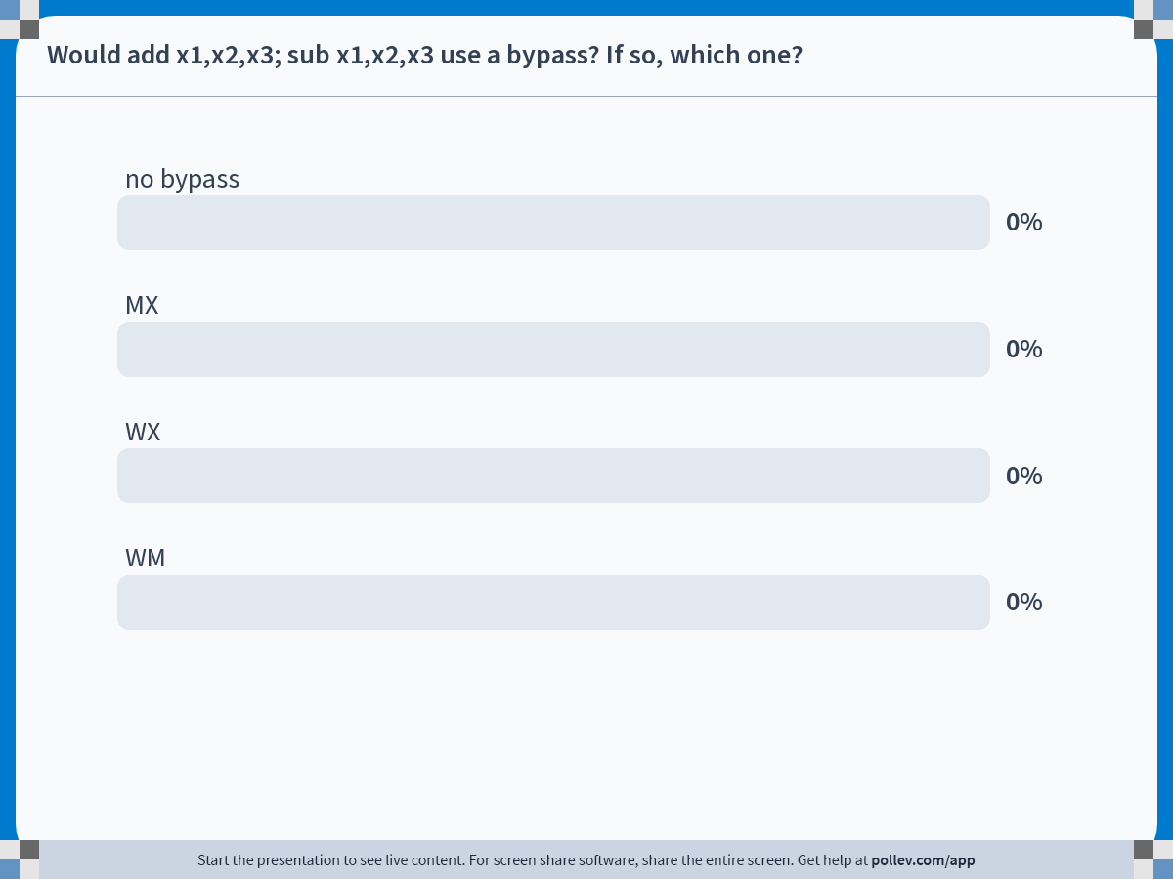
Notes:
Do not modify the notes in this section to avoid tampering with the Poll Everywhere activity.
More info at polleverywhere.com/support
Would add x1,x2,x3; sub x1,x2,x3 use a bypass? If so, which one?
https://www.polleverywhere.com/multiple_choice_polls/LZp3vJvFd9tmqTuby9M9v?state=opened&flow=Default&onscreen=persist

Slide 61

Notes:
Do not modify the notes in this section to avoid tampering with the Poll Everywhere activity.
More info at polleverywhere.com/support
Would add x1,x2,x3; mul x3,x2,x1 use a bypass? If so, which one?
https://www.polleverywhere.com/multiple_choice_polls/lBUEONonC6fd1LqXVslbg?state=opened&flow=Default&onscreen=persist

Slide 62
Bypass and Stall Logic
Two separate things
  Stall logic controls pipeline registers
  Bypass logic controls multiplexors
But complementary
  For a given data hazard: if we can’t bypass, must stall
Previous slide shows full bypassing
  all possible bypasses
  Have we prevented all data hazards?
  Is stall logic totally unnecessary?

Slide 63
Have We Prevented All Data Hazards?
IN
Register
File
A
B
IN
O
B
IN
O
D
IN
Data
Mem
a
s1
s2
d
d
D
X
S
X
M
W
nop
stall
add x4,x2,x3
lw x3,8(x2)
No. Consider a “load” followed by a dependent “add” insn
Bypassing alone isn’t sufficient!
Must detect this situation and inject a stall cycle

Slide 64
Stalling on load-to-use dependences
IN
Register
File
A
B
IN
O
B
IN
O
D
IN
Data
Mem
a
s1
s2
d
d
D
X
S
X
M
W
nop
stall
add x4,x2,x3
lw x3,8(x2)
Prevent Decode insn from advancing this cycle
  Write nop into X.IN (effectively, insert nop in hardware)
  Keep same “D insn”, same PC next cycle
  Re-evaluate situation next cycle

Slide 65
Stalling on load-to-use dependences
IN
Register
File
A
B
IN
O
B
IN
O
D
IN
Data
Mem
a
s1
s2
d
d
D
X
S
X
M
W
nop
stall
add x4,x2,x3
lw x3,8(x2)
Stall = (X.IN.Operation == LOAD) &&
( (D.IN.RegSrc1 == X.IN.RegDest) ||
((D.IN.RegSrc2 == X.IN.RegDest)) )

Slide 66
Stalling on load-to-use dependences
IN
Register
File
A
B
IN
O
B
IN
O
D
IN
Data
Mem
a
s1
s2
d
d
D
X
S
X
M
W
nop
stall
add x4,x2,x3
nop
lw x3,8(x2)
Stall = (X.IN.Operation == LOAD) &&
( (D.IN.RegSrc1 == X.IN.RegDest) ||
((D.IN.RegSrc2 == X.IN.RegDest)) )

Slide 67
Stalling on load-to-use dependences
IN
Register
File
A
B
IN
O
B
IN
O
D
IN
Data
Mem
a
s1
s2
d
d
D
X
S
X
M
W
nop
stall
add x4,x2,x3
nop
lw x3,8(x2)
Stall = (X.IN.Operation == LOAD) &&
( (D.IN.RegSrc1 == X.IN.RegDest) ||
((D.IN.RegSrc2 == X.IN.RegDest)) )

Slide 68
Load-to-store-data dependences
IN
Register
File
A
B
IN
O
B
IN
O
D
IN
Data
Mem
a
s1
s2
d
d
D
X
S
X
M
W
nop
stall
sw x3,2(x4)
lw x3,8(x2)
Stall = (X.IN.Operation == LOAD) &&
( (D.IN.RegSrc1 == X.IN.RegDest) ||
((D.IN.RegSrc2 == X.IN.RegDest) && (D.IN.Op != STORE)) )
Notes:
Note the check for the STORE instruction which is one case where you could do forwarding from WB to the MEM stage

Slide 69
WM Bypassing
IN
Register
File
A
B
IN
O
B
IN
O
D
IN
Data
Mem
a
s1
s2
d
d
D
X
S
X
M
W
sw x3,4(x4)
lw x3,8(x2)
When is WM bypassing allowed?
  Not to the address input (why not?)
  But to the store data input, yes
sw x4,4(x3)
lw x3,8(x2)
X
sw x3,4(x4)
lw x3,8(x2)
Notes:
Address needs to be computed in the Execute stage

Slide 70
Pipeline Diagrams with Bypassing
Producer & consumer are in same cycle
  Example: MX bypass
 | 1 | 2 | 3 | 4 | 5 | 6 | 7 | 8 | 9 | 10
add x1,x2,x3 | F | D | X | M | W
sub x2,x1,x4 |  | F | D | X | M | W
  Example: WX bypass
 | 1 | 2 | 3 | 4 | 5 | 6 | 7 | 8 | 9 | 10
add x1,x2,x3 | F | D | X | M | W
lw x5,4(x7) |  | F | D | X | M | W
sub x2,x1,x4 |  |  | F | D | X | M | W
  Example: WM bypass
 | 1 | 2 | 3 | 4 | 5 | 6 | 7 | 8 | 9 | 10
lw x1,0(x2) | F | D | X | M | W
sw x1,0(x3) |  | F | D | X | M | W

Slide 71
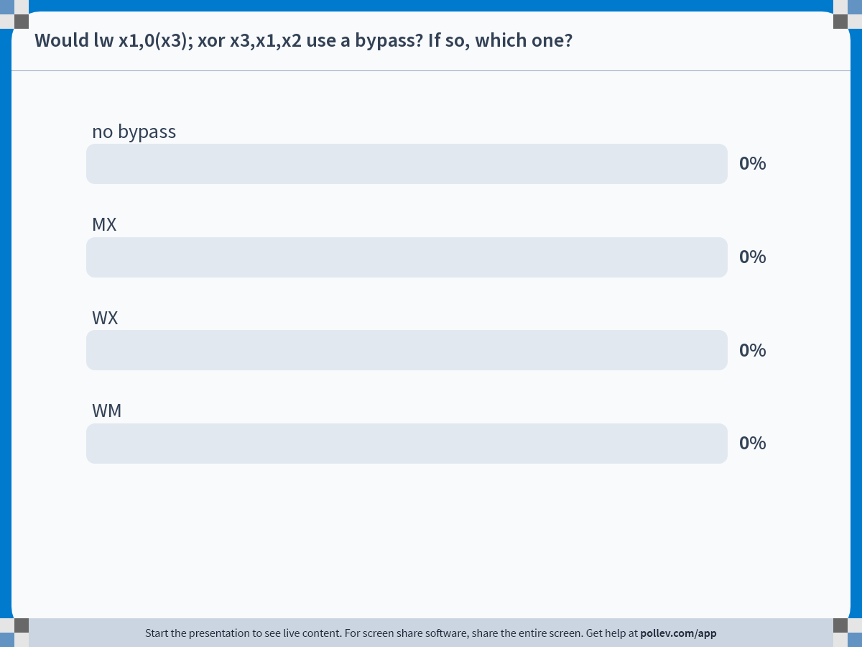
Notes:
Do not modify the notes in this section to avoid tampering with the Poll Everywhere activity.
More info at polleverywhere.com/support
Would lw x1,0(x3); xor x3,x1,x2 use a bypass? If so, which one?
https://www.polleverywhere.com/multiple_choice_polls/4x23cXTYy9xSXkClrJSAe?state=opened&flow=Default&onscreen=persist

Slide 72
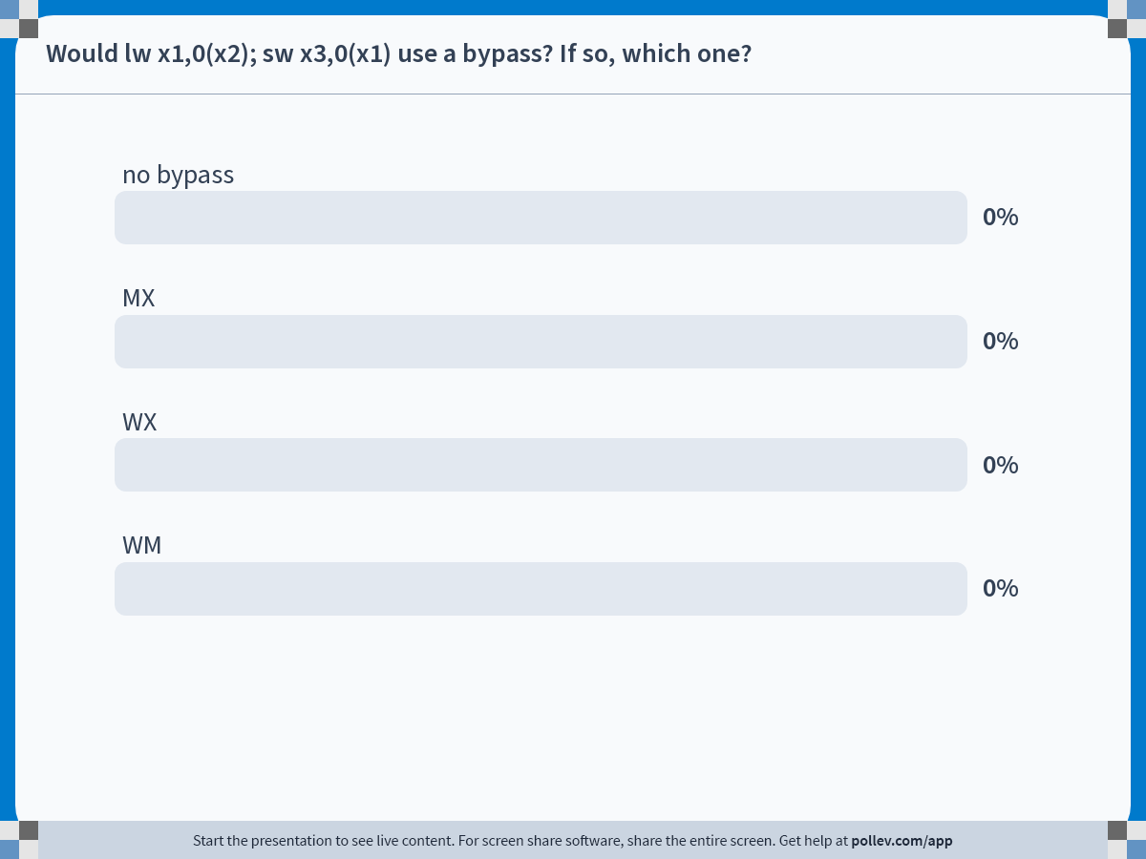
Notes:
Do not modify the notes in this section to avoid tampering with the Poll Everywhere activity.
More info at polleverywhere.com/support
Would lw x1,0(x2); sw x3,0(x1) use a bypass? If so, which one?
https://www.polleverywhere.com/multiple_choice_polls/Ll54sqZjUTtmqQ5FDcOVq?state=opened&flow=Default&onscreen=persist

Slide 73
Reducing Load-Use Stall Frequency
 | 1 | 2 | 3 | 4 | 5 | 6 | 7 | 8 | 9
add x3,x2,x1 | F | D | X | M | W
lw x4,4(x3) |  | F | D | X | M | W
addi x6,x4,1 |  |  | F | D | * | X | M | W
sub x8,x3,x1 |  |  |  | F | * | D | X | M | W
* shows stall, addi writes into X register in cycle 6
Compiler can help here
  Like software interlocks, but for performance not correctness
 | 1 | 2 | 3 | 4 | 5 | 6 | 7 | 8 | 9
add x3,x2,x1 | F | D | X | M | W
lw x4,4(x3) |  | F | D | X | M | W
sub x8,x3,x1 |  |  | F | D | X | M | W
addi x6,x4,1 |  |  |  | F | D | X | M | W

Slide 74
Dependencies Through Memory
IN
Register
File
A
B
IN
O
B
IN
O
D
IN
Data
Mem
a
s1
s2
d
d
D
X
S
X
M
W
lw x4,8(x1)
sw x5,8(x1)
What about “store-to-load” memory dependencies?
  Not a problem!
  lw following sw to same address in next cycle, gets right value
  Why? Data mem read/write always take place in same stage

Slide 75
Pipelining in SystemVerilog
Pipeline registers hold lots of state
  all values needed by all future stages
  recommend using packed struct with logic fields
    more organized than individual logics
  without packed keyword, will get combinational loop errors
// inside your module
my_stage_t decode_reg;
always_ff @(posedge clk) begin
decode_reg.a <= a_in;
decode_reg.b <= b_in;
decode_reg.c <= c_in;
end
// outside your module
typedef struct packed {
logic [31:0] a;
logic [31:0] b;
logic c;
} my_stage_t;

Slide 76
Multi-Cycle Operations

Slide 77
Why Does Every Insn Take 5 Cycles?
PC
IN
PC
A
B
IN
<<
2
+
4
O
B
IN
O
D
IN
PC
Insn
Mem
Register
File
Data
Mem
a
PC
s1
s2
d
d
D
X
S
X
M
W
add x3,x2,x1
lw x4,8(x5)
Should we allow add to skip M and go to W? No
  It wouldn’t help: peak fetch still only 1 insn per cycle
  Structural hazard: add after lw (only 1 regfile write port)

Slide 78
Structural Hazards
Structural hazards
  Two insns trying to use same circuit at same time
    E.g., structural hazard on register file write port
To avoid structural hazards by construction
  Each insn uses every structure exactly once
  For at most one cycle
  All instructions travel through all stages
Alternative solutions to avoid structural hazards
  Add more resources
    Example: two memory ports (insn fetch & load/store)
  Stall pipeline when hazard would occur

Slide 79
Pipelining and Multi-Cycle Operations
IN
Register
File
A
B
IN
O
B
IN
O
D
IN
Data
Mem
a
D
s1
s2
d
X
M
d
D
Q
IN
Q
Xctrl
What if you wanted to add a multi-cycle operation?
  E.g., 4-cycle divide
  Q: separate output register connects to W stage
  Controlled by pipeline control finite state machine (FSM)

Slide 80
A Pipelined Divider
IN
Register
File
A
B
IN
O
B
IN
O
D
IN
Data
Mem
a
D
s1
s2
d
X
M
d
Q
M
IN
Q
M
IN
Q
M
IN
Q
M
IN
Q0
Q1
Q2
Q3
W
Divider is already pipelined
  Can start different divide operations in consecutive cycles
  But still takes 4 cycles to generate output value

Slide 81
Pipeline Diagram with Divider
Allow independent instructions
Allow independent divide instructions
Stall subsequent dependent instructions:
 | 1 | 2 | 3 | 4 | 5 | 6 | 7 | 8 | 9
div x4,x3,x5 | F | D | Q0 | Q1 | Q2 | Q3 | W
addi x6,x7,1 |  | F | D | X | M | W
 | 1 | 2 | 3 | 4 | 5 | 6 | 7 | 8 | 9
div x4,x3,x5 | F | D | Q0 | Q1 | Q2 | Q3 | W
div x6,x7,x8 |  | F | D | Q0 | Q1 | Q2 | Q3 | W
 | 1 | 2 | 3 | 4 | 5 | 6 | 7 | 8 | 9
div x4,x3,x5 | F | D | Q0 | Q1 | Q2 | Q3 | W
addi x6,x4,1 |  | F | D | d* | d* | d* | X | M | W
Notes:
Why can’t we use P1=>X bypass?

Slide 82
What about Stall Logic?
IN
Register
File
A
B
IN
O
B
IN
O
D
IN
Data
Mem
a
D
s1
s2
d
X
M
d
Q
M
IN
Q
M
IN
Q
M
IN
Q
M
IN
Q0
Q1
Q2
Q3
W
 | 1 | 2 | 3 | 4 | 5 | 6 | 7 | 8 | 9
div x4,x3,x5 | F | D | Q0 | Q1 | Q2 | Q3 | W
addi x6,x4,1 |  | F | D | d* | d* | d* | X | M | W

Slide 83
What about Stall Logic?
IN
Register
File
A
B
IN
O
B
IN
O
D
IN
Data
Mem
a
D
s1
s2
d
X
M
d
Q
M
IN
Q
M
IN
Q
M
IN
Q
M
IN
Q0
Q1
Q2
Q3
W
Stall = (OldStallLogic) ||
(D.IN.RegSrc1 == Q0.IN.RegDest) || (D.IN.RegSrc2 == Q0.IN.RegDest) ||
(D.IN.RegSrc1 == Q1.IN.RegDest) || (D.IN.RegSrc2 == Q1.IN.RegDest) ||
(D.IN.RegSrc1 == Q2.IN.RegDest) || (D.IN.RegSrc2 == Q2.IN.RegDest)

Slide 84
Divider Write Port Structural Hazard
What about…
  Two instructions trying to write register file in same cycle?
  Structural hazard!
Must prevent:
Solution? stall the subsequent instruction
 | 1 | 2 | 3 | 4 | 5 | 6 | 7 | 8 | 9
div x4,x3,x5 | F | D | Q0 | Q1 | Q2 | Q3 | W
addi x6,x1,1 |  | F | D | X | M | W
add x5,x6,x10 |  |  | F | D | X | M | W
 | 1 | 2 | 3 | 4 | 5 | 6 | 7 | 8 | 9
mul x4,x3,x5 | F | D | Q0 | Q1 | Q2 | Q3 | W
addi x6,x1,1 |  | F | D | X | M | W
add x5,x6,x10 |  |  | F | D | d* | X | M | W

Slide 85
Preventing Structural Hazard
IN
Register
File
A
B
IN
O
B
IN
O
D
IN
Data
Mem
a
D
s1
s2
d
X
M
d
Q
M
IN
Q
M
IN
Q
M
IN
Q
M
IN
Q0
Q1
Q2
Q3
W
Fix to problem on previous slide:
  Stall = (OldStallLogic) ||
  (D.IN.RegDest “is valid” &&
  D.IN.Operation != DIV && Q1.IN.RegDest “is valid”)
Notes:
Answer: avoid two writes to the register file in same cycle

Slide 86
More Divider Nasties
What about…
  Mis-ordered writes to the same register
  Software thinks add gets x4 from addi, actually from mul
More common with deeper pipelines
  In any case, must be correct!
 | 1 | 2 | 3 | 4 | 5 | 6 | 7 | 8 | 9
div x4,x3,x5 | F | D | Q0 | Q1 | Q2 | Q3 | W
addi x4,x1,1 |  | F | D | X | M | W
…
…
add x10,x4,x6 |  |  |  |  | F | D | X | M | W

Slide 87
Preventing Mis-Ordered Reg. Write
IN
Register
File
A
B
IN
O
B
IN
O
D
IN
Data
Mem
a
D
s1
s2
d
X
M
d
Q
M
IN
Q
M
IN
Q
M
IN
Q
M
IN
Q0
Q1
Q2
Q3
W
Fix to problem on previous slide:
  Stall = (OldStallLogic) ||
  ((D.IN.RegDest == Q0.IN.RegDest) ||
  (D.IN.RegDest == Q1.IN.RegDest))
Notes:
Answer: avoid mis-ordered writes to the same register

Slide 88
Corrected Pipeline Diagram
With the correct stall logic
  Prevent mis-ordered writes to the same register
  Why two cycles of delay?
 | 1 | 2 | 3 | 4 | 5 | 6 | 7 | 8 | 9
div x4,x3,x5 | F | D | Q0 | Q1 | Q2 | Q3 | W
addi x4,x1,1 |  | F | D | d* | d* | X | M | W
…
…
add x10,x4,x6 |  |  |  |  | F | D | X | M | W

Slide 89
Pipelined Functional Units
Most multi-cycle functional units are pipelined
  Each operation takes N cycles
  Can start initiate a new (independent) operation every cycle
  Requires internal registers and some hardware replication
  Cheap way to add bandwidth vs multiple non-pipelined units
 | 1 | 2 | 3 | 4 | 5 | 6 | 7 | 8 | 9 | 10 | 11
mulf f0,f1,f2 | F | D | E* | E* | E* | E* | W
mulf f3,f4,f5 |  | F | D | E* | E* | E* | E* | W
  One exception: int/FP divide: difficult to pipeline and not worth it
 | 1 | 2 | 3 | 4 | 5 | 6 | 7 | 8 | 9 | 10 | 11
divf f0,f1,f2 | F | D | E/ | E/ | E/ | E/ | W
divf f3,f4,f5 |  | F | D | s* | s* | s* | E/ | E/ | E/ | E/ | W
  s* = structural hazard, two insns need same structure
    ISAs and pipelines designed to have few of these
    Canonical example: all insns forced to go through M stage

Slide 90
Pipeline Depth

Slide 91
Pipelining: Clock Frequency vs. IPC
Increase number of pipeline stages
  Keep cutting datapath into finer pieces
  Increases clock frequency (decreases clock period)
    Register overhead & imbalanced stages
    Double the stages won’t quite double the frequency
  Increases CPI (decreases IPC)
    More pipeline “hazards”, higher branch penalty
    Memory latency relatively higher (same abs. latency but more cycles)
  Result: after some point, deeper pipelining can decrease performance
  Optimal pipeline depth is program- and technology-specific

Slide 92
Pipeline Depth
data from http://cpudb.stanford.edu/
integer pipeline
floating point pipeline
Notes:
each data point is a different uarch – many different chips share the same uarch

Slide 93
Summary
App
App
App
Processor performance
  Latency vs throughput
Single-cycle & multi-cycle datapaths
Basic pipelining
Data hazards
  Software interlocks and scheduling
  Hardware interlocks and stalling
  Bypassing
  Load-use stalling
Pipelined multi-cycle operations
System software
Mem
CPU
I/O

