Slide 1
Lecture 4:
Modern Techniques in SAT Solving
CIS
1921
Notes:
Last lecture about SAT for a while before moving onto next topic
Today going to bring our SAT solving techniques solidly into the 21st century and talk about some of the really incredible and cool strategies that made the SAT revolution possible!

Slide 2
Recap: Iterative DPLL

Slide 3
Chronological Backtracking
DPLL uses chronological backtracking: when we find a conflict, backtrack to the previous decision level
Issue: might reach conflicts (contradictions) caused by the same underlying reason over and over again
Notes:
The next big improvement to DPLL will require us to examine how we’ve been handling backtracking

Slide 4
Chronological Backtracking

Slide 5
Chronological Backtracking
1
T

Slide 6
Chronological Backtracking
1
UNSAT subformula
T

Slide 7
Chronological Backtracking
1
UNSAT subformula
T

Slide 8
Backjumping
Not every decision actually contributes to a conflict
Idea: upon conflict, instead of backtracking one level to the last decision, backjump to an important decision
i.e., a decision that contributed to the conflict
But how do we know what is an important decision?
Notes:
We’re going to spend the majority of the remaining time in this lecture building up the tools to answer that question.

Slide 9
Decision Levels
What are the different ways in which variables get assigned in DPLL?

Slide 10
Decision Levels
A decision refers to any time our algorithm arbitrarily assigns a variable (without being forced to do so)
Selecting a literal and assigning it True is a decision
Unit propagation & reassigning selected literal after backtracking are not decisions
All assignments implied by the i^{th} decision are said to be on the i^{th} decision level
Can assignments ever be on the zeroth decision level?

Slide 11
Decision Levels
When we backtrack, all assignments made at the current decision level get unassigned.

Slide 12
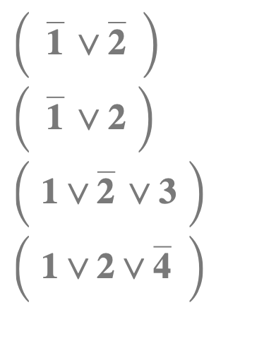
Example: DPLL
Steps
Unit!
1
T
1 | 2 | 3 | 4
T

Slide 13
Example: DPLL
Steps
1
Conflict!
T
2
F
1 | 2 | 3 | 4
T | F

Slide 14
Example: DPLL
Steps
1
T
F
2
F
1 | 2 | 3 | 4
F

Slide 15
Example: DPLL
Steps
1
T
F
2
2
F
T
Unit!
1 | 2 | 3 | 4
F | T

Slide 16
Example: DPLL
Steps
1
T
F
2
2
F
T
3
T
1 | 2 | 3 | 4
F | T | T

Slide 17
Implication Graphs

Slide 18
Implication Graphs

Slide 19
Implication Graphs

Slide 20
Implication Graphs

Slide 21
Implication Graphs

Slide 22
Implication Graphs

Slide 23
Implication Graphs

Slide 24
Implication Graphs

Slide 25
Implication Graphs

Slide 26
Implication Graphs

Slide 27
Implication Graphs
Notes:
Remember that we were originally trying to answer the question: “How do we know which decisions really caused the conflict?”. So let’s talk a little more about conflicts in the implication graph.

Slide 28
Implication Graphs
Conflict!
Notes:
Remember that we were originally trying to answer the question: “How do we know which decisions really caused the conflict?”. So let’s talk a little more about conflicts in the implication graph.

Slide 29
Conflicts
A conflict set of assignments (collectively) imply a conflict
A conflict cut in an implication graph is a bipartition of the vertices V = R ∪ C such that:
Reason side R contains all decisions (source nodes)
Conflict side C contains the conflict node (a sink)
No edges cross C → R, only R → C
The set of vertices with an outgoing edge crossing a given conflict cut forms a conflict set
Notes:
Collectively imply a conflict: i.e., if you set them all to true, you can derive a conflict by unit propagation

Slide 30
Ex: Conflict Cuts
REASON SIDE
CONFLICT SIDE
And more...
Notes:
Now we are finally ready to make the most important observation in the last three decades of SAT solving.
if some literals form a conflict set, i.e. they collectively imply a conflict, then what must be true about those literals in any satisfying assignment?

Slide 31
Clause Learning

Slide 32
Asserting Clauses
Many conflict cuts – how do we decide which to choose to build a conflict clause?
Goal: after backjumping, be able to apply new knowledge from learned clause right away
Want learned clause to become a unit clause right after backjumping
Notes:
What should our learned clause look like in order to ensure this?

Slide 33
Asserting Clauses
A learned clause is asserting if it contains only one variable set on the same decision level as conflict
Observation: iff a clause is asserting, it will become a unit clause after backtracking
How far can we backjump and still have asserting clauses become unit clauses?
Backjump to second-largest (i.e., deepest) decision level in asserting clause (or zeroth level if asserting clause has size 1)
i.e., return to that decision level (don’t undo the decision)
Called the asserting level
Notes:
Since the reason side of a conflict cut has to contain all decisions, including the last decision that was made before the conflict, then there must be some node at that level that points across the cut.

Slide 34
CDCL (Pseudocode)

Slide 35
Asserting Level Backjump
Conflict!

Slide 36
Asserting Level Backjump

Slide 37
Decision Levels
When we backjump from level j to level i, all variables that got assigned after level i until and including level j get unassigned

Slide 38
Asserting Level Backjump
Backjump!

Slide 39
Asserting Level Backjump
Unit!

Slide 40
Asserting Level Backjump
Wait a second... same outcome as backtracking with DPLL.
Unit!
Notes:
The only thing that happened is, where we previously set 5 to true, now we set it to false. So did we just do all this extra work for the same result?
Well, no. The problem is that we just picked any asserting clause to learn – let’s talk about how to pick a more useful learned clause.

Slide 41
Unique Implication Points
Unique implication point (UIP): a node in the implication graph that all paths from the most recent decision variable to the conflict must pass through
Intuition: at the decision level of the conflict, the UIP is a literal that, by itself, implies a contradiction
UIPs
Notes:
Does a UIP always exist?
Yes, the most recent decision variable is itself a trivial UIP

Slide 42
The 1-UIP Scheme
The “first” UIP is the closest UIP to the conflict node
i.e., the “rightmost”
When we reach a conflict, cut after the first UIP
First UIP

Slide 43
1-UIP Backjump
Conflict!

Slide 44
1-UIP Backjump
Conflict!
Asserting?
Yes!
Level?
1

Slide 45
1-UIP Backjump
Backjump!

Slide 46
1-UIP Backjump
Unit!
Notes:
So that is the gist of how CDCL works. Let’s also take a couple minutes to talk about a few extra strategies that synergize well with CDCL.

Slide 47
Restarts
Problem: if we make bad early guesses, can get stuck in fruitless areas of search tree
Solution: periodically restart the search – throw away the current partial assignment
Modern solvers favor aggressive restart policy
MiniSAT, PicoSAT: every ~100 conflicts
Key idea: CDCL is deterministic, so why won’t we end up back where we were?
Learned clauses remain in formula after restart

Slide 48
Incremental SAT Solving

Slide 49
Introducing: PennSAT
HW2: PennSAT (due in a couple weeks)
Features:
DPLL-based
Iterative
Maintains propagation queue
No Two-Watched Literals
Static most-frequent decision heuristic
This assignment is tricky – start early!
Requires solid understanding

Slide 50
Iterative DPLL
A decision refers to any time our algorithm arbitrarily assigns a variable (without being forced to do so)
Selecting a literal and assigning it True is a decision
Unit propagation & reassigning selected literal after backtracking are not decisions
All assignments implied by the i^{th} decision are said to be on the i^{th} decision level
Can assignments ever be on the zeroth decision level?

Slide 51
Iterative DPLL
Maintain an assignment stack with the assignments from each decision level
Whenever we make a new decision, copy the current assignment onto the top of the stack
To backtrack: pop the current assignment off the stack, restoring the previous one
Keep a propagation queue of literals that are set to False
Take literals from the queue and check if their watching clauses are empty/unit

Slide 52
Assignment Stack
T | T | F | T | T
T | T | F
T
1 | 2 | 3 | 4 | 5

Slide 53
Assignment Stack
Backtrack!
Pop!
T | T | F | T | T
T | T | F
T
1 | 2 | 3 | 4 | 5

Slide 54
Iterative DPLL (Pseudocode)

Slide 55
Testing a SAT Solver
SAT solvers have tons of complicated logic... how to check for soundness bugs?
Hard and tedious to figure out all cases to unit test
Random testing: generate random CNF formulas to test against reference solver
If reference solver is not available, can at least check that satisfying assignments are valid

Slide 56
Debugging a SAT Solver
Once we’ve found a bug, how do we find the mistake in the code?
Print debugging: stick a bunch of print statements in relevant places and look at the console
Easy, but not as effective for complex systems
Easy to forget to print something, or print in wrong place

Slide 57
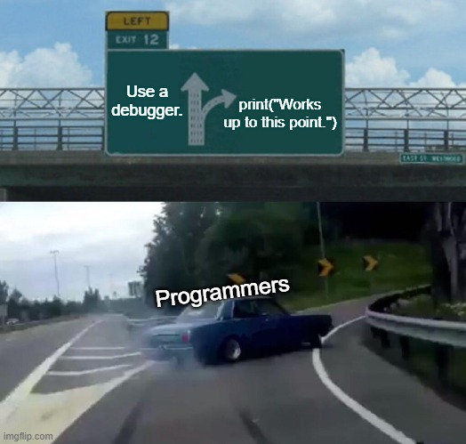
Debugging a SAT Solver

Slide 58
Debugging in VS Code
Debugger: allows us to stop program mid-execution, run code line-by-line, inspect values of local variables
Breakpoint: STOP at this line of code

Slide 59
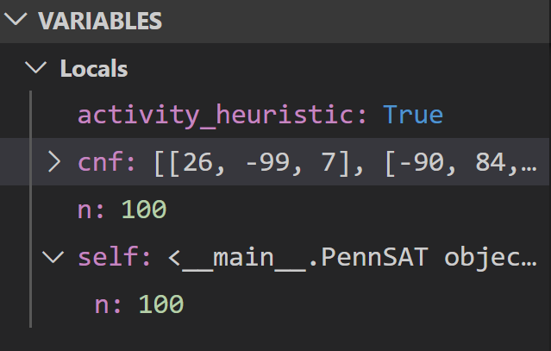
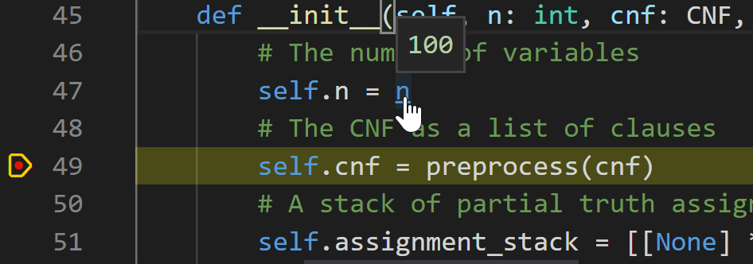
Debugging in VS Code
After breakpoints set: Run > Start Debugging (F5)
View or modify current variables & values
Hover over variables to inspect values
Stopped right before line 49!

Slide 60
Debugging in VS Code
Control flow:
Continue (F5): run until next breakpoint hit
Step Over (F10): run just one more line of code
Restart (Ctrl+Shift+F5): start over from beginning
Stop (Shift+F5): quit the debugger

Slide 61
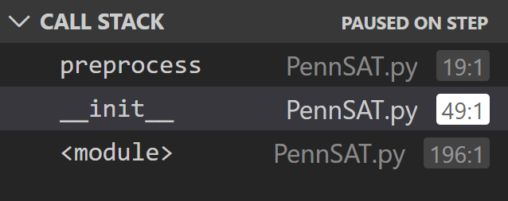
Debugging in VS Code
Step Into (F11): enter code of first function called on the current line and resume debugging there
Step Out (Shift+F11): run until the current function returns; resume debugging from parent function
Can click to view different levels of the call stack
Useful for inspecting values of local vars in different scopes

Slide 62
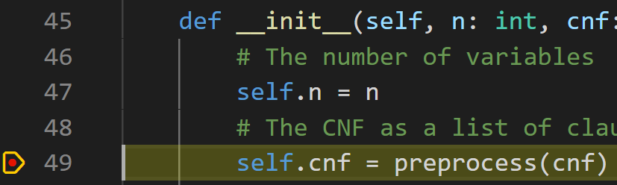
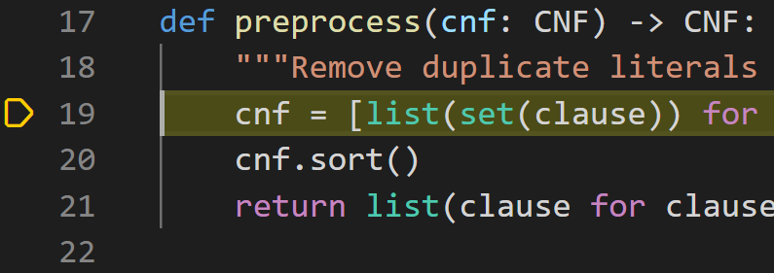
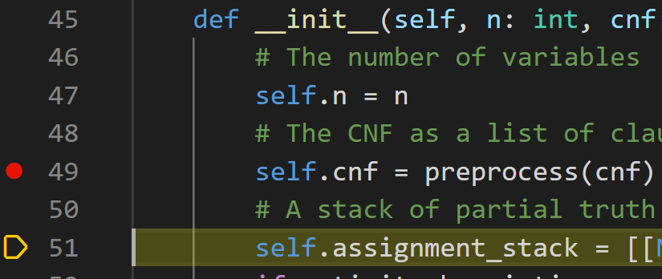
Debugging in VS Code
+

Slide 63
Stay Diligent
“Things may come to those who wait, but only the things left by those who hustle” ~Abraham Lincoln

Slide 64
References
A. Biere, Handbook of satisfiability. Amsterdam: IOS Press, 2009.
E. Torlak, “A Modern SAT Solver,” CSE507: Computer-Aided Reasoning for Software Engineering. [Online]. Available: https://courses.cs.washington.edu/courses/cse507/.
V. Ganesh, On the Unreasonable Effectiveness of Boolean SAT Solvers. Saarbrücken, Germany: Max Planck Institute, 2017. Available: https://docs.google.com/a/gsd.uwaterloo.ca/viewer?a=v&pid=sites&srcid=Z3NkLnV3YXRlcmxvby5jYXxtYXBsZXNhdHxneDozYzQ3NDJjYjk4YWE4YTA0
J. Liang, V. Ganesh, E. Zulkoski, A. Zaman, and K. Czarnecki. “Understanding VSIDS Branching Heuristics in Conflict-Driven Clause-Learning SAT Solvers.” Hardware and Software: Verification and Testing Lecture Notes in Computer Science, 2015, 225–41. https://doi.org/10.1007/978-3-319-26287-1_14.

