Slide 1
CIT 590
Examples
Debugging

Slide 2
Agenda
This class is an experiment in letting students learn by just doing things as opposed to me talking all the time!
So if you do not have a laptop or do not have a friend to sit next to,
Time to take a nap

Slide 3
A big request …
Turn on line numbers!
Reading your code becomes a nightmare for me
If you hate it, just remove it at the end of the course.
Window -> Preferences -> search for the word line number
It will highlight text editors
In there find the checkbox that says ‘show line numbers’ and please check it

Slide 4
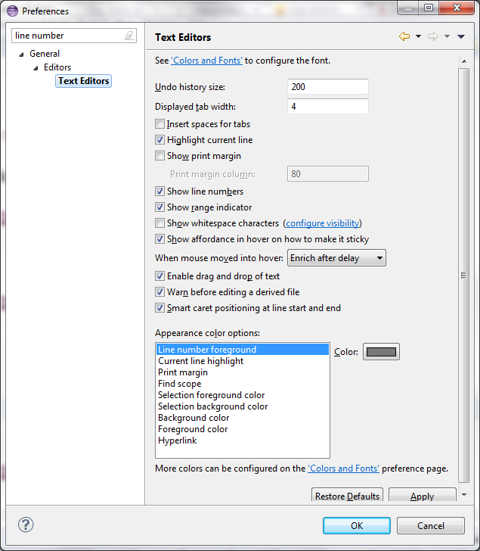

Slide 5
Debugging
Debugging is a skill that you will use regardless of which programming language you come across
Almost all IDEs(Integrated Developer Environment) will have a debugger
The concepts of Step over, Step into, Continue stay exactly the same.

Slide 6
Reading that stack trace
The error message that java throws at you is called a stack trace
Stack??
Function calls are being stored on a stack
Last in, first out
So the error was hit at the first location.
But who called that function?
Go read the next line
In Eclipse, just click on the ‘link’ and it will take you to the line number

Slide 7
Example
Download the card project from the repository
Try not to read the code outside of Solitaire.
We are pretending this is code that you have never seen before and are trying to debug.
Imagine you wrote Solitaire
Your enemy wrote Card and Deck and it is potentially riddled with bugs
Run solitaire
Step 1
You should hit an actual error
Java gives you a stack trace.
Read stack trace
Click right link
Get to the line number
Fix

Slide 8
Example
Step 2
Put a breakpoint in front of deck.shuffle (line 12)
Run in debug mode. F11 on most systems
It will stop at a break point
You can do so many things from that point.
Mouse over a variable. You will get the value
In the variables section (the icon is x=)
Window->Show View -> Display
The Display window is one of the coolest features for debugging
You can write code there and execute it
If you liked IDLE’s ability to run short pieces of code, this is similar
Fix the error

Slide 9
Theory of abstract classes
Some problem is given to you
Break it down into the different nouns involved. Each noun is an object
Program a game of chess – Human versus Computer
The nouns are
Human
Computer
What else …

Slide 11
Theory of abstract classes
Now look at all the nouns you have written down
To each noun write down the things they can do
Verbs!
A Human makes a move
A Computer makes a move
A Human captures a piece
Others
Each verb is basically a method
The arguments to the verb are going to be the things you need to complete the sentence
A Human makes a move of a Pawn from e2 to e4
Move(Piece piece, Coordinate start, Coordinate end)

Slide 13
Hands on coding example
We will try and write a fair bit of code for Pig – which is an assignment that Dr Dave used a few years ago in CIT 591.
If we mess up we can see
http://www.cis.upenn.edu/~matuszek/cit590-2013/Assignments/08-pig.html
Go to http://en.wikipedia.org/wiki/Pig_(dice_game)

Slide 14
To introduce UI into it
Let’s make a ‘nice’ (very subjective) die
Click the die
It generates a random number
Sorry no animation ☹ - maybe later
Copy the code from
https://www.dropbox.com/s/zqanw9lg3450vzh/ImageLoading.java

Slide 15
try {
File imageCheck = new File("red-dice-icon.jpg");
if(imageCheck.exists())
System.out.println("Image file found!");
else
System.out.println("Image file not found!");
img = ImageIO.read(new File("red-dice-icon.jpg"));
rollButton.setIcon(new ImageIcon(img));
add(rollButton, BorderLayout.CENTER);
} catch (IOException e) {
e.printStackTrace();
}
Put your image file in the main Pig folder

Slide 16
But that’s just a cute button …
Write code that handles the rolling of the die
When button clicked
Pick random number between 1 and 6
Display
Display? Where??

Slide 17
Other classes in Pig
2 player game
Human v Computer
What classes will you make?
What methods should they have?
Might be easier to do away with the UI and just generate a random number now

