Slide 1
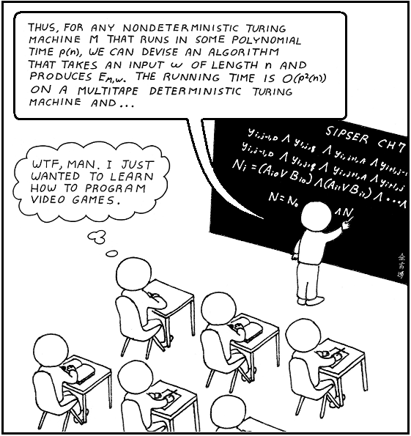
Algorithmic Game Theory
Incentives and Computation

Slide 2
Basic Parameters
When: Tuesday/Thursday, 3:30-4:50
Where: AGH 203.
Who:
  Professor: Aaron Roth
  TAs: Sikata Sengupta, Ramya Ramalingam, Kayan Mohamed, Prithvi Balehannina, Marwan Achi, Max Rubin Tolles
How: Biweekly Problem Sets (45%), 1 midterm (25%), final exam (25%), Participation In Person/On Slack (5%)
Infrastructure (sign up for accounts):
  Question/Discussion: Slack
  Problem Sets/Grades: Gradescope

Slide 3
Basic Parameters
Homework Policy: Reasonable Person Principle. Feel free to work together.
List who you worked with
Everyone turns in their own assignment
20% off per day late
  e.g. if assignment is due on Tuesday, and you turn it in on Wednesday, your score is multiplied by 0.8

Slide 4
Algorithm Design vs.
Mechanism Design

Slide 5

Algorithms vs. Games
If we control the whole system, we can just design an algorithm.

Slide 6
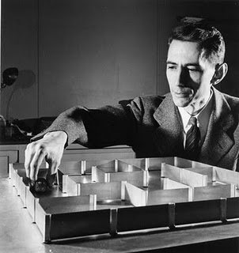
Algorithms vs. Games
Otherwise, we have to design the constraints and incentives so that agents in the system work to achieve our goals.

Slide 7
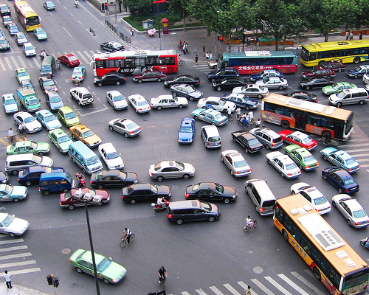
Algorithms vs. Games
And once the rules are in place, predict what will happen…

Slide 8
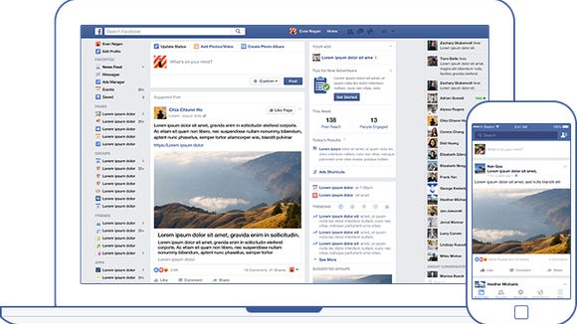
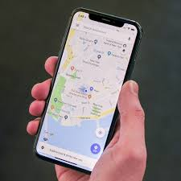


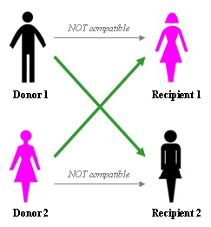

This comes up all the time…

Slide 9
Game Theory Basics
What is a game?
A set of Players
A set of Actions
A set of Payoffs

Slide 10



Game Theory
0,0 | -1,1 | 1,-1
1,-1 | 0,0 | -1 , 1
-1,1 | 1 , -1 | 0,0

Slide 11
Can we predict outcomes?
What happens if everyone plays “Rationally”?
What if some people don’t?

Slide 12
Traffic Routing
Delay is 1.5 hours for everybody at the unique Nash equilibrium
50
Town A
Town B
50
Suppose 100 drivers leave from town A towards town B.
Every driver wants to minimize her own travel time.
What is the traffic on the network?
In any unbalanced traffic pattern, all drivers on the most loaded path have incentive to switch their path.

Slide 13
Traffic Routing
Delay is 2 hours for everybody at the unique Nash equilibrium
100
Town A
Town B
A benevolent governor builds a superhighway connecting the short roads of the network.
What is the traffic on the network now?
No matter what the other drivers are doing it is always better for me to follow the zig-zag path.

Slide 14
Traffic Routing
50
100
A
B
vs
A
B
50
Adding a fast road on a road-network is not always a good idea!
Braess’s paradox
In the RHS network there exists a traffic pattern where all players have delay 1.5 hours.
Price of Anarchy:
measures the loss in system performance due to free-will

Slide 15
Can we influence outcomes?
Can we change the rules of the game to encourage “rational” players to do what we want?

Slide 16
Computation?
How does computational complexity affect our predictions?
How does computational complexity limit our design choices?

Slide 17
Information?
How does limited information affect our predictions?
How does limited information limit our design choices?

Slide 18
An Easy Game
(Prisoner’s Dilemma)
 | Stay Silent | Testify
Stay Silent | 5 Years, 5 Years | 50 Years, 3 Years
Testify | 3 Years, 50 Years | 40 Years, 40 Years

Slide 19
Guess Two-Thirds of the Average
- k players p₁, p₂, p₃, …, p_{k}
- each player submits a number in [0,100]
- compute
- find x_{j}, closest to
- player p_{j} wins $5, all other players win nothing

Slide 20
Guess Two-Thirds of the Average
Play by submitting your guess here! https://forms.gle/Y3w92NFf2eFmwGKDA
(You’ll need to log in with your SEAS Google account)
Winner gets $5 next class (Tuesday).

Slide 21
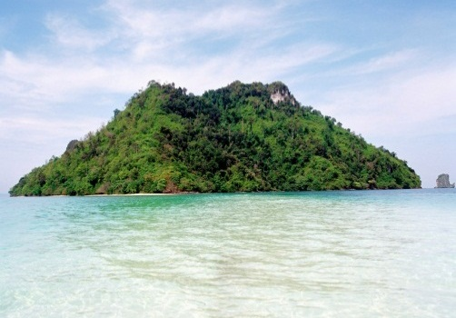
Is Common Knowledge Reasonable?
The Parable of the Islanders
On an isolated island, 100 logicians live in total isolation. They all have brunch together every morning. They have developed an unusual culture:
If any islander can deduce that she has blue eyes, she must leave the island on midnight that night.
No islander may tell another that she has blue eyes.
Another quirk: All of the islanders are blue-eyed. Since there are no mirrors and the water is murky, no one has ever known their own eye color, and they have lived in harmony for hundreds of years with no departures.

Slide 22
Is Common Knowledge Reasonable?
The Parable of the Islanders
One day, an explorer arrives on the island and addresses the islanders with a faux-pas.
“At Least One of You Has Blue Eyes,” he tells them.
Due to the explorer’s terrible breach in manners, the islanders quickly dispatch of him, but the damage has already been done.
Has anything changed? Does Brunch continue to have full attendance? What happens?

