Slide 1

(un)Fairness in Machine Learning
Aaron Roth

Slide 2
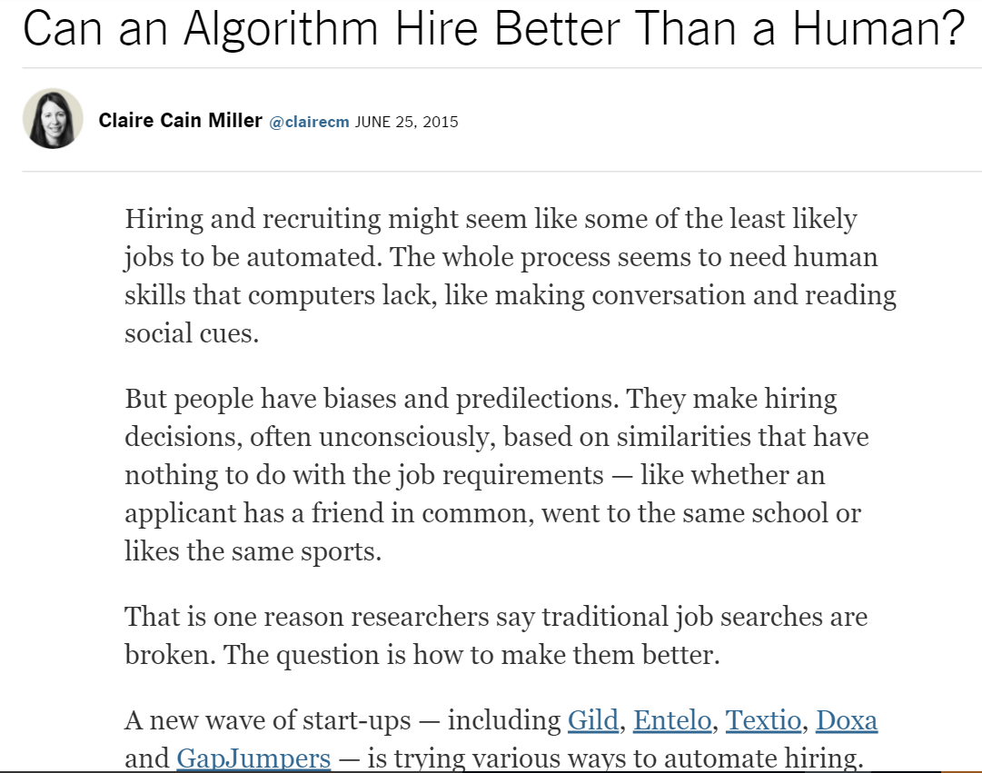
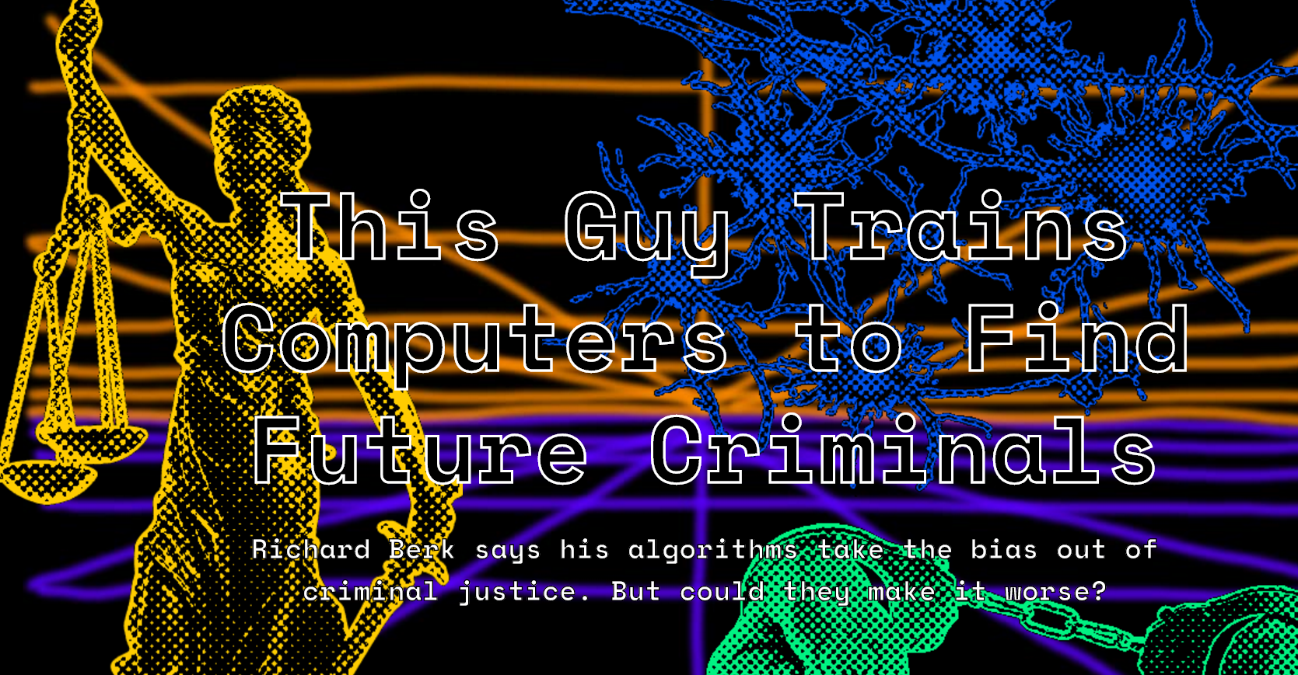
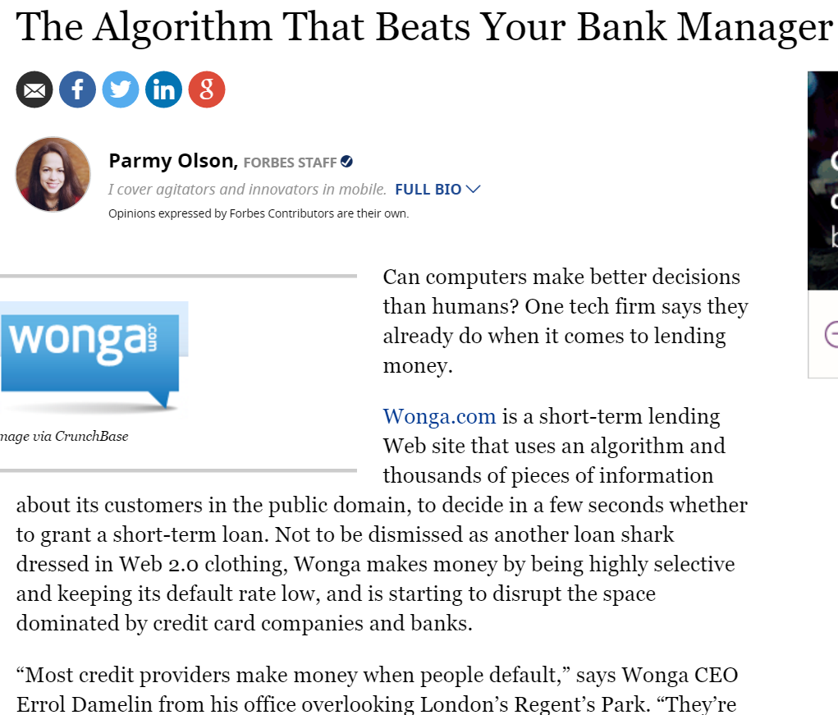
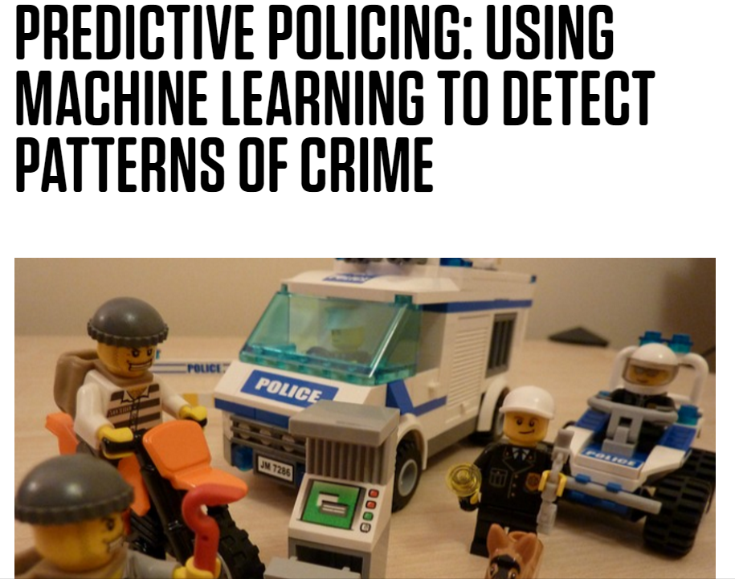
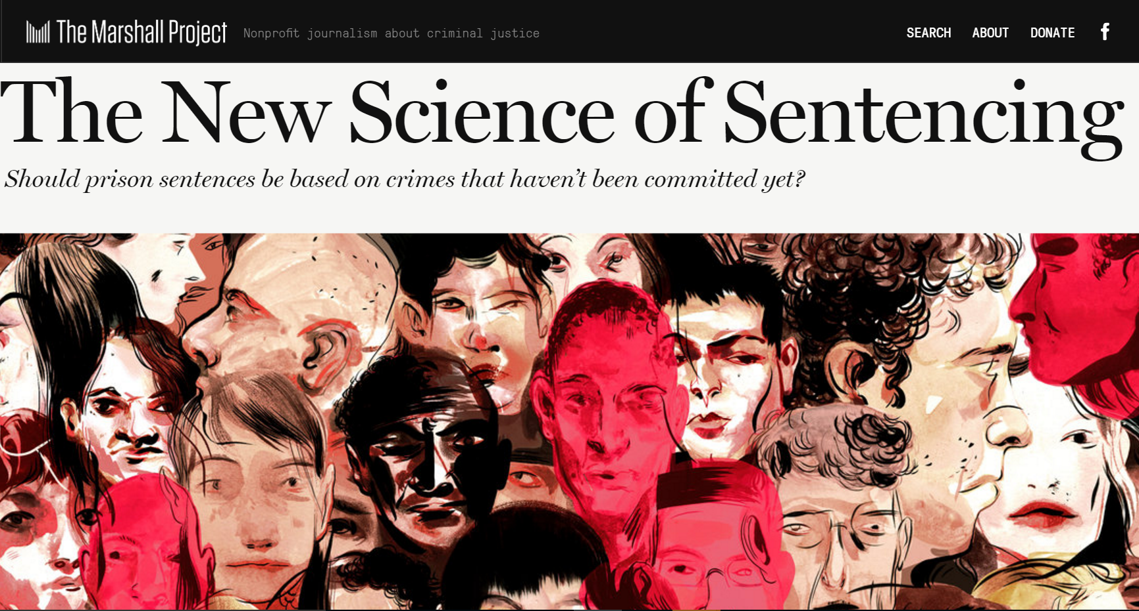

Slide 3
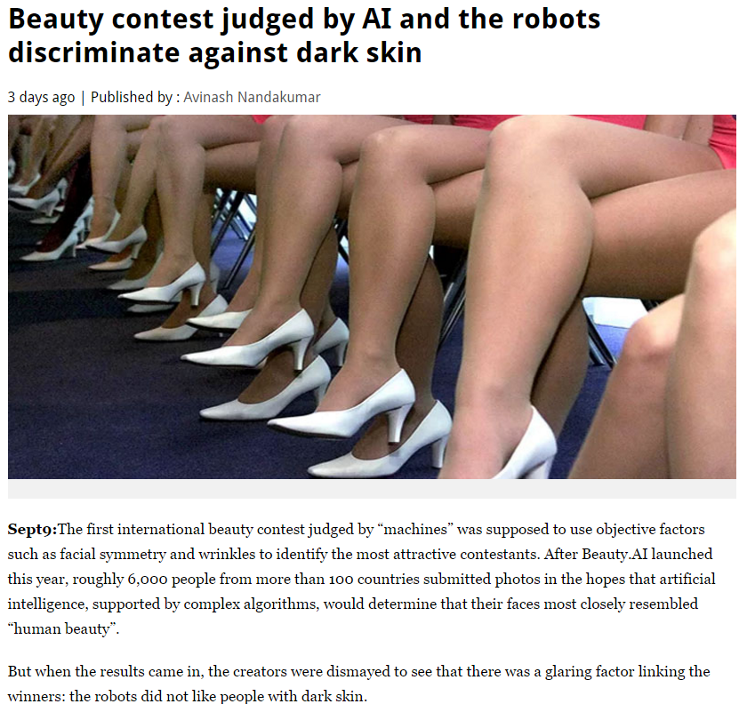
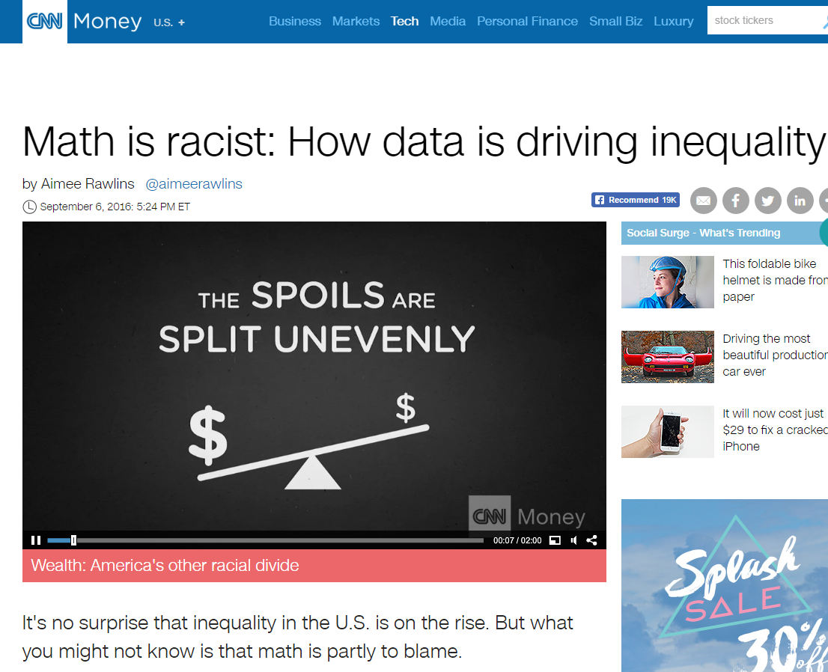
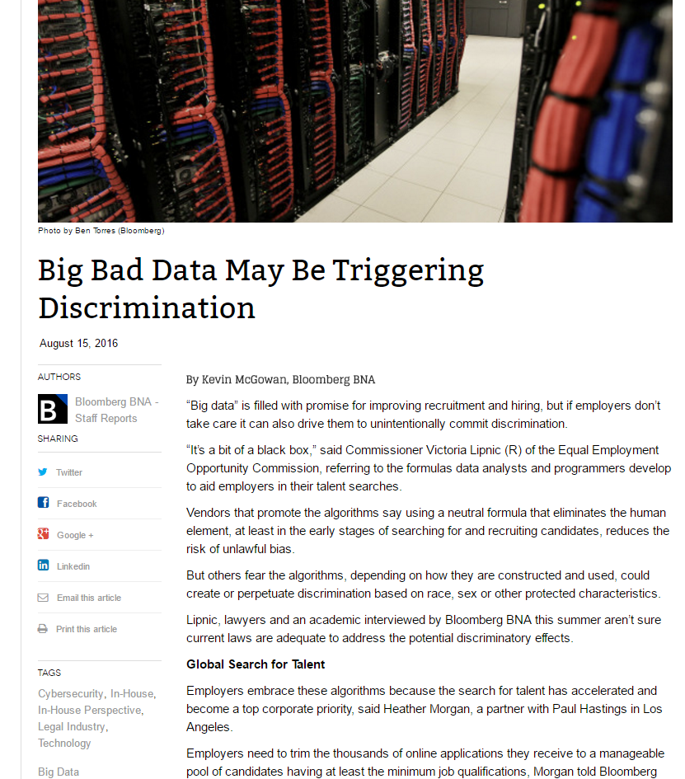
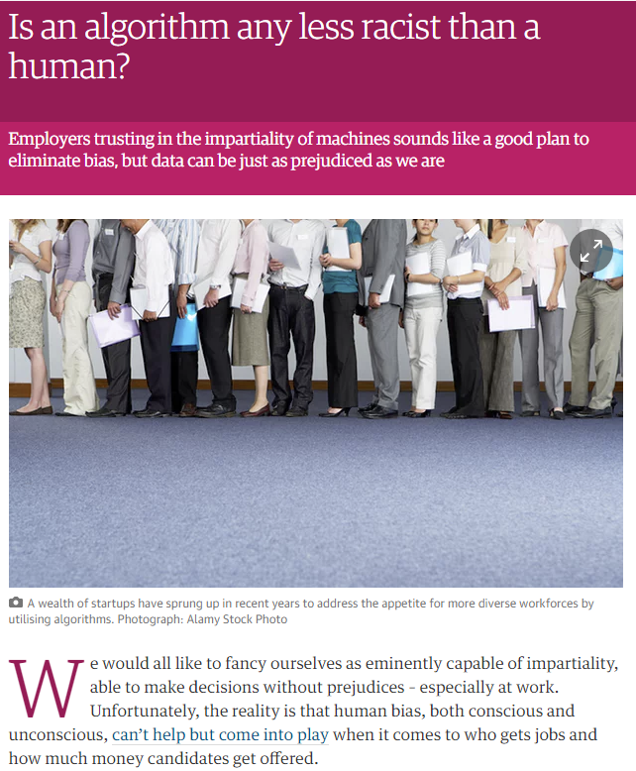
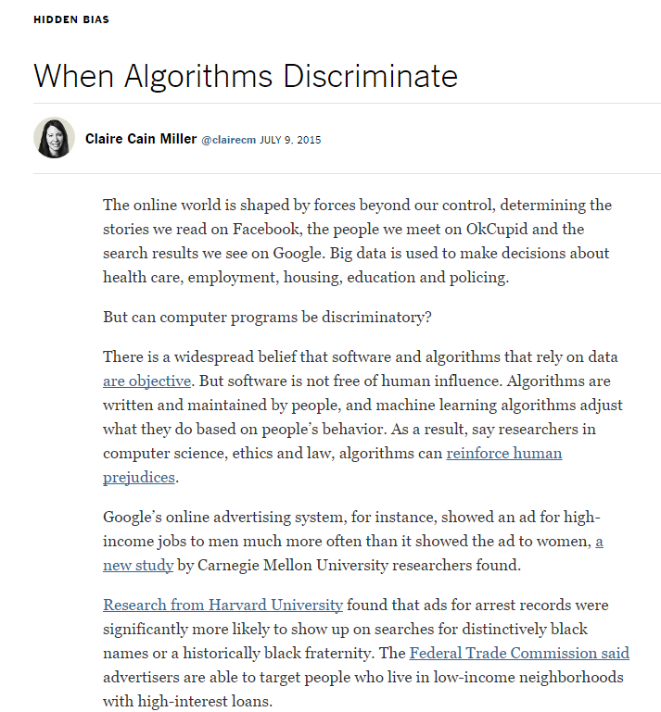
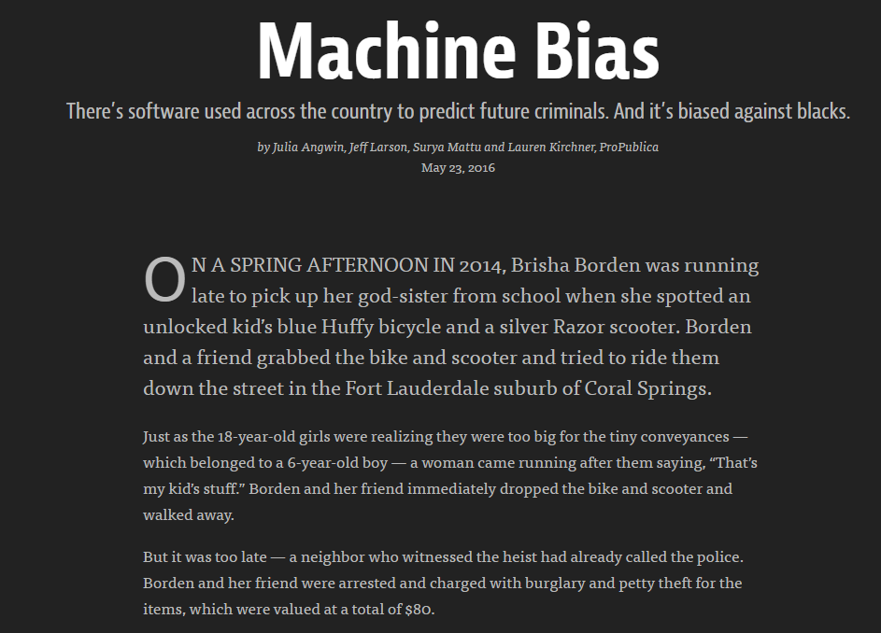

Slide 4
Machine Learning?
Means many things:
  Batch classification
  Online classification
  Unsupervised learning
  Reinforcement learning
  …

Slide 5
Machine Learning?
Means many things:
  Batch classification
  Online classification
  Unsupervised learning
  Reinforcement learning
  …

Slide 6
Unfair?
We will be precise about what we mean in each application, but…
Think about “unfairness” as relating to how the mistakes made by an algorithm are distributed.
  It can be “unfair” if an algorithm is much more likely to make a mistake about you than about others.

Slide 7
Why might machine learning be “unfair”?
Many reasons:
  Data might encode existing biases.
    E.g. labels are not “Committed a crime?” but “Was arrested.”
  Data collection feedback loops.
    E.g. only observe “Paid back loan?” if the loan was granted.
  Different populations with different properties.
    E.g. “SAT score” might correlate with label differently in populations that employ SAT tutors.
  Less data (by definition) about minority populations.
  The burden of exploration might disproportionately fall on certain populations

Slide 8
Why might machine learning be “unfair”?
Many reasons:
  Data might encode existing biases.
    E.g. labels are not “Committed a crime?” but “Was arrested.”
  Data collection feedback loops.
    E.g. only observe “Paid back loan?” if the loan was granted.
  Different populations with different properties.
    E.g. “SAT score” might correlate with label differently in populations that employ SAT tutors.
  Less data (by definition) about minority populations.
  The burden of exploration might disproportionately fall on certain populations

Slide 9
SAT Score
Number of Credit Cards
Population 1
Population 2

Slide 10
SAT Score
Number of Credit Cards
Population 1
Population 2

Slide 11
SAT Score
Upshot: To be “fair”, the algorithm may need to explicitly take into account group membership.
Else, optimizing accuracy fits the majority population.
Number of Credit Cards
Population 1
Population 2

Slide 12
Why might machine learning be “unfair”?
Many reasons:
  Data might encode existing biases.
    E.g. labels are not “Committed a crime?” but “Was arrested.”
  Data collection feedback loops.
    E.g. only observe “Paid back loan?” if the loan was granted.
  Different populations with different properties.
    E.g. “SAT score” might correlate with label differently in populations that employ SAT tutors.
  Less data (by definition) about minority populations.
  The burden of exploration might disproportionately fall on certain populations

Slide 13
SAT Score
Number of Credit Cards
Population 1
Population 2

Slide 14
Upshot: Algorithms trained on minority populations will be less accurate.
Qualified individuals will be denied at a higher rate.
SAT Score
Number of Credit Cards
Population 1
Population 2

Slide 15
Why might machine learning be “unfair”?
Many reasons:
  Data might encode existing biases.
    E.g. labels are not “Committed a crime?” but “Was arrested.”
  Data collection feedback loops.
    E.g. only observe “Paid back loan?” if the loan was granted.
  Different populations with different properties.
    E.g. “SAT score” might correlate with label differently in populations that employ SAT tutors.
  Less data (by definition) about minority populations.
  The burden of exploration might disproportionately fall on certain populations

Slide 16
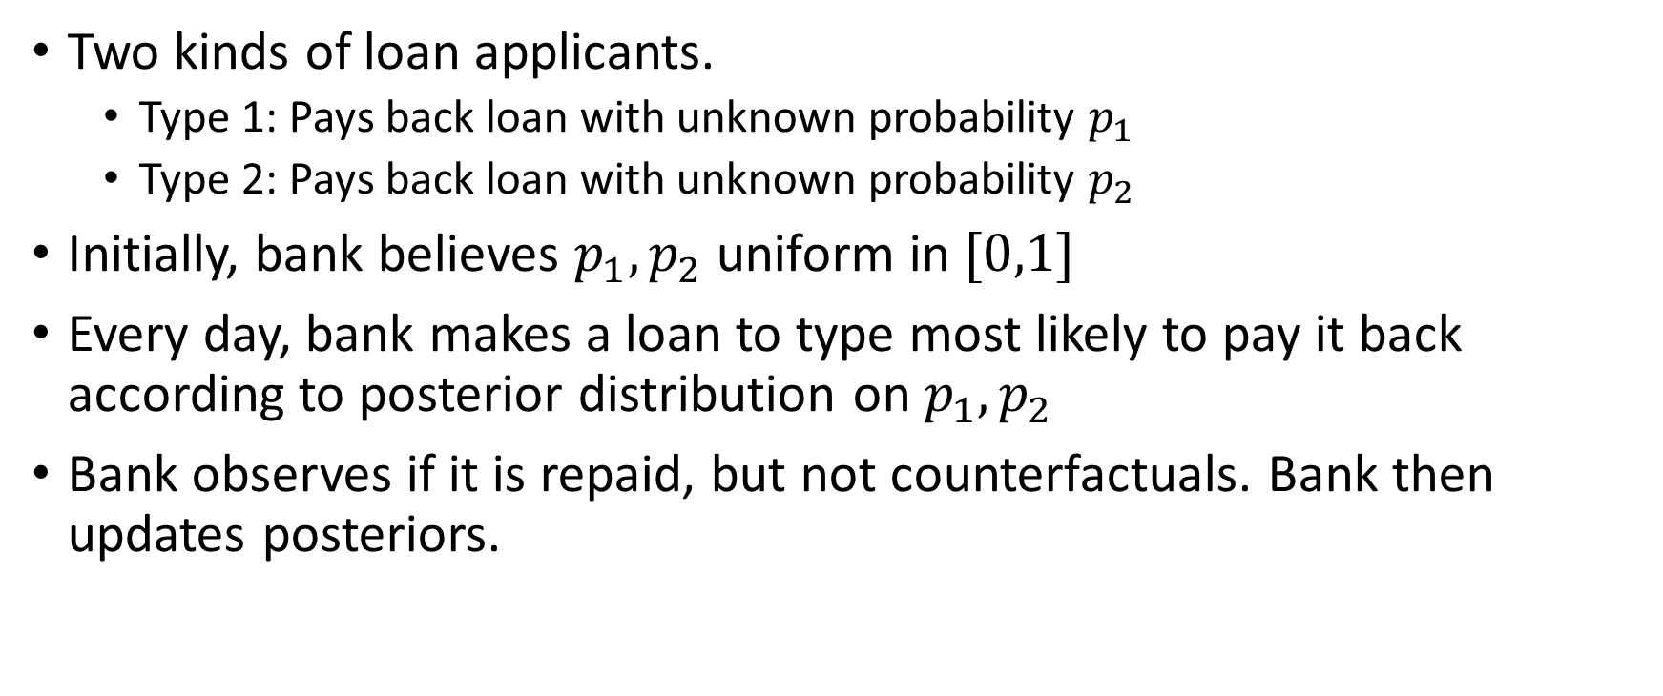
Toy Model
Two kinds of loan applicants.
  Type 1: Pays back loan with unknown probability $p_{1}$
  Type 2: Pays back loan with unknown probability $p_{2}$
Initially, bank believes $p_{1},p_{2}$ uniform in $[0,1]$
Every day, bank makes a loan to type most likely to pay it back according to posterior distribution on $p_{1},p_{2}$
Bank observes if it is repaid, but not counterfactuals. Bank then updates posteriors.

Slide 17



Toy Model
Suppose bank has made $n_{i}$ loans to population $i$, $s_{i}$ have paid them back , $d_{i}$ have defaulted. ($n_{i}=s_{i}+d_{i})$
Expected payoff of next loan is $\frac{s_{i}+1}{s_{i}+d_{i}+2}$
$$p_{1}=p_{2}=\frac{1}{2}$$
0.5
0.5
$$n_{i}=0$$
$$s_{i}=0$$
$$d_{i}=0$$
$$n_{i}=0$$
$$s_{i}=0$$
$$d_{i}=0$$

Slide 18

Toy Model
Suppose bank has made $n_{i}$ loans to population $i$, $s_{i}$ have paid them back , $d_{i}$ have defaulted. ($n_{i}=s_{i}+d_{i})$
Expected payoff of next loan is $\frac{s_{i}+1}{s_{i}+d_{i}+2}$
$$p_{1}=p_{2}=\frac{1}{2}$$
0.5
0.33
$$n_{i}=1$$
$$s_{i}=0$$
$$d_{i}=1$$
$$n_{i}=0$$
$$s_{i}=0$$
$$d_{i}=0$$

Slide 19

Toy Model
Suppose bank has made $n_{i}$ loans to population $i$, $s_{i}$ have paid them back , $d_{i}$ have defaulted. ($n_{i}=s_{i}+d_{i})$
Expected payoff of next loan is $\frac{s_{i}+1}{s_{i}+d_{i}+2}$
$$p_{1}=p_{2}=\frac{1}{2}$$
0.66
0.33
$$n_{i}=1$$
$$s_{i}=0$$
$$d_{i}=1$$
$$n_{i}=1$$
$$s_{i}=1$$
$$d_{i}=0$$

Slide 20

Toy Model
Suppose bank has made $n_{i}$ loans to population $i$, $s_{i}$ have paid them back , $d_{i}$ have defaulted. ($n_{i}=s_{i}+d_{i})$
Expected payoff of next loan is $\frac{s_{i}+1}{s_{i}+d_{i}+2}$
$$p_{1}=p_{2}=\frac{1}{2}$$
0.75
0.33
$$n_{i}=1$$
$$s_{i}=0$$
$$d_{i}=1$$
$$n_{i}=2$$
$$s_{i}=2$$
$$d_{i}=0$$

Slide 21

Toy Model
Suppose bank has made $n_{i}$ loans to population $i$, $s_{i}$ have paid them back , $d_{i}$ have defaulted. ($n_{i}=s_{i}+d_{i})$
Expected payoff of next loan is $\frac{s_{i}+1}{s_{i}+d_{i}+2}$
$$p_{1}=p_{2}=\frac{1}{2}$$
0.60
0.33
$$n_{i}=1$$
$$s_{i}=0$$
$$d_{i}=1$$
$$n_{i}=3$$
$$s_{i}=2$$
$$d_{i}=1$$

Slide 22

Toy Model
Suppose bank has made $n_{i}$ loans to population $i$, $s_{i}$ have paid them back , $d_{i}$ have defaulted. ($n_{i}=s_{i}+d_{i})$
Expected payoff of next loan is $\frac{s_{i}+1}{s_{i}+d_{i}+2}$
$$p_{1}=p_{2}=\frac{1}{2}$$
0.5
0.33
$$n_{i}=1$$
$$s_{i}=0$$
$$d_{i}=1$$
$$n_{i}=4$$
$$s_{i}=2$$
$$d_{i}=2$$

Slide 23

Toy Model
Suppose bank has made $n_{i}$ loans to population $i$, $s_{i}$ have paid them back , $d_{i}$ have defaulted. ($n_{i}=s_{i}+d_{i})$
Expected payoff of next loan is $\frac{s_{i}+1}{s_{i}+d_{i}+2}$
$$p_{1}=p_{2}=\frac{1}{2}$$
0.57
0.33
$$n_{i}=1$$
$$s_{i}=0$$
$$d_{i}=1$$
$$n_{i}=5$$
$$s_{i}=3$$
$$d_{i}=2$$

Slide 24

Toy Model
Suppose bank has made $n_{i}$ loans to population $i$, $s_{i}$ have paid them back , $d_{i}$ have defaulted. ($n_{i}=s_{i}+d_{i})$
Expected payoff of next loan is $\frac{s_{i}+1}{s_{i}+d_{i}+2}$
$$p_{1}=p_{2}=\frac{1}{2}$$
0.625
0.33
$$n_{i}=1$$
$$s_{i}=0$$
$$d_{i}=1$$
$$n_{i}=6$$
$$s_{i}=4$$
$$d_{i}=2$$

Slide 25

Toy Model
Suppose bank has made $n_{i}$ loans to population $i$, $s_{i}$ have paid them back , $d_{i}$ have defaulted. ($n_{i}=s_{i}+d_{i})$
Expected payoff of next loan is $\frac{s_{i}+1}{s_{i}+d_{i}+2}$
$$p_{1}=p_{2}=\frac{1}{2}$$
0.55
0.33
$$n_{i}=1$$
$$s_{i}=0$$
$$d_{i}=1$$
$$n_{i}=7$$
$$s_{i}=4$$
$$d_{i}=3$$

Slide 26
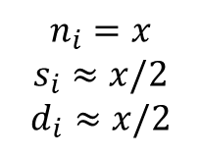
Toy Model
Upshot: Algorithms making myopically optimal decisions may forever discriminate against a qualified population because of unlucky prefix.
Less myopic algorithms balance exploration and exploitation – but this has its own unfairness issues.
Suppose bank has made $n_{i}$ loans to population $i$, $s_{i}$ have paid them back , $d_{i}$ have defaulted. ($n_{i}=s_{i}+d_{i})$
Expected payoff of next loan is $\frac{s_{i}+1}{s_{i}+d_{i}+2}$
$$p_{1}=p_{2}=\frac{1}{2}$$
0.5000001
0.33
$$n_{i}=1$$
$$s_{i}=0$$
$$d_{i}=1$$
$$n_{i}=x$$
$$s_{i}≈x/2$$
$$d_{i}≈x/2$$

Slide 27
Why might machine learning be “unfair”?
Many reasons:
  Data might encode existing biases.
    E.g. labels are not “Committed a crime?” but “Was arrested.”
  Data collection feedback loops.
    E.g. only observe “Paid back loan?” if the loan was granted.
  Different populations with different properties.
    E.g. “SAT score” might correlate with label differently in populations that employ SAT tutors.
  Less data (by definition) about minority populations.
  The burden of exploration might disproportionately fall on certain populations

Slide 28
Externalities of Exploration
It is well understood how to learn in bandit settings: explore!
Common/optimal strategy: “Optimism in the face of uncertainty”
  Bias decision making towards actions about which we have less data.
  Concretely: Maintain confidence intervals around cost estimates. Behave as if costs are as low as possible, consistent with confidence intervals.
The presence of a majority population can have negative externalities on a minority population.

Slide 29




Externalities of Exploration
A
$$1−ε$$
Consider a routing algorithm run just on the
BLUE population.
$$10\%$$
B
D
C
$$1$$
$$90\%$$

Slide 30
Externalities of Exploration
A
$$1−ε$$
Consider a routing algorithm run just on the
BLUE population.
$$10\%$$
B
D
C
$$1$$
$$90\%$$

Slide 31
Externalities of Exploration
A
$$1−ε$$
Consider a routing algorithm run just on the
BLUE population.
$$10\%$$
B
D
C
$$1$$
$$90\%$$

Slide 32
Externalities of Exploration
A
$$1−ε$$
Consider a routing algorithm run just on the
BLUE population.
$$10\%$$
B
D
C
$$1$$
$$90\%$$

Slide 33
Externalities of Exploration
A
$$1−ε$$
Consider a routing algorithm run just on the
BLUE population.
$$10\%$$
B
D
C
$$1$$
$$90\%$$

Slide 34
Externalities of Exploration
A
$$1−ε$$
Consider a routing algorithm run just on the
BLUE population.
$$10\%$$
B
D
C
$$1$$
$$90\%$$

Slide 35
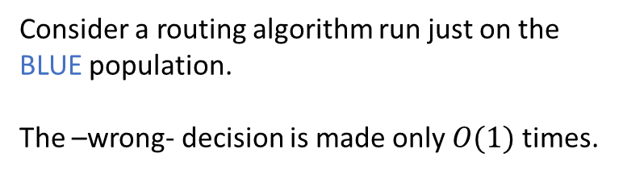
Externalities of Exploration
A
$$1−ε$$
Consider a routing algorithm run just on the
BLUE population.
The –wrong- decision is made only $O(1)$ times.
$$10\%$$
B
D
C
$$1$$
$$90\%$$

Slide 36



Externalities of Exploration
$$90\%$$
A
$$1−ε$$
Consider the addition of a majority RED population.
REDs are 90% of the overall population.
$$1\%$$
B
D
C
$$1$$
$$9\%$$

Slide 37
Externalities of Exploration
$$90\%$$
A
$$1−ε$$
Consider the addition of a majority RED population.
REDs are 90% of the overall population.
$$1\%$$
B
D
C
$$1$$
$$9\%$$

Slide 38
Externalities of Exploration
$$90\%$$
A
$$1−ε$$
Consider the addition of a majority RED population.
REDs are 90% of the overall population.
$$1\%$$
B
D
C
$$1$$
$$9\%$$

Slide 39
Externalities of Exploration
$$90\%$$
A
$$1−ε$$
Consider the addition of a majority RED population.
REDs are 90% of the overall population.
$$1\%$$
B
D
C
$$1$$
$$9\%$$

Slide 40
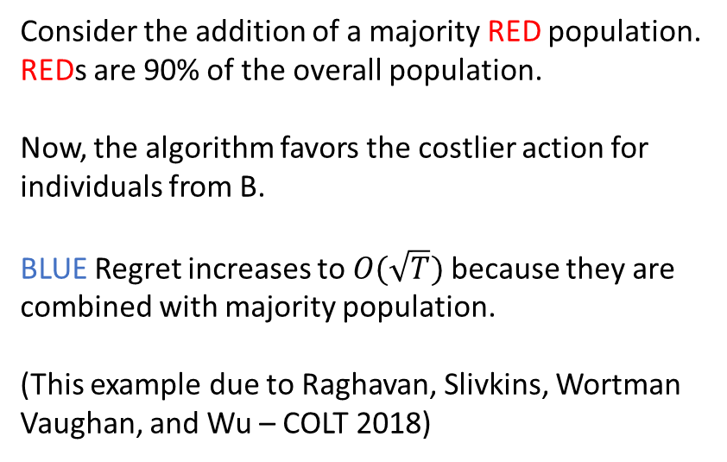
Externalities of Exploration
$$90\%$$
A
$$1−ε$$
Consider the addition of a majority RED population.
REDs are 90% of the overall population.
Now, the algorithm favors the costlier action for
individuals from B.
BLUE Regret increases to $O(\sqrt{T})$ because they are
combined with majority population.
(This example due to Raghavan, Slivkins, Wortman
Vaughan, and Wu – COLT 2018)
$$1\%$$
B
D
C
$$1$$
$$9\%$$

Slide 41
Batch Classification

Slide 42
Can we design fair ML algorithms?
What does fairness mean?
Literature divides between individual and statistical fairness definitions.

Slide 43
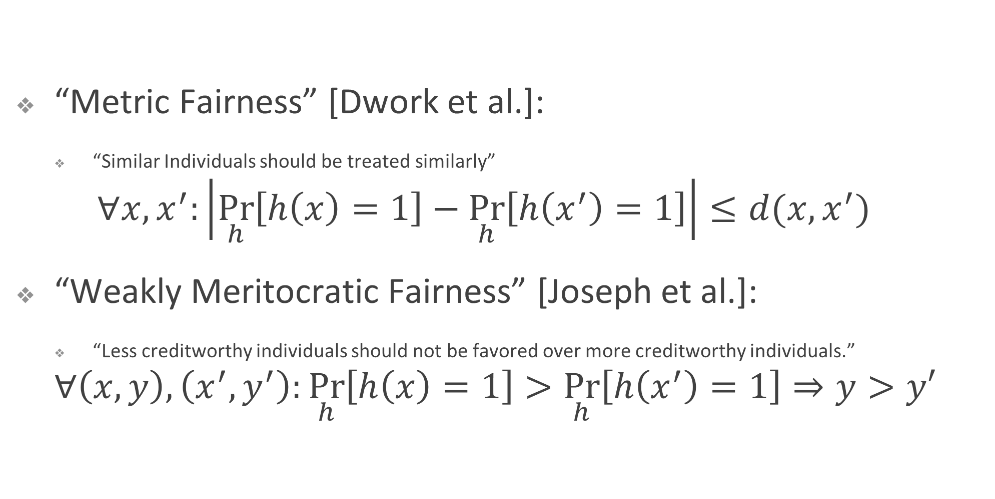
Individual Fairness Notions
  For classification problems (e.g. lending)
“Metric Fairness” [Dwork et al.]:
  “Similar Individuals should be treated similarly”
  $$∀x, x^{′}:\left|\underset{h}{Pr}\left[h\left(x\right)=1\right]−\underset{h}{Pr}\left[h\left(x^{′}\right)=1\right]\right|≤d(x, x^{′})$$
“Weakly Meritocratic Fairness” [Joseph et al.]:
  “Less creditworthy individuals should not be favored over more creditworthy individuals.”
  $$∀\left(x, y\right), \left(x^{′}, y^{′}\right):\underset{h}{Pr}\left[h\left(x\right)=1\right]>\underset{h}{Pr}\left[h\left(x^{′}\right)=1\right]⇒y>y′$$

Slide 44
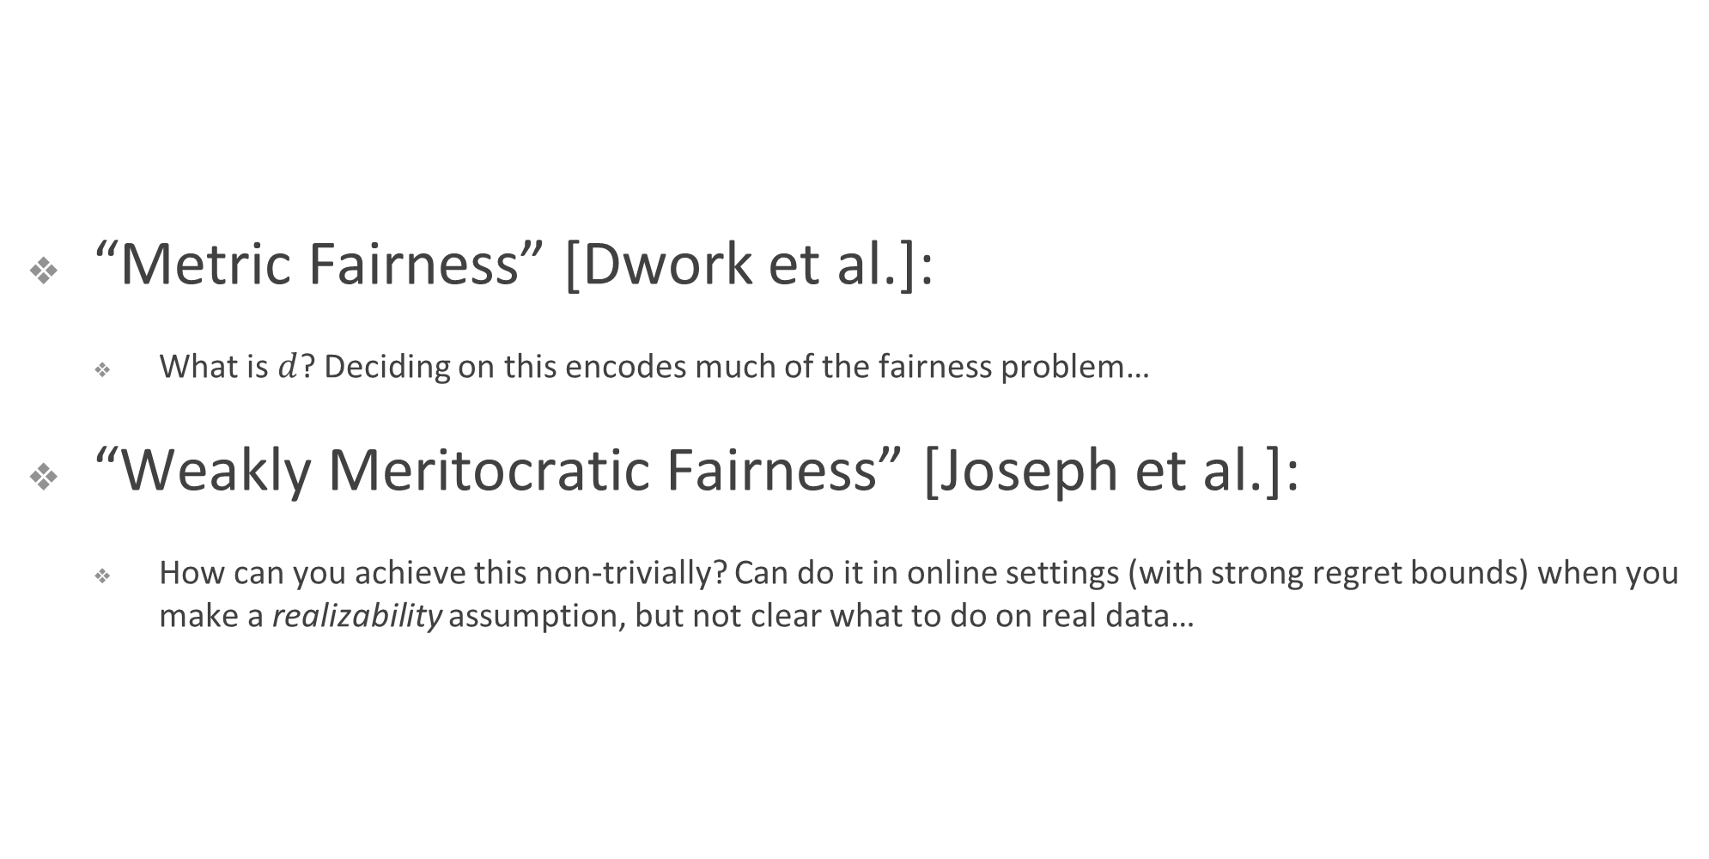
Individual Fairness Notions
  Strong individual level semantics, but…
“Metric Fairness” [Dwork et al.]:
  What is $d$? Deciding on this encodes much of the fairness problem…
“Weakly Meritocratic Fairness” [Joseph et al.]:
  How can you achieve this non-trivially? Can do it in online settings (with strong regret bounds) when you make a realizability assumption, but not clear what to do on real data…

Slide 45
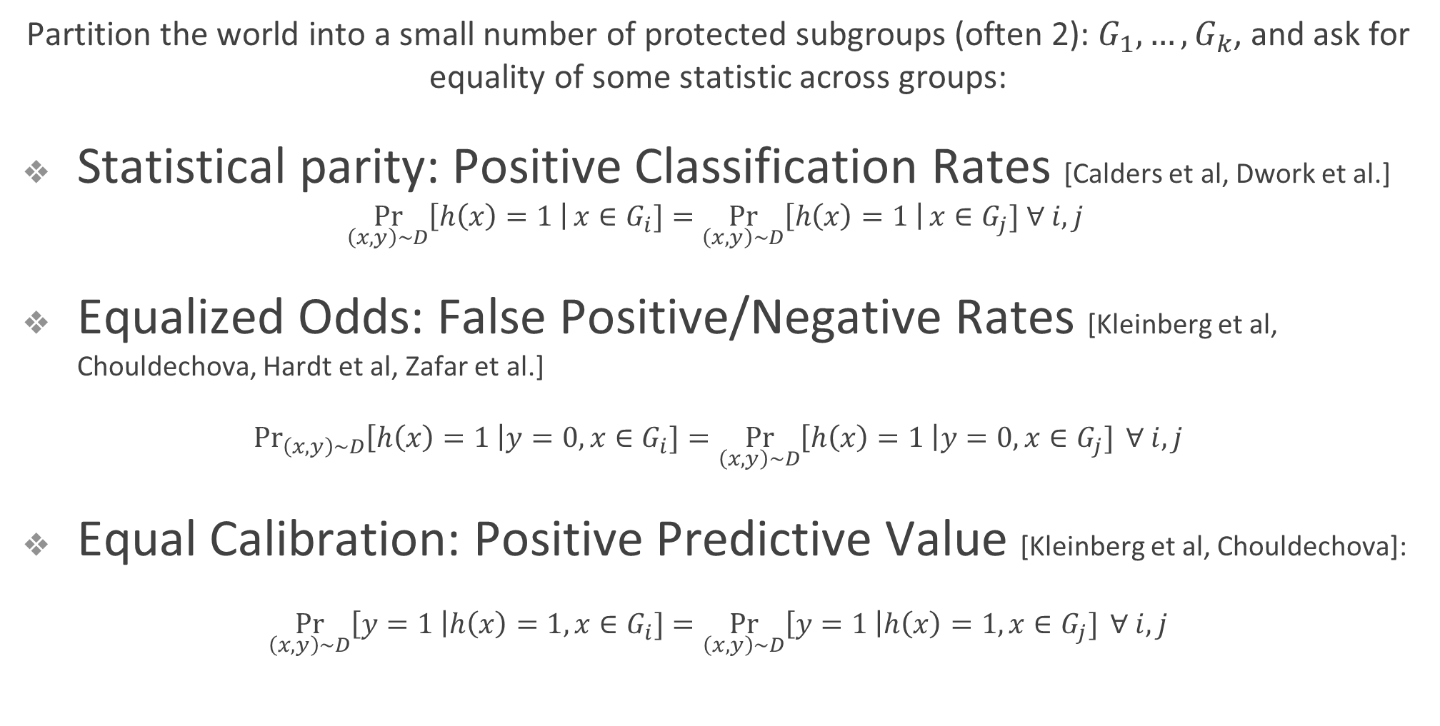
Statistical Fairness Notions
Partition the world into a small number of protected subgroups (often 2): $G_{1},…,G_{k}$, and ask for equality of some statistic across groups:
Statistical parity: Positive Classification Rates [Calders et al, Dwork et al.]
$$\underset{\left(x,y\right)∼D}{Pr}\left[h\left(x\right)=1 \right|x∈G_{i}]=\underset{\left(x,y\right)∼D}{Pr}\left[h\left(x\right)=1 \right|x∈G_{j}] ∀ i, j$$
Equalized Odds: False Positive/Negative Rates [Kleinberg et al, Chouldechova, Hardt et al, Zafar et al.]
$\underset{\left(x,y\right)∼D}{Pr}\left[h\left(x\right)=1 \right|y=0, x∈G_{i}]=\underset{\left(x,y\right)∼D}{Pr}\left[h\left(x\right)=1 \right|y=0, x∈G_{j}] ∀ i,j$
Equal Calibration: Positive Predictive Value [Kleinberg et al, Chouldechova]:
$\underset{\left(x,y\right)∼D}{Pr}\left[y=1 \right|h\left(x\right)=1, x∈G_{i}]=\underset{\left(x,y\right)∼D}{Pr}\left[y=1 \right|h\left(x\right)=1, x∈G_{j}] ∀ i,j$

Slide 46



A Case Study: the COMPAS recidivism prediction tool.
The COMPAS risk tool is fair. It has equal positive predictive value on both the black and white population.
The COMPAS risk tool is unfair. It has a higher false positive rate on the black population compared to the white population.
A cartoon of the COMPAS tool:
  People have features $x$, and true label $y∈\{$R(eoffend), D(id not reoffend)}
  The tool makes a prediction $f\left(x\right)∈\left\{R, D\right\}.$

Slide 47
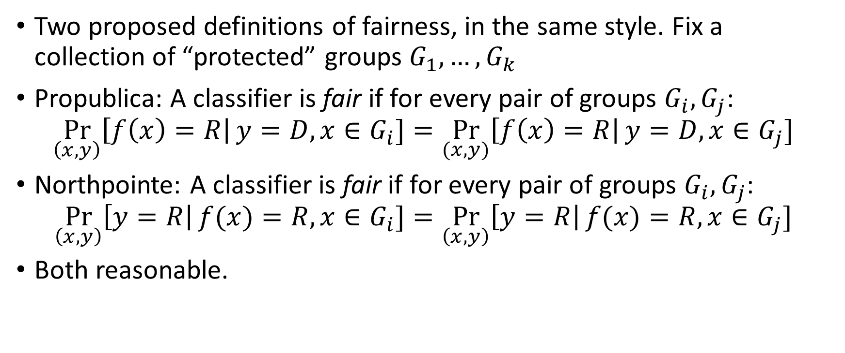
A Case Study: the COMPAS recidivism prediction tool.
Two proposed definitions of fairness, in the same style. Fix a collection of “protected” groups $G_{1},…,G_{k}$
Propublica: A classifier is fair if for every pair of groups $G_{i},G_{j}$:
$$\underset{\left(x,y\right)}{Pr}\left[f\left(x\right)=R\right|y=D, x∈G_{i}]=\underset{(x,y)}{Pr}\left[f\left(x\right)=R\right|y=D, x∈G_{j}]$$
Northpointe: A classifier is fair if for every pair of groups $G_{i},G_{j}$:
$$\underset{\left(x,y\right)}{Pr}\left[y=R\right|f(x)=R, x∈G_{i}]=\underset{\left(x,y\right)}{Pr}\left[y=R\right|f(x)=R, x∈G_{j}]$$
Both reasonable.

Slide 48
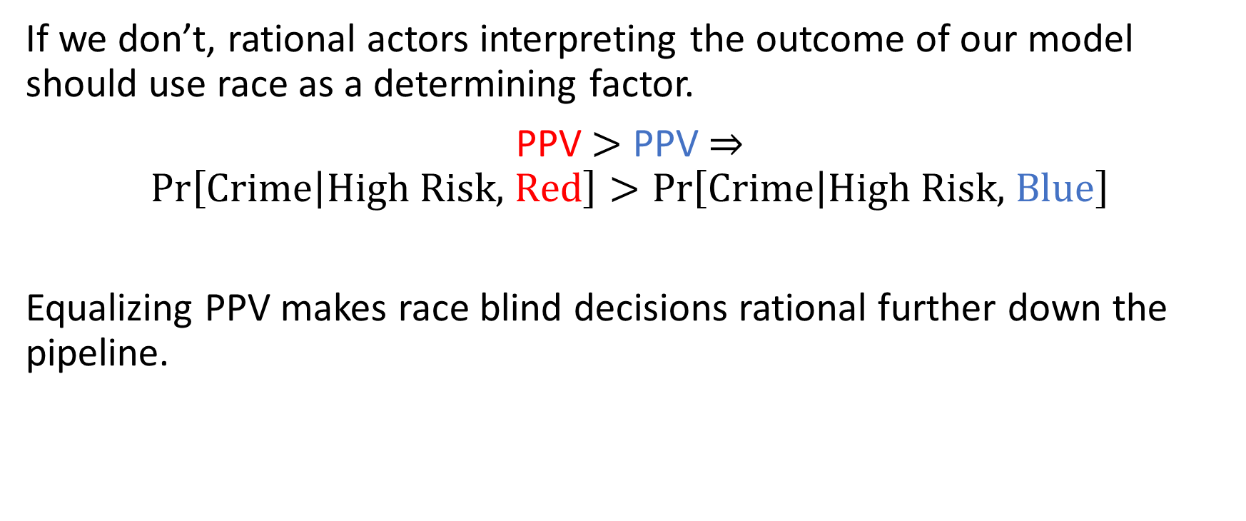
Why do we want to equalize PPV?
If we don’t, rational actors interpreting the outcome of our model should use race as a determining factor.
PPV $>$ PPV $⇒$
$$\operatorname{Pr}\left[\text{Crime} | \text{High} \text{Risk}\text{, }\text{Red}\right]>\operatorname{Pr}\left[\text{Crime} | \text{High} \text{Risk}\text{, }\text{Blue}\right]$$
Equalizing PPV makes race blind decisions rational further down the pipeline.

Slide 49
Why do we want to equalize FPR?
Being incorrectly labelled as “High Risk” constitutes a harm. FP rate is your probability of being harmed if you are born as a uniformly random “Low Risk” member of a population.

Slide 50
Why do we want to equalize FPR?
Being incorrectly labelled as “High Risk” constitutes a harm. FP rate is your probability of being harmed if you are born as a uniformly random “Low Risk” member of a population.
Equal FP rates => Indifference between
groups when behind veil of ignorance.

Slide 51
Impossibility
[Chouldechova 16], [Kleinberg, Mullainathan, Raghavan 16]:
“If the base rates differ between two populations, then no classifier can simultaneously equalize false positive rates, false negative rates, and positive predictive value unless it is perfect”.

Slide 52



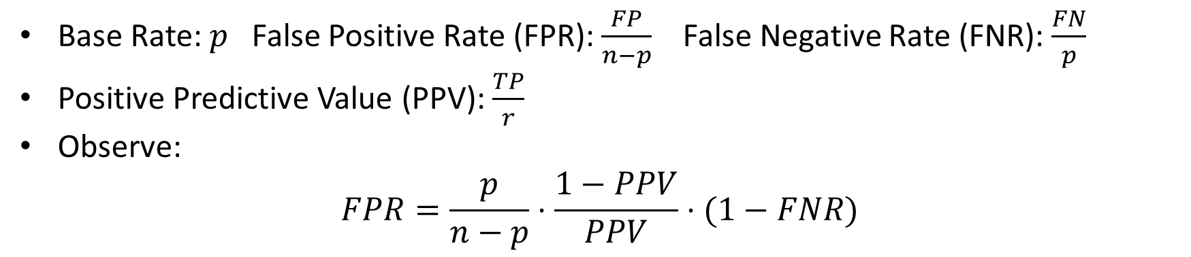


Impossibility
Classifier\Truth | Crime | No Crime
High Risk | True Positives (TP) | False Positives (FP)
Low Risk | False Negatives (FN) | True Negatives (TN)
$$r$$
$$n−r$$
$$p$$
$$n−p$$
Base Rate: $p$ False Positive Rate (FPR): $\frac{FP}{n−p}$ False Negative Rate (FNR): $\frac{FN}{p}$
Positive Predictive Value (PPV): $\frac{TP}{r}$
Observe:
$$FPR=\frac{p}{n−p}⋅\frac{1−PPV}{PPV}⋅(1−FNR)$$
$$\frac{FP}{n−p}=\frac{p}{n−p}⋅\frac{FP}{r}⋅\frac{r}{TP}⋅\frac{TP}{p}$$

Slide 53


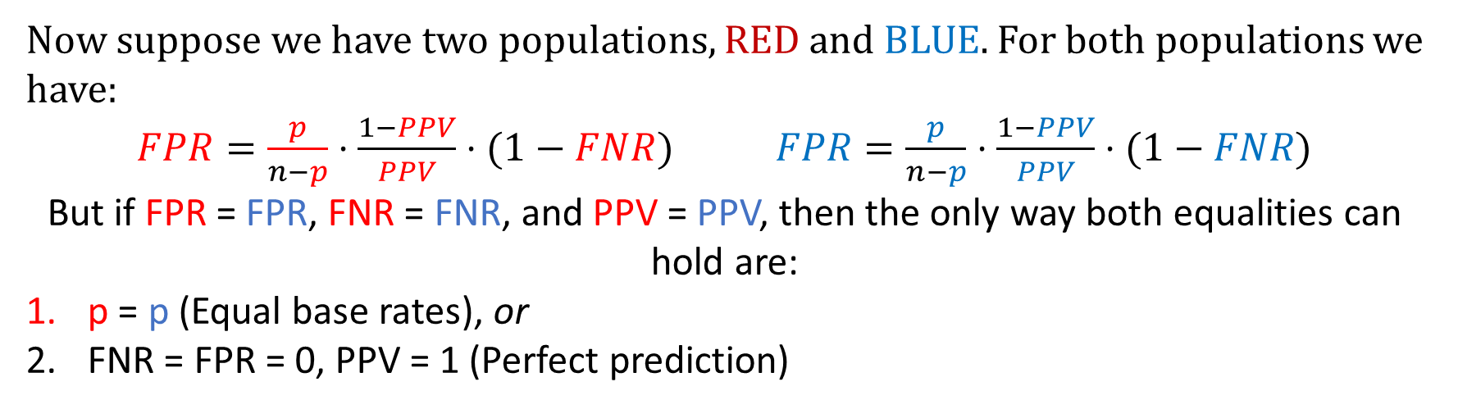
Impossibility
Classifier\Truth | Crime | No Crime
High Risk | True Positives (TP) | False Positives (FP)
Low Risk | False Negatives (FN) | True Negatives (TN)
$$r$$
$$n−r$$
$$p$$
$$n−p$$
Now suppose we have two populations, RED and BLUE. For both populations we have:
$FPR=\frac{p}{n−p}⋅\frac{1−PPV}{PPV}⋅(1−FNR)$ $FPR=\frac{p}{n−p}⋅\frac{1−PPV}{PPV}⋅(1−FNR)$
But if FPR = FPR, FNR = FNR, and PPV = PPV, then the only way both equalities can hold are:
p = p (Equal base rates), or
FNR = FPR = 0, PPV = 1 (Perfect prediction)

Slide 54
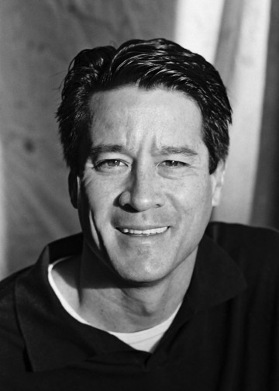

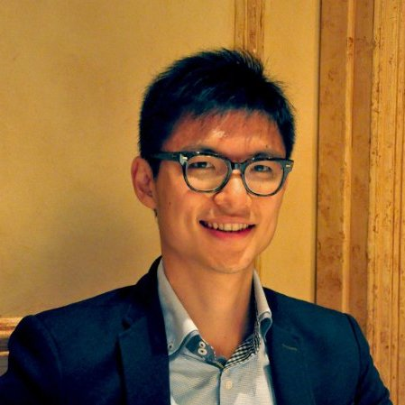
Weaknesses of statistical fairness notions
(and a partial mitigation…)
Preventing Fairness Gerrymandering: Auditing and Learning for Subgroup Fairness
Joint work with:
Michael Kearns
Seth Neel
Steven Wu

Slide 55
Statistical Fairness Notions
Partition the world into a small number of protected subgroups (often 2): $G_{1},…,G_{k}$, and ask for equality of some statistic across groups:
Statistical parity: Positive Classification Rates [Calders et al, Dwork et al.]
$$\underset{\left(x,y\right)∼D}{Pr}\left[h\left(x\right)=1 \right|x∈G_{i}]=\underset{\left(x,y\right)∼D}{Pr}\left[h\left(x\right)=1 \right|x∈G_{j}] ∀ i, j$$
Equalized Odds: False Positive/Negative Rates [Kleinberg et al, Chouldechova, Hardt et al, Zafar et al.]
$\underset{\left(x,y\right)∼D}{Pr}\left[h\left(x\right)=1 \right|y=0, x∈G_{i}]=\underset{\left(x,y\right)∼D}{Pr}\left[h\left(x\right)=1 \right|y=0, x∈G_{j}] ∀ i,j$
Equal Calibration: Positive Predictive Value [Kleinberg et al, Chouldechova]:
$\underset{\left(x,y\right)∼D}{Pr}\left[y=1 \right|h\left(x\right)=1, x∈G_{i}]=\underset{\left(x,y\right)∼D}{Pr}\left[y=1 \right|h\left(x\right)=1, x∈G_{j}] ∀ i,j$

Slide 56


Weaknesses of statistical fairness notions
(Statistically) easy to check and enforce without making any assumptions, but semantics have limited meaning when applied to individuals…
Toy example: Protected subgroups are “Men”, “Women”, “Blue”, “Green”. Labels are independent of protected attributes.
The following allocation achieves statistical parity and equalized odds:
Blue
Green
Male
Female

Slide 57
Statistical Fairness Notions
The problem: Statistical constraints averaged over coarse subgroups can be “gerrymandered” to pack unfairness into structured subgroups.
  No reason to expect it won’t happen with standard optimization techniques: we will see it does.
Just add “green men”, “blue women”, etc. as protected subgroups?
  What about other groups?

Slide 58
Statistical Fairness Notions
Include all possible groups? Including singleton groups?
  e.g. FPR({Alice}) = FPR({Bob})
    Nothing to average over! But can take randomness over the classifier.
A strong guarantee of individual fairness
  Implied by “Weakly Meritocratic Fairness” [Joseph et al. 2016]
  Can usefully achieve it in special circumstances (we’ll see in a bit)
But in general, can’t be non-trivially achieved
  Need some notion of realizability to avoid both overfitting and non-triviality.

Slide 59
Interpolating group fairness and individual fairness
Still sensible to ask for statistical fairness on every subgroup definable by a class $C$ of bounded VC-dimension.
  E.g. conjunctions on $d$ attributes: $3^{d}$ such subgroups
    (isMan) and (isBlack) and $¬$(isDisabled)
  Halfspaces on $d$ attributes: continuously many subgroups
    0.23(income) + 0.05(isMan) – 0.76(GRE-score) $≥20$
Mitigates the “gerrymandering problem”
  Now asking for statistical fairness over many finely defined subgroups.

Slide 60
Binary Classification Formulation
n samples (or individuals) (x, x’, y) ~ P; features x are “protected”
Model/Decision algorithm D makes prediction/decision D(x, x’)
g(x) is characteristic function of some subgroup:
  g(x) = 1 indicates (x, x’, y) belongs the subgroup g
G: rich but limited class of subgroups over protected features
  e.g. G = conjunctions, linear thresholds, decision lists

Slide 61
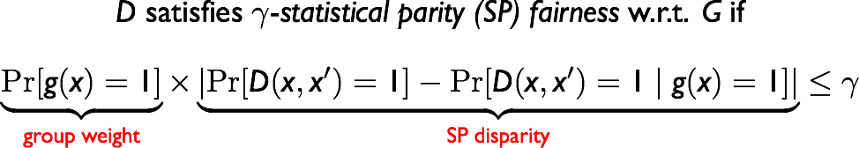
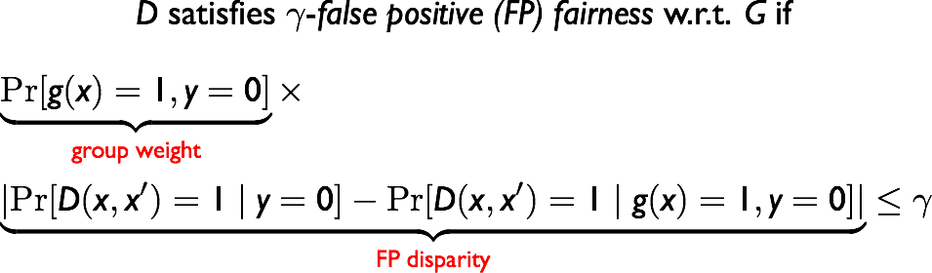
Statistical Fairness Notions
$$∀g∈G:$$
$$∀g∈G:$$
  Related: [Hebert-Johnson et al. 2018] for calibration

Slide 62
Generalization
VC dimension of $G$ allows us to bound the generalization error.
Theorem (Informal): Fix a concept class $H$ and a group structure $G$. Given a dataset $D$ of $n$ samples drawn iid from any distribution $P$, then with high probability for every $h∈H$, if $h$ has error $ε$ and is $γ$-fair on $D$, then $h$ has error at most $ε+η$ and is $γ+η$ fair on $P$ if:
$$n≥\tilde{O}\left(\frac{VCDIM\left(H\right)+VCDIM\left(G\right)}{η^{2}}\right)$$

Slide 63
Auditing and Learning
Auditing: given access to samples $(x, D(x, x’), y)$induced by a black-box algorithm D, decide that D is $γ$-fair with respect to G, or output a violated g in the class $G$.
Learning: given a hypothesis class H over features (x, x’), find a distribution D over H to minimize classification error that satisfies γ-fairness over the class $G$.

Slide 64
Hardness of Auditing
Theorem (Informal): Auditing an arbitrary D for $γ$-(SP/FP/FN) fairness with respect to G is computationally equivalent to weak agnostic learning of G.
Weak agnostic learning of G [Kearns et al. 1994; Kalai et al. 2008]:
given a dataset of (x, y) pairs drawn from P, whenever the best classifier in G has accuracy at least (1/2 + γ), find a function g in G with accuracy (1/2 + γ - ε), for some ε ≤ γ
The labels y are not promised to be generated by any g in G
Intuition: if g can predict the decisions D(x, x’) only using the protected features x, then D discriminates on the subgroup g

Slide 65
Bad News/Good News
  Bad news theoretically
  auditing even for simple structured classes G (e.g. conjunctions, half-spaces) is computationally intractable in the worst case.
  learning over many classes of H (even without fairness constraint) is also NP-hard in the worst case.
  Potentially good news in practice
  there exist powerful heuristics for agnostic learning/ERM problems
  SVM, logistic regressions, neural nets, boosting…

Slide 66
Bad News/Good News
  What should we hope for re: learning?
  Can’t expect a polynomial time algorithm (hard even without fairness constraints..)
  But what about an “oracle efficient reduction?”
    Assume we can solve the unconstrained learning problem. Is this enough to solve the fair learning problem?

Slide 67
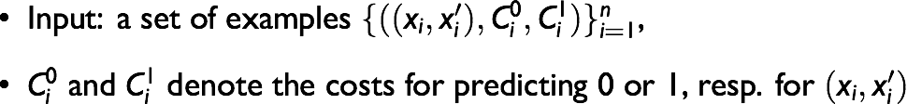
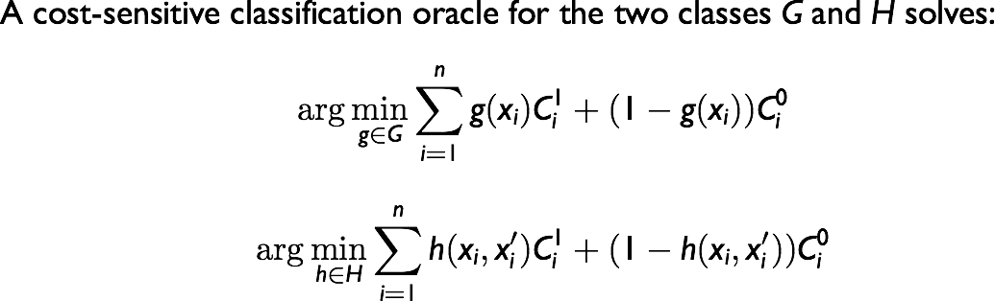
Cost-Sensitive Classification (CSC)

Slide 68
Cost-Sensitive Classification (CSC)
CSC problem is equivalent to agnostic learning.
Proof sketch:
  If the cost of making an “error” is smaller than the cost of correct classification, flip the label.
  The argmin is invariant to translation of costs, so can translate costs so that WLOG, the cost of correct classification is 0. Now cost of error is non-negative.
  We now have a weighted classification problem. Equivalently, an agnostic learning problem over a re-weighted distribution. Sample a new dataset from the reweighted distribution and run your agnostic learning oracle.

Slide 69

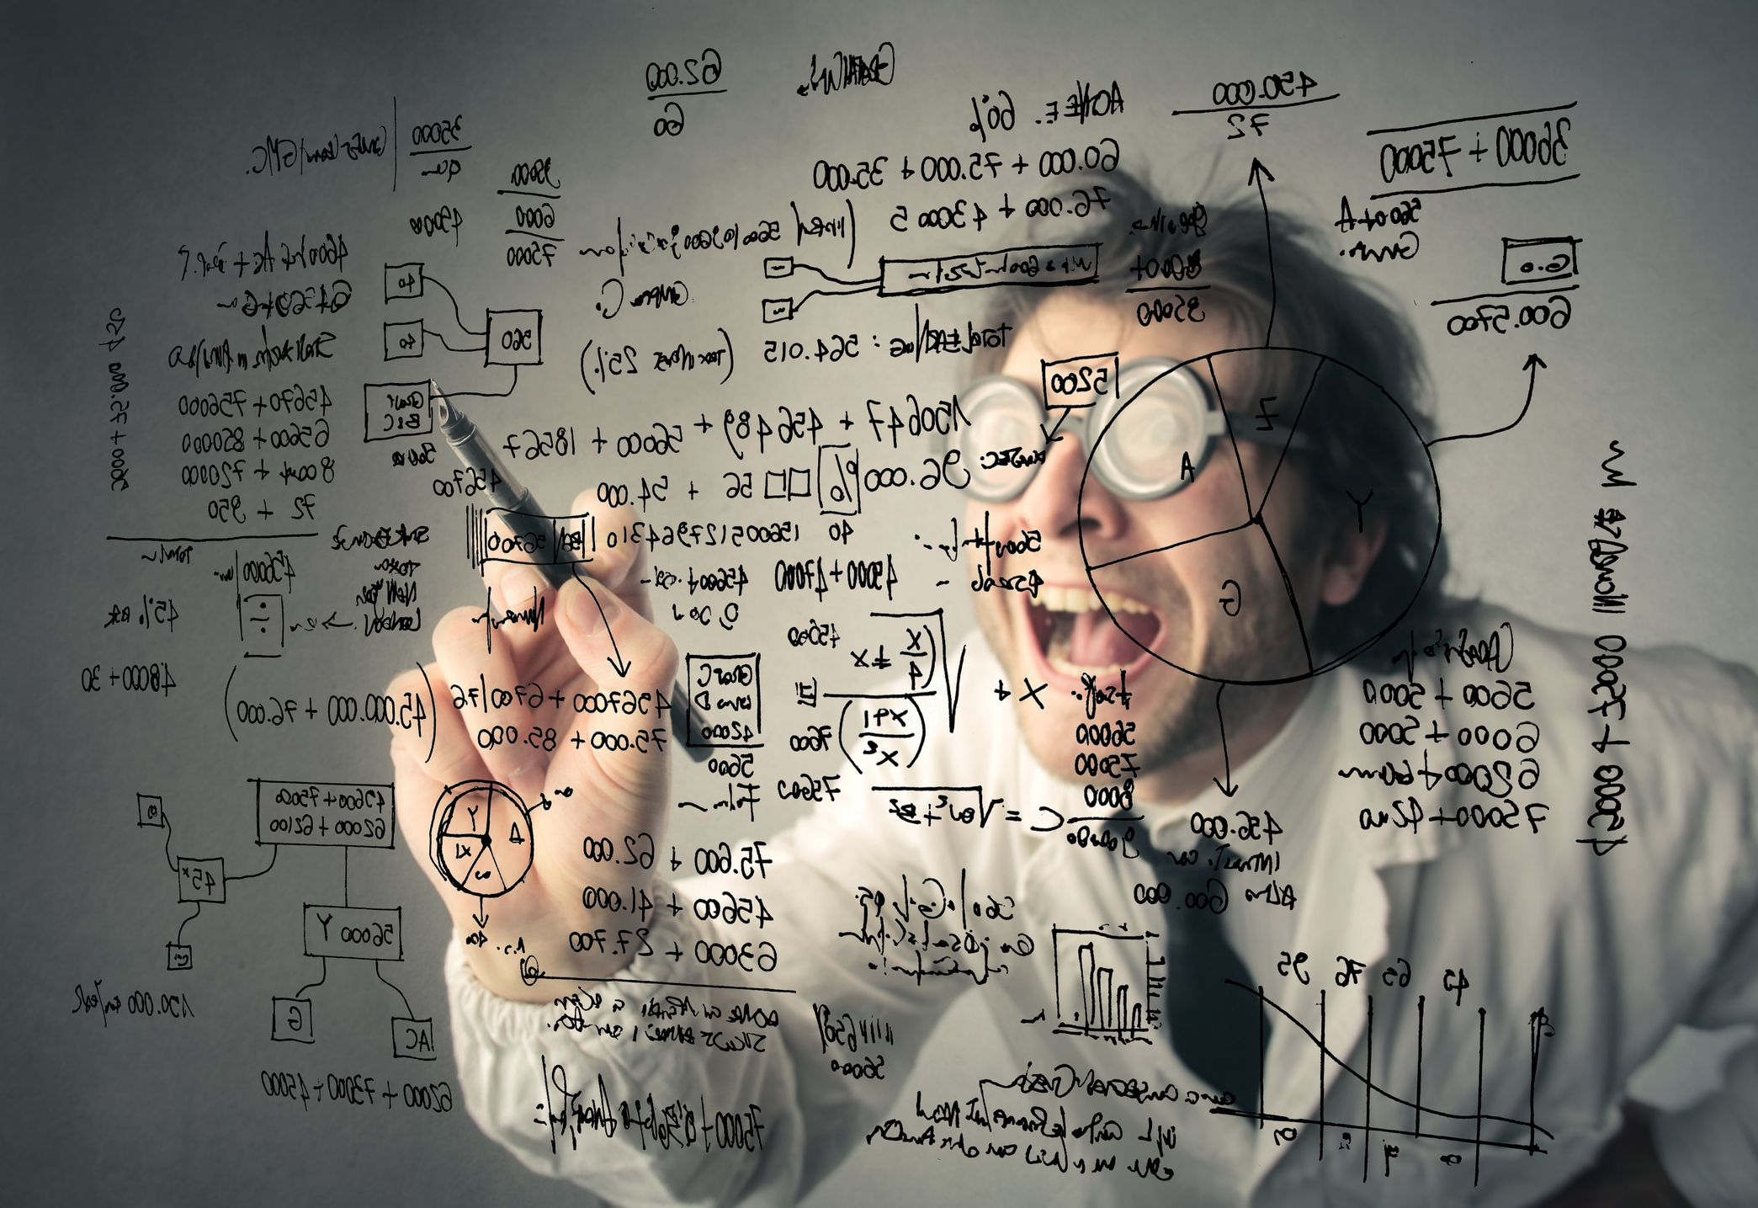
Learning for Subgroup Fairness
Goal: find the optimal fair distribution over classifiers in H
Main result: reduction to a short sequence of CSC problems
(generalize [Agarwal et al. 2017] to many subgroups)
Key idea: simulate a zero-sum game between an Auditor and a Learner

Slide 70
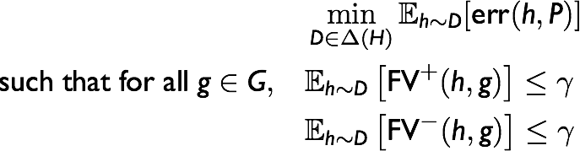
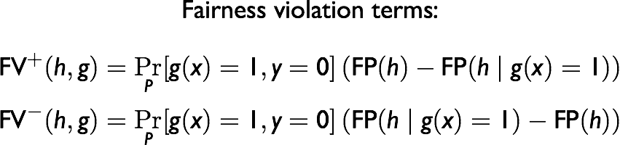
Fair Empirical Risk Minimization Problem
Let P be the empirical distribution over the n data points

Slide 71
Fair Empirical Risk Minimization Problem
Problem: Horribly non-convex.
  “Solution”: blow up the dimension! One variable for every $h∈H$.
    Now its just a linear program.
New problem: infinitely many variables, constraints.
  Solution: By the Sauer-Shelah lemma, the number of distinct hypotheses in $H$ is $n^{O(VCDIM\left(H\right))}$, number of distinct groups is $n^{O(VCDIM\left(G\right))}$.
    Now “only” exponentially many variables, constraints…
    But at least strong duality holds.

Slide 72
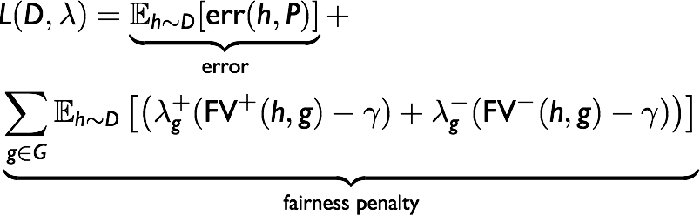
From Lagrangian to Zero-Sum Games
Optimal solution for fair ERM is the minimax equilibrium:
Learner controlling D v.s. Auditor controlling λ

Slide 73
Best Response as CSC
  Lemma: The best response for both the Learner and the Auditor can be computed by solving a cost-sensitive classification problem over H and G respectively.
Intuition: False positive rates are just classification error on a subset of the data. Upweight points in that subset.

Slide 74
Learner’s best response
Write $λ_{g}=(λ_{g}^{+}−λ_{g}^{−})$.
Given $λ$, find $h∈H$ to maximize:
$$err\left(h\right)+\sum_{g∈G}{λ_{g}\left(FP\left(h | g\right)−FP\left(h\right)\right)⋅Pr⁡[g\left(x\right)=1, y=0]}$$
Note:
$$err\left(h\right)=\sum_{i}{1[h\left(x_{i}\right)≠y_{i}]}, FP\left(h\right)=\frac{\sum_{i:y_{i}=0}{1[h\left(x_{i}\right)≠y_{i}]}}{Pr⁡[y_{i}=0]},FP\left(h|g\right)=\frac{\sum_{i:y_{i}=0,g\left(x_{i}\right)=1}{1[h\left(x_{i}\right)≠y_{i}]}}{Pr⁡[y_{i}=0, g\left(x_{i}\right)=1]}$$
So, this is just a CSC problem with:
$C_{i}^{0}=1, C_{i}^{1}=0$ if $y_{i}=1$
$C_{i}^{0}=0$, $C_{i}^{1}=1+\sum_{g}{λ_{g}⋅(1\left[g\left(x\right)=1\right]−\operatorname{Pr}\left[g\left(x\right)=1 \right|y=0]) }$if $y_{i}=0$.

Slide 75
Auditor’s Best Response
Given $D$, find $g∈G$ to maximize:
$$\left(FP\left(h | g\right)−FP\left(h\right)\right)⋅Pr⁡[g\left(x\right)=1, y=0]$$
We can set:
$C_{i}^{0}=0, C_{i}^{1}=0$ if $y_{i}=1$
$C_{i}^{0}=0$, $C_{i}^{1}=E_{h∼D}[FP\left(h\right)]−E_{h∼D}[h\left(x_{i}\right)≠y_{i}]$ if $y_{i}=0$

Slide 76
Best Response as CSC
  Lemma: The best response for both the Learner and the Auditor can be computed by solving a cost-sensitive classification problem over H and G respectively.
So we can compute best responses. How do we compute equilibrium?

Slide 77
No Regret Dynamics in Zero Sum Games
Given:
An action set $H$ for the minimization player (Min)
An actions set $G$ for the maximization player (Max)
A loss function $ℓ:H×G→ℝ$.
In rounds $t=1,…,T$:
  Min picks a distribution $D_{t}∈ΔH$, Max picks $P_{t}∈ΔG$
  Both experience loss $E_{h∼D_{t}, g∼P_{t}}[ℓ\left(h,g\right)]$.

Slide 78
No Regret Dynamics in Zero Sum Games
Given a play history ${\left(D_{t},P_{t}\right)}_{t=1}^{T}$, Min and Max’s Regret is:
$$Regret_{MIN}=\frac{1}{T}\left(\sum_{t=1}^{T}{E_{h∼D_{t}, g∼P_{t}}\left[ℓ\left(h,g\right)\right]}−\min_{h^{∗}∈H}{\sum_{t=1}^{T}{E_{g∼P_{t}}\left[ℓ\left(h^{∗},g\right)\right]}}\right)$$
$$Regret_{MAX}=\frac{1}{T}\left(\max_{g^{∗}∈H}{\sum_{t=1}^{T}{E_{h∼D_{t}}\left[ℓ\left(h,g^{∗}\right)\right]}}−\sum_{t=1}^{T}{E_{h∼D_{t}, g∼P_{t}}\left[ℓ\left(h,g\right)\right]}\right)$$

Slide 79
No Regret Dynamics in Zero Sum Games
Theorem: [Freund and Schapire] Given a play history ${\left(D_{t},P_{t}\right)}_{t=1}^{T}$ such that $Regret_{MAX}, Regret_{MIN}≤ε$, the distributions $\overline{D}=\frac{1}{T}\sum_{t}{D_{t}}, \overline{P}=\sum_{t}{P_{t}}$ form an $ε$-approximate minmax equilibrium:
$$\max_{g∈G}{E_{h∼\overline{D}}\left[ℓ\left(h,g\right)\right]≤v^{∗}+ε}$$
$$\min_{h∈H}{E_{g∼\overline{P}}\left[ℓ\left(h,g\right)\right]≥v^{∗}−ε}$$
Where:
$$v^{∗}=\min{\max{E[ℓ\left(h,g\right)]}}=\max{\min{E[ℓ\left(h,g\right)]}}$$

Slide 80
No Regret Dynamics in Zero Sum Games
In our case: $\overline{D}$ is an $ε$-approximate solution to our fair ERM problem:
$$E_{h∼\overline{D}}\left[err\left(h,P\right)\right]≤OPT+ε$$
And for all $g∈G$:
$$E_{h∼\overline{D}}\left[FV^{+}\left(h,g\right)\right],E_{h∼\overline{D}}\left[FV^{−}\left(h,g\right)\right]≤γ+ε$$

Slide 81
How can players obtain diminishing regret?
One way: cheat! Peak and best respond to opponent’s distribution.
  E.g. set $g_{t}=\arg{\max_{g}{E_{h∼D_{t}}[ℓ\left(h,g\right)]}}.$
  Then, guaranteed that $Regret_{MAX}≤0$.
Can’t do this in a “real” interaction, but could do it in a simulation.
  But at most 1 player can play like this --- can’t both look ahead without circularity!
Another way: If the loss function can be written as a low dimensional linear function.

Slide 82
How can players obtain diminishing regret?
Suppose there is some mapping $φ:H→{\left[0,1\right]}^{d}$, and $θ:G→{\left[0,1\right]}^{d}$ such that: $ℓ\left(h,g\right)=\left\langle φ\left(h\right), θ\left(g\right)\right\rangle .$
Then “Follow the Perturbed Leader” plays the following distribution:
At round $t$:
  Let $ρ∼Uniform{\left[0,1\right]}^{d}$
  Output $h_{t}=\arg{min_{h∈H}{⟨φ\left(h\right),\sum_{j=1}^{t−1}{θ\left(g_{j}\right)}+\frac{ρ}{η}⟩ }}$
Guarantee: In the worst case over opponent behavior:
$$Regret_{MIN}≤\tilde{O}\left(\frac{d^{\frac{5}{4}}}{\sqrt{T}}\right)$$

Slide 83
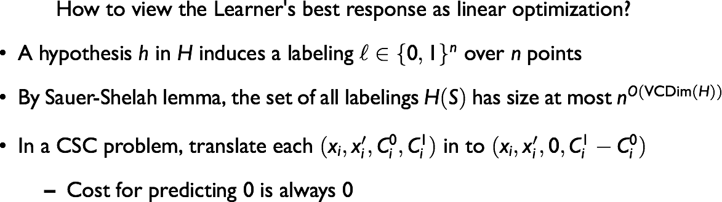
No-Regret Algorithm for the Learner
Can Learner use FTPL to obtain diminishing regret?
CSC problem becomes find:
$$\arg{\min_{h∈H}{\sum_{i=1}^{n}{\left(h\left(x_{i},x_{i}^{′}\right)⋅C_{i}^{1}+\left(1 −h\left(x_{i},x_{i}^{′}\right)\right)⋅C_{i}^{0}\right)= }}}$$
$$\arg{\min_{h∈H}{\sum_{i=1}^{n}{h\left(x_{i},x_{i}^{′}\right)⋅(C_{i}^{1}−C_{i}^{0}) }}=\arg{\min_{h∈H}{⟨ℓ\left(h\right), C^{1}−C^{0}⟩}}}$$

Slide 84
The Algorithm
In round $t=1,…,T$:
  Form the CSC corresponding to the Auditor’s best responses $g_{1},…,g_{t−1}$ represented as costs $C$.
  Translate the costs so that for all $i$, $C_{i}^{0}=0$.
  Let $D_{t}$ be the distribution describing:
  $$h_{t}=\arg{\underset{h∈H}{m\text{in}}{⟨}}h\left(x\right), C+ρ⟩ ρ∼Unif\left[0,\frac{1}{η}\right]$$
  Let $g_{t}$ be the subgroup for which the fairness constraint is maximially violated given $D_{t}$.
Output $\overline{D}= \sum_{t=1}^{T}{D_{t}}$.

Slide 85
Main Theoretical Result
Theorem (Informal): Given access to CSC oracles for $H$ and $G$, there is an algorithm that makes poly$\left(n,\frac{1}{ε}\right)$ oracle calls, and outputs a distribution $D$ over $H$ that achieves $ε$-optimal error (with respect to the best $γ$-fair distribution over classifiers), and is $(γ+ε)$-fair with respect to $G$.
Is this useful?

Slide 86
Practical Shortcomings
The algorithm is implementable, but requires many oracle calls per iteration.
  In step 4, the auditor needs to best respond to $D_{t}$, not just to a single draw $h_{t}∼D_{t}$.
  But we don’t have an explicit representation of $D_{t}$. With an oracle call, we can sample from it.
  In theory: take $O\left(\frac{VCDIM\left(G\right)}{ε^{2}}\right)$ samples from $D_{t}$ at each round and have the auditor best respond to the empirical distribution (with one additional oracle call).

Slide 87
Empirical Evaluation
Solving the zero-sum game using Fictitious Play:
  Each player in each round plays best response against the opponent’s empirical play so far
  Avoids repeated sampling from FTPL distributions --- only 1 oracle call per player per round.
  Only guarantees asymptotic convergence
  In practice has the merit of simplicity and faster per-step computation

Slide 88
Dataset
Communities and Crime dataset:
  census and other data on 2K U.S. communities
  target prediction: high vs. low violent crime rate
  122 features total; 18 protected (racial groups, incomes, racial makeup of police)
  fairness w.r.t. 18 features separately: audit finds subgroup of weight 0.67 with FP disparity 0.26
Both H (d = 122) and G (d = 18) are linear threshold functions
Implemented with thresholded linear regression as CSC oracle

Slide 89
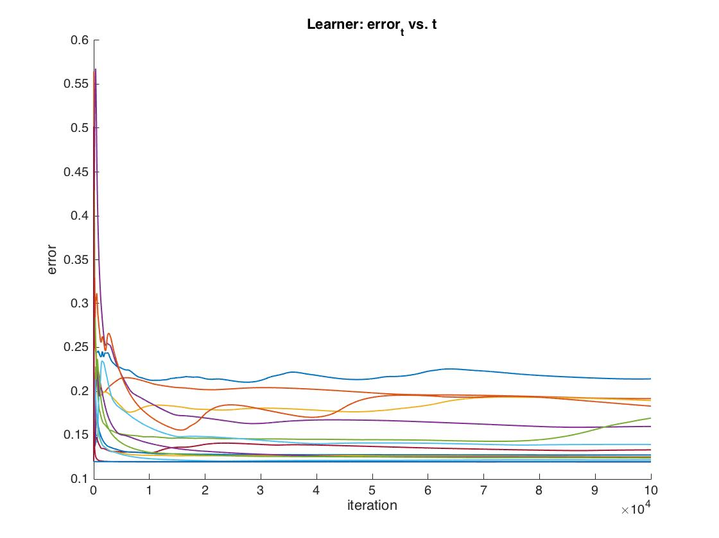
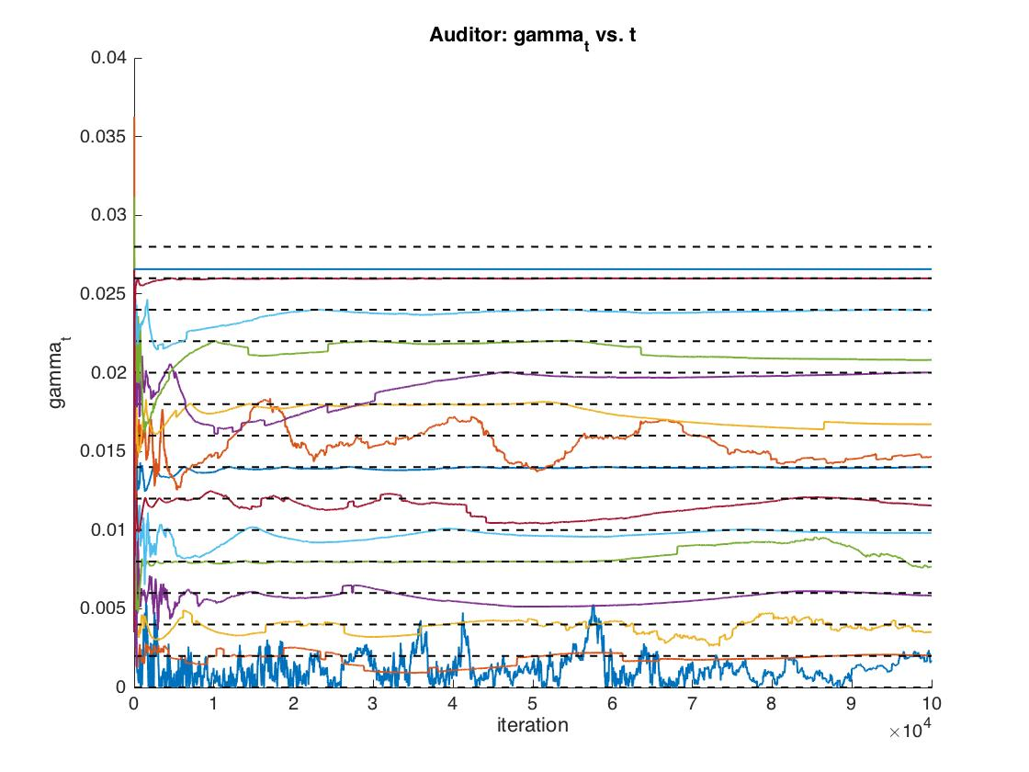
Convergence for different input γ’s

Slide 90
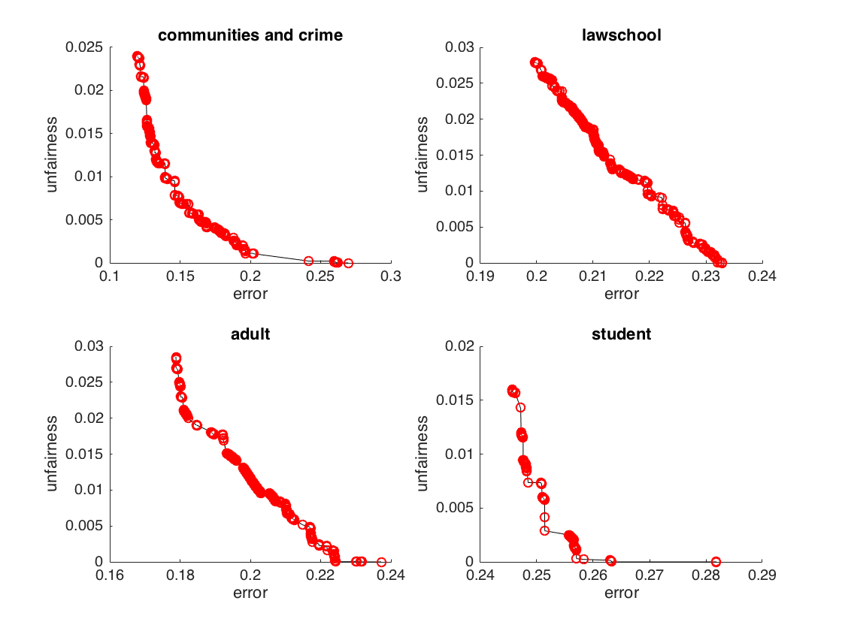
Pareto Curves: (error, γ)
      Across a range of datasets unfairness starts around .02-.03
    We are able to drive near 0 with only a 3-6% increase in error

Slide 91
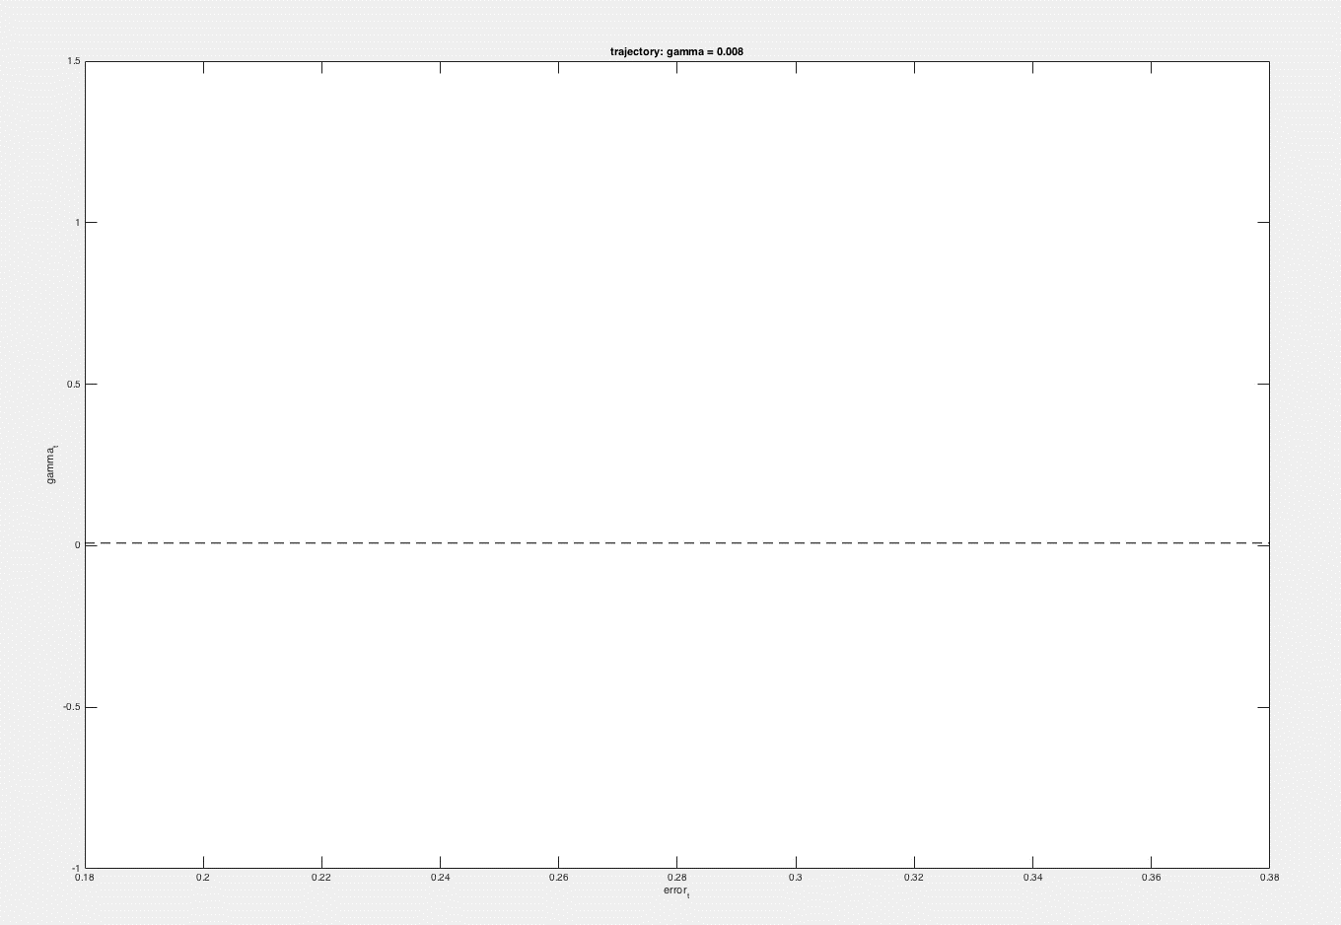

Slide 92
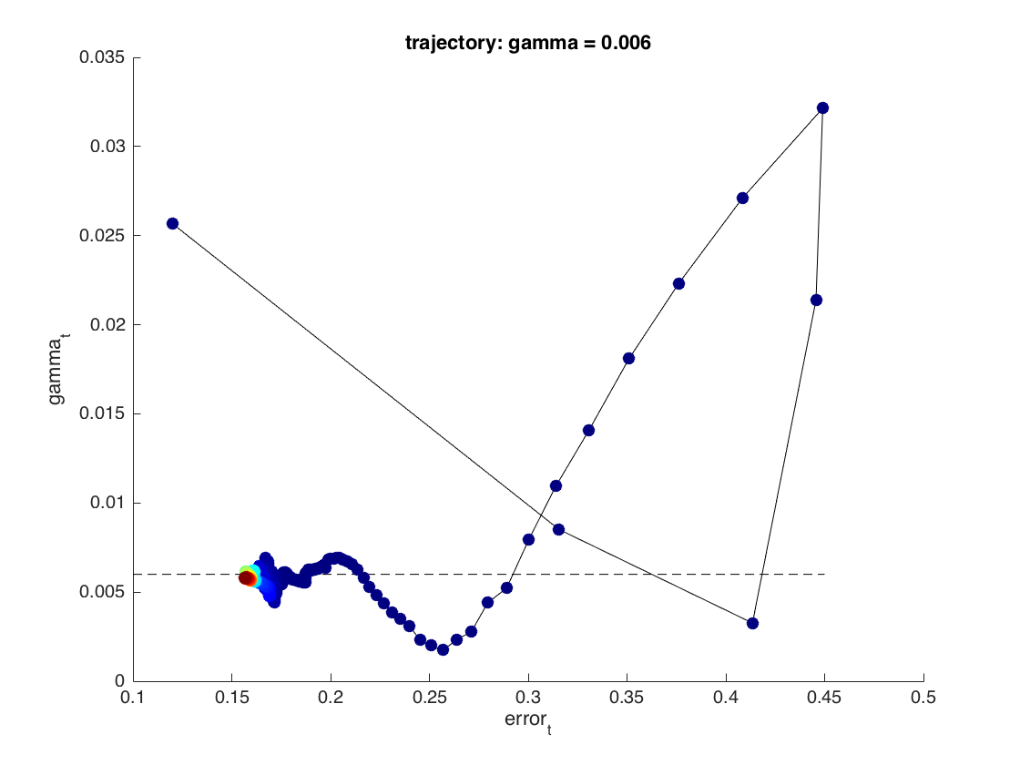

Slide 93
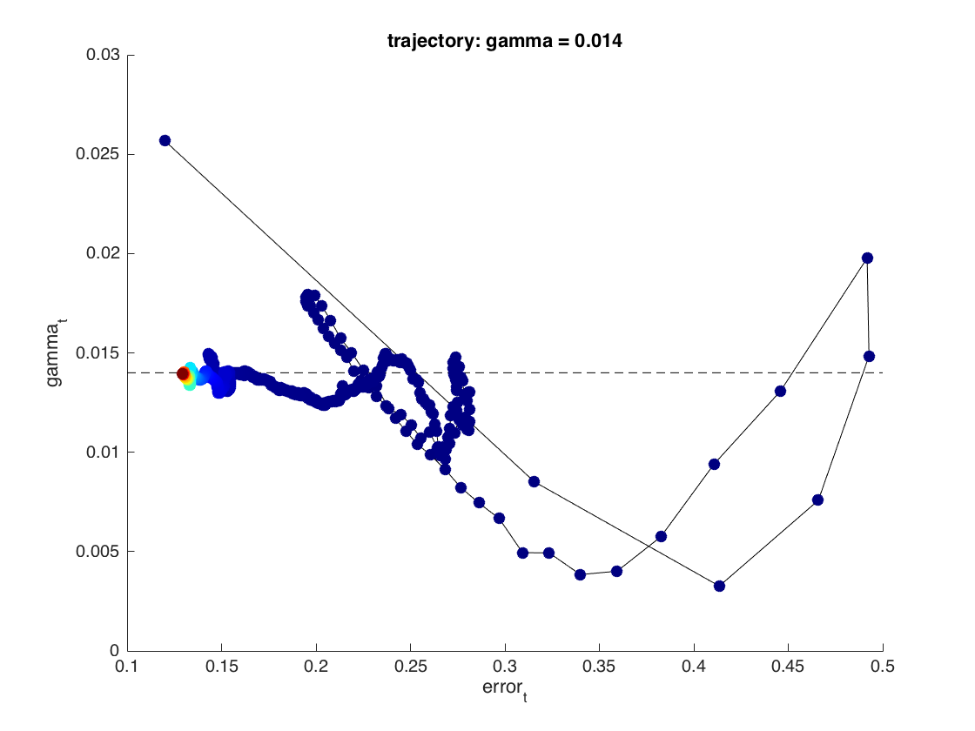

Slide 94


Slide 95

Flattening the Discrimination Heatmap

Slide 96


Slide 97


Slide 98

Subgroup Fairness!

Slide 99

Does fairness to marginal subgroups achieve finer subgroup fairness? No!

Slide 100

Pareto curve for (error, γ): varying the features

Slide 101
Takeaways
For learning problems, designing “oracle efficient algorithms” seems to lead to practical algorithms.
  But don’t abuse the model: 1 query oracle efficient algorithm for TSP.
  Formalize what a “reasonable” oracle efficient algorithm is?
    For now, needs to come with empirical evaluation.
By asking for statistical fairness over LOTS of finely defined groups, we can mitigate the weaknesses of statistical fairness definitions while keeping their benefits.
  But ultimately, the weaknesses are still there, just at a finer grain.
Empirically, most of the fairness/accuracy tradeoff seems to arise from making $γ$ small. Making $G$ big seems relatively cheap.

Slide 102



Online Learning in the Bandit Setting
And the Problem with Exploration…
Based on joint work with
Sampath Kannan, Jamie Morgenstern, Bo Waggoner, Steven Wu

Slide 103

Bandit Problems
Model the common situation when algorithm decisions feed back into training data, and counterfactuals cannot be observed.
  Recidivism Prediction
    Would an inmate who is not released have gone on to commit another crime?
  Loan Allocation
    Would an applicant denied a loan have missed loan payments?
  Drug Trials
    How would a patient have responded had she been given a different drug?

Slide 104
Bandit Problems
Classic Tension: Exploration vs. Exploitation
  To maximize immediate payoff, algorithm needs to exploit its current knowledge to make decisions that are most likely to be high payoff.
  To maximize long-term payoff, algorithm needs to explore actions about which it has little data, so as to improve its future decision making ability.
  In tension when under-explored actions are not the ones estimated to have high payoff.

Slide 105
Linear Bandit Problems
$k$unknown parameter vectors $β_{1},{…,β}_{k}∈ℝ^{d}$
In rounds $t∈\left\{1,…,T\right\}:$
  $k$ contexts arrive $x_{1}^{t}, {…, x}_{k}^{t}∈ℝ^{d}$
  Algorithm chooses context $i_{t}$, obtains reward $r_{i_{t}}^{t}$ such that $𝔼\left[r_{i_{t}}^{t}\right]=β_{i_{t}}⋅x_{i_{t}}^{t}$
  Algorithm does not observe reward for contexts not chosen.
Measure performance of the algorithm via Regret:
Regret = $\frac{1}{T}\left(\sum_{t}{\max_{i}{β_{i}⋅x_{i}^{t}} − \sum_{t}{β_{i_{t}}⋅x_{i_{t}}^{t}}}\right)$

Slide 106
Example: Simple Stochastic Bandits ($d=0$)
$2$ arms $i∈\{1,2\}$
  Each with an unknown mean $μ_{i}∈[0,1]$
In rounds $t∈\left\{1,…,T\right\}:$
  Algorithm chooses an arm $i_{t}$, obtains reward $r_{i_{t}}^{t}$ such that $𝔼\left[r_{i_{t}}^{t}\right]=μ_{i_{t}}$
  Algorithm does not observe reward for arms not chosen.

Slide 107
Greedy Algorithm: Concern
Recall: We already saw that a lack of exploration can result in feedback loops that can lead to unfairness.

Slide 108
Greedy Algorithm: Concern
Greedy: Exploit only. Every round, pick arm with highest empirical average.
Suppose $μ_{1}=\frac{2}{3}, μ_{2}=\frac{1}{2}$
0.5
0.5
$$n_{i}=0$$
$$s_{i}=0$$
$$d_{i}=0$$
$$n_{i}=0$$
$$s_{i}=0$$
$$d_{i}=0$$

Slide 109
Greedy Algorithm: Concern
Greedy: Exploit only. Every round, pick arm with highest empirical average.
Suppose $μ_{1}=\frac{2}{3}, μ_{2}=\frac{1}{2}$
0.5
0.33
$$n_{i}=1$$
$$s_{i}=0$$
$$d_{i}=1$$
$$n_{i}=0$$
$$s_{i}=0$$
$$d_{i}=0$$

Slide 110
Greedy Algorithm: Concern
Greedy: Exploit only. Every round, pick arm with highest empirical average.
Suppose $μ_{1}=\frac{2}{3}, μ_{2}=\frac{1}{2}$
0.66
0.33
$$n_{i}=1$$
$$s_{i}=0$$
$$d_{i}=1$$
$$n_{i}=1$$
$$s_{i}=1$$
$$d_{i}=0$$

Slide 111
Greedy Algorithm: Concern
Greedy: Exploit only. Every round, pick arm with highest empirical average.
Suppose $μ_{1}=\frac{2}{3}, μ_{2}=\frac{1}{2}$
0.75
0.33
$$n_{i}=1$$
$$s_{i}=0$$
$$d_{i}=1$$
$$n_{i}=2$$
$$s_{i}=2$$
$$d_{i}=0$$

Slide 112
Greedy Algorithm: Concern
Greedy: Exploit only. Every round, pick arm with highest empirical average.
Suppose $μ_{1}=\frac{2}{3}, μ_{2}=\frac{1}{2}$
0.60
0.33
$$n_{i}=1$$
$$s_{i}=0$$
$$d_{i}=1$$
$$n_{i}=3$$
$$s_{i}=2$$
$$d_{i}=1$$

Slide 113
Greedy Algorithm: Concern
Greedy: Exploit only. Every round, pick arm with highest empirical average.
Suppose $μ_{1}=\frac{2}{3}, μ_{2}=\frac{1}{2}$
0.5
0.33
$$n_{i}=1$$
$$s_{i}=0$$
$$d_{i}=1$$
$$n_{i}=4$$
$$s_{i}=2$$
$$d_{i}=2$$

Slide 114
Greedy Algorithm: Concern
Greedy: Exploit only. Every round, pick arm with highest empirical average.
Suppose $μ_{1}=\frac{2}{3}, μ_{2}=\frac{1}{2}$
0.57
0.33
$$n_{i}=1$$
$$s_{i}=0$$
$$d_{i}=1$$
$$n_{i}=5$$
$$s_{i}=3$$
$$d_{i}=2$$

Slide 115
Greedy Algorithm: Concern
Greedy: Exploit only. Every round, pick arm with highest empirical average.
Suppose $μ_{1}=\frac{2}{3}, μ_{2}=\frac{1}{2}$
0.625
0.33
$$n_{i}=1$$
$$s_{i}=0$$
$$d_{i}=1$$
$$n_{i}=6$$
$$s_{i}=4$$
$$d_{i}=2$$

Slide 116
Greedy Algorithm: Concern
Greedy: Exploit only. Every round, pick arm with highest empirical average.
Suppose $μ_{1}=\frac{2}{3}, μ_{2}=\frac{1}{2}$
0.55
0.33
$$n_{i}=1$$
$$s_{i}=0$$
$$d_{i}=1$$
$$n_{i}=7$$
$$s_{i}=4$$
$$d_{i}=3$$

Slide 117
Greedy Algorithm: Concern
Greedy: Exploit only. Every round, pick arm with highest empirical average.
Suppose $μ_{1}=\frac{2}{3}, μ_{2}=\frac{1}{2}$
Upshot: Greedy might with constant probability fail to pull highest payoff arm more than finitely many times!
Highly suboptimal payoff
“Unfairness” never corrects itself
0.5000001
0.33
$$n_{i}=1$$
$$s_{i}=0$$
$$d_{i}=1$$
$$n_{i}=x$$
$$s_{i}≈x/2$$
$$d_{i}≈x/2$$

Slide 118
Greedy Algorithm: Concern
This might be a real problem.
  Myopia as a friction to fairness:
    What if decision makers are myopic (e.g. loan officers want to maximize their short-term bonus, not long term gains)
    What if decision makers are naïve? E.g. “Runaway Feedback Loops in Predictive Policing” [EFNSV17]
May be a meritorious population forever under-served…
  And if we are not the decision maker, might not be able to correct this directly.
But in the “typical case”, should we expect myopia to be a long term friction to learning, or will it be self correcting?

Slide 119
Standard Solution: Optimism in the Face of Uncertainty [Auer 2002]
Maintain point predictions for each context (e.g. the OLS estimator)
Maintain estimates of uncertainty for point predictions (confidence intervals)
Be optimistic: choose context with the highest upper confidence bound.
Optimally trades off exploration and exploitation!

Slide 120
Is Exploration Unethical?
E.g. [Bird, Barocas, Crawford, Dias, Wallach]
Often, decisions at each round correspond to individuals.
Exploration sacrifices utility for individuals today for the benefit of future individuals.
  Drug trials: Can we give cancer drugs we believe to be sub-optimal to speed learning?
  Recidivism Prediction: Should we release criminals believed to be at high risk of recidivism to improve future predictions?
  More generally: who should bear the cost of exploration?

Slide 121
Two reasons to study myopic decision making
It may be the case that decision makers beyond our control are behaving myopically.
  Will this friction be a long-term impediment to learning/fairness (in which case, we might consider regulatory interventions), or…
  Will learning still occur at a fast rate?
In high stakes settings, ethical considerations might prevent exploration.
  Is learning impossible in these settings? Or…
  Can we “have our cake and eat it too”?

Slide 122


Lets study the greedy algorithm.
Two cases:
  $β_{1}=β_{2}=…=β_{k}=β$
  2) $β_{i}$distinct.

Slide 123
Lets study the greedy algorithm.
Prior Work: [Bastani, Bayati, Khosravi 17]
  Give conditions on context distribution for Greedy algorithm to be no regret in the $k=2$ case.
This work:
  Give substantially weaker conditions that are satisfied by small perturbations of arbitrary contexts
  Allows for smoothed analysis of Greedy with adversarially selected contexts.
  Applies to $k≥2$

Slide 124
Lets study the greedy algorithm.
We want to show that the greedy algorithm “typically” does well.
What should this mean?
  Pick a distribution on contexts, and prove that the greedy algorithm does well?
    Analysis is brittle --- real distribution is likely different. Might not even be iid.
  Give a worst case analysis?
    We know the greedy algorithm does badly in the worst case.
  Give a smoothed analysis?
    An interpolation between “worst case” and “average case”.

Slide 125
A Smoothed Analysis
Contexts come from an adaptive, $ε$-perturbed adversary.
At each round $t$, as a function of the entire history:
  An adversary chooses contexts ${\hat{x}}_{i}^{t}$ s.t. ${||\hat{x}}_{i}^{t}||≤1$
  Nature produces perturbations $e_{i}∼N(0,εI)$
  Algorithm is presented with $x_{i}^{t}=\left({\hat{x}}_{i}^{t}+e_{i}\right)$
Goal:
  Regret bounds depending polynomially on $d,1/ε$.
  Initialization with a number of examples scaling polynomially with $d,1/ε$
    Or even better: no initialization

Slide 126
Plan of Attack
$ε$-Perturbations produce distributions over contexts that satisfy two properties:
  Conditional Diversity: For every $\hat{β}$, and every constant $c≤2$:
  $λ_{min}\left(𝔼_{x}\left[x^{T}x | x⋅\hat{β}≥c\right]\right)≥Ω(ε^{2})$
  b) Conditional Margins: For every $i$, and every constant $c≤2$:
  $$\underset{x_{i} }{Pr}\left[β_{i}x_{i}≥c+ε\right|β_{i}x_{i}≥c]≥Ω(1)$$

Slide 127
Plan of Attack
2) Single $β$ case:
  When contexts are drawn from distributions satisfying (a), with probability $1−δ$:
  Regret$\left(T\right)≤\tilde{O}\left(\frac{1}{ε^{2}}\sqrt{T⋅d⋅\ln\left(\frac{T}{δ}\right)}\right)$
3) Distinct $β$ case:
  When contexts are drawn from distributions satisfying (a) and (b), and each arm is initialized with $s=O\left(\frac{d}{ε^{4}}\right)$ random examples, with probability $1−δ$:
  Regret$\left(T\right)≤\tilde{O}\left(\frac{1}{ε^{2}}\sqrt{T⋅k⋅d⋅\ln\left(\frac{T}{δ}\right)}\right)$
  (note: $ε$ is small relative to $|\left|x\right||$ when $ε=o\left(\frac{1}{d}\right)$)

Slide 128
Lower Bound
A “Warm Start” is necessary in the distinct $β$ case.
  Even when $d=1$, $k=2$ the greedy algorithm can get regret superpolynomial in $\frac{1}{ε}$ if initialized with $o\left(\frac{1}{ε}\right)$ examples.

Slide 129
Conditional Diversity
First, recall some facts:
For a symmetric real valued matrix $A$, $λ_{min}\left(A\right)=\min_{w:\left|\left|w\right|\right|=1}{w^{⊤}Aw}$.
For a random variable $R:$
  $Var\left(R\right)=E\left[R^{2}\right]−E{\left[R\right]}^{2}$
  $Var\left(R+c\right)=Var(R)$ for all constants $c$.
  $Var\left(aR+bR^{′}\right)=a^{2}Var\left(R\right)+b^{2}Var(R^{′})$
For an orthonormal matrix $Q:$
  $\left\langle Qx, Qy\right\rangle =⟨x, y⟩$
  If $e∼N(0, εI)$ then $Qe∼N(0,εI)$
For any vector $\hat{β}$, there is an orthonormal matrix $Q$ such that $Q\hat{β}=(\left|\left|\hat{β}\right|\right|,0,…,0)$.

Slide 130
Conditional Diversity
$$λ_{min}\left(E\left[xx^{t} \right|x⋅\hat{β}≥c\right]=\min_{w :\left|\left|w\right|\right|=1}{w^{⊤}E[xx^{⊤}|x⋅\hat{β}≥c]}w$$
$$=\min_{w :\left|\left|w\right|\right|=1}{E[w^{⊤}xx^{⊤}w|x⋅\hat{β}≥c]}$$
$$=\min_{w :\left|\left|w\right|\right|=1}{E[{\left\langle w, x\right\rangle }^{2}|x⋅\hat{β}≥c]}$$
$$=\min_{w :\left|\left|w\right|\right|=1}{E[{\left\langle w, x\right\rangle }^{2}|Qx⋅Q\hat{β}≥c]}$$
$$=\min_{w :\left|\left|w\right|\right|=1}{E[{\left\langle w, \hat{x}+e\right\rangle }^{2}|Q(\hat{x}+e)⋅Q\hat{β}≥c]}$$
$$=\min_{w :\left|\left|w\right|\right|=1}{E[{\left\langle w, \hat{x}+e\right\rangle }^{2}|Qe⋅Q\hat{β}≥c−\hat{x}⋅\hat{β}]}$$
$$≥\min_{w :\left|\left|w\right|\right|=1}{\text{Var}[w⋅\hat{x}+w⋅e|e_{1}≥O(1)]}$$
$$=\min_{w :\left|\left|w\right|\right|=1}{\text{Var}[w⋅e|e_{1}≥O(1)]}$$
$$=\min_{w :\left|\left|w\right|\right|=1}{\text{Var}[e_{1}|e_{1}≥O(1)]}⋅w_{1}^{2}+ε⋅\sum_{i=2}^{d}{w_{2}^{2}}$$
$$≥\text{Var}[e_{1}|e_{1}≥O(1)]$$
$$≥Ω\left(ε^{2}\right)$$

Slide 131
Sketch (distinct $β$ case)
Write ${error}_{i}^{t}=\left|β_{i}x_{i}^{t}−{\hat{β}}_{i}^{t}x_{i}^{t}\right|$.
Let $i_{t}^{∗}=\arg{\max_{i}{β_{i}x_{i}^{t}}}$
Claim: $Regret_{t}≤error_{i_{t}^{∗}}^{t}+error_{i_{t}}^{t}$
$$β_{i_{∗}^{t}}x_{i_{t}^{∗}}^{t}$$
$$error_{i_{t}^{∗}}^{t}$$
$$\text{Regre}{\text{t}}_{\text{t}}$$
$${\hat{β}}_{i_{t}}^{t}x_{i_{t}}^{t}$$
$${\hat{β}}_{i_{t}^{∗}}^{t}x_{i_{t}^{∗}}^{t}$$
$$error_{i_{t}}^{t}$$
$$β_{i_{t}}x_{i_{t}}^{t}$$
In contrast, using UCB like algorithm, regret can be charged to error of arm pulled.

Slide 132
Sketch (distinct $β$ case)
Suppose arm $i$ is played $n_{i}^{t}$ times during steps $1,…, t$.
Standard Claim: With high probability for any $x_{i}^{t}$ with $\left|\left|x_{i}^{t}\right|\right|≤2$:
$\left|β_{i}x_{i}^{t}−{\hat{β}}_{i}^{t}x_{i}^{t}\right|≤\tilde{O}\left(\frac{1}{λ_{min}{\left({(X}_{i}^{t}\right)}^{T}X_{i}^{t})}⋅\sqrt{d{⋅n}_{i}^{t}⋅\ln{\frac{T}{δ}}}\right)$
${\left(X_{i}^{t}\right)}^{T}X_{i}^{t}=\sum_{t :{\hat{β}}_{i}^{t}x_{i}^{t}≥c_{t}}{{\left(x_{i}^{t}\right)}^{T}x_{i}^{t}}$ where $c_{t}=\max_{j≠i_{t}} {\hat{β}}_{j}^{t}x_{j}^{t}≤2$
Conditional diversity condition (and martingale matrix concentration) implies
$\left|β_{i}x_{i}^{t}−{\hat{β}}_{i}^{t}x_{i}^{t}\right|≤\tilde{O}\left(\frac{\sqrt{d⋅\ln{\frac{T}{δ}}}}{ε^{2}\sqrt{n_{i}^{t}}}\right)$

Slide 133
Sketch (distinct $β$ case)
$$Regret=\sum_{t}{Regret_{t}}≤\sum_{t}{error_{i_{t}^{∗}}^{t}+error_{i_{t}}^{t}}=\sum_{t}{error_{i_{t}}^{t}}+\sum_{t}{error_{i_{t}^{∗}}^{t}}$$
$$\sum_{t}{error_{i_{t}}^{t}}=\sum_{j=1}^{k}{\sum_{t :i_{t}=j}{error_{j}^{t}}}≤\sum_{j=1}^{k}{\sum_{t :i_{t}=j}{\tilde{O}\left(\frac{\sqrt{d⋅\ln{\frac{T}{δ}}}}{ε^{2}\sqrt{n_{j}^{t}}}\right)}}$$
$$≤\tilde{\sum_{j=1}^{k}{\sum_{n=1}^{n_{j}^{T}}{\tilde{O}\left(\frac{\sqrt{d⋅\ln{\frac{T}{δ}}}}{ε^{2}\sqrt{n}}\right) }}}≤\sum_{j=1}^{k}{\tilde{O}\left(\frac{\sqrt{d⋅n_{j}^{T}\ln{\frac{T}{δ}}}}{ε^{2}}\right)}$$
$≤$ $\tilde{O}\left(\frac{\sqrt{d⋅k⋅T⋅\ln{\frac{T}{δ}}}}{ε^{2}}\right)$

Slide 134
Sketch (distinct $β$ case)
$$Regret=\sum_{t}{Regret_{t}}≤\sum_{t}{error_{i_{t}^{∗}}^{t}+error_{i_{t}}^{t}}=\sum_{t}{error_{i_{t}}^{t}}+\sum_{t}{error_{i_{t}^{∗}}^{t}}$$
$$\sum_{t}{error_{i_{t}^{∗}}^{t}}=\sum_{j=1}^{k}{\sum_{t :i_{t}^{∗}=j}{error_{j}^{t}}}≤\sum_{j=1}^{k}{\sum_{t :i_{t}^{∗}=j}{\tilde{O}\left(\frac{\sqrt{d⋅\ln{\frac{T}{δ}}}}{ε^{2}\sqrt{n_{j}^{t}}}\right)}}$$
Difficulty: $n_{j}^{t}$ doesn’t (necessarily) increase on rounds for which $i_{t}^{∗}=j$ (But in the single parameter case we would be done…)
Solution: Conditional Margin condition!

Slide 135
Sketch (distinct $β$ case)
Suppose for all $t, j$: $error_{j}^{t}≤\frac{ε}{2}$
  Guaranteed w.h.p. if each arm starts with $s=\tilde{O}\left(\frac{d⋅\log{k}}{ε^{4}}\right)$ samples.
Then, whenever arm $i$ is the best arm by margin $ε$, Greedy picks arm $i$
Conditional Margin condition: Conditioned on arm $i$ being the best arm, it is the best by margin $≥ε$ with constant probability.
Write $N_{j}^{t}=\{t^{′}<t :i_{t^{′∗}}=j\}$
Lemma: When each arm is initialized with $\tilde{O}\left(\frac{d⋅\log{k}}{ε^{4}}\right)$ samples, with high probability, for every $t$, $N_{j}^{t}≥\tilde{Ω}\left(n_{j}^{t}\right)$.

Slide 136
Sketch (distinct $β$ case)
$$Regret=\sum_{t}{Regret_{t}}≤\sum_{t}{error_{i_{t}^{∗}}^{t}+error_{i_{t}}^{t}}=\sum_{t}{error_{i_{t}}^{t}}+\sum_{t}{error_{i_{t}^{∗}}^{t}}$$
$$\sum_{t}{error_{i_{t}^{∗}}^{t}}=\sum_{j=1}^{k}{\sum_{t :i_{t}^{∗}=j}{error_{j}^{t}}}≤\sum_{j=1}^{k}{\sum_{t :i_{t}^{∗}=j}{\tilde{O}\left(\frac{\sqrt{d⋅\ln{\frac{T}{δ}}}}{ε^{2}\sqrt{n_{j}^{t}}}\right)}}$$
$$≤\tilde{\sum_{j=1}^{k}{\sum_{n=1}^{N_{j}^{T}}{\tilde{O}\left(\frac{\sqrt{d⋅\ln^{2}{\frac{T}{δ}}}}{ε^{2}\sqrt{n}}\right) }}}≤\sum_{j=1}^{k}{\tilde{O}\left(\frac{\sqrt{d⋅N_{j}^{T}\ln^{2}{\frac{T}{δ}}}}{ε^{2}}\right)}$$
$≤$ $\tilde{O}\left(\frac{\sqrt{d⋅k⋅T⋅\ln^{2}{\frac{T}{δ}}}}{ε^{2}}\right)$

Slide 137
Sketch (Lower Bound)
Suppose we initialize with $s$ samples for each arm. Consider the $d=1$ instance:
$$β_{1}=β_{2}=1$$
At every round $t$:
$$x_{1}^{t}∼N\left(1,ε\right), x_{2}^{t}∼N\left(1−\frac{1}{s},ε\right)$$
$$y_{i}^{t}=β_{i}x_{i}^{t}+N(0,1)$$
Claim 1: At initialization, with constant probability:
$${\hat{β}}_{1}≤1 −Ω\left(\frac{1}{\sqrt{s}}\right), {\hat{β}}_{2}≥1$$

Slide 138
Sketch (Lower Bound)
Point estimates for arms:
$$x_{1}^{t}⋅{\hat{β}}_{1}∼N\left(1−Ω\left(\frac{1}{\sqrt{s}}\right),O\left(ε\right)\right), x_{2}^{t}⋅{\hat{β}}_{2}∼N\left(1−\frac{1}{s},O\left(ε\right)\right)$$
Arm 1 pulled if $x_{1}^{t} ⋅{\hat{β}}_{1}>x_{2}^{t}⋅{\hat{β}}_{2}$, i.e. if:
$$e>0 e\sim N\left(−Ω\left(\frac{1}{\sqrt{s}}\right),O\left(ε\right)\right)$$
The probability of this is $≪1/poly\left(\frac{1}{ε}\right)$ if $\sqrt{ε}≪\frac{1}{\sqrt{s}}$: i.e. if $s=o\left(\frac{1}{ε}\right)$
Each time arm $1$ pulled, expected regret = $\frac{1}{s}>ε$
So cumulative regret $≫poly\left(\frac{1}{ε}\right)$

Slide 139
Summary
Myopia need not be a long-term friction to learning (and fairness?) in the presence of small perturbations. We recover nearly optimal regret bounds.
  So might be able to obey the Hippocratic oath while still learning
  And might not need to worry in the long-run about myopic actors.
But in the multi-parameter setting, this is only true if we start with a minimal amount of data for each action
  And this is unavoidable.

Slide 140
Discussion
When can we justify explicit exploration? Is it worth the cost? Is it consistent with the Hippocratic oath?
Is Greedy really a best-effort attempt at serving each individual?
  OLS estimates are not unbiased because data gathering is adaptive.
  Different arms may be biased differently! How to correct for this?
Greedy is generically self correcting “eventually”
  When decision makers are myopic, when are other interventions warranted?
“Smoothed analysis” of other learning problems?

Slide 141


Anytime fairness in Bandit Learning
Based on joint work with:
Mathew Joseph, Michael Kearns, and Jamie Morgenstern

Slide 142
Fairness in Bandit Problems
We’ve considered when we can avoid the ethical problem of exploration.
But suppose we are happy to explore. Can we do so fairly?
  What should fairness mean? Harken back to earlier in the day…
  Lets be ambitious and aim for an individual definition of fairness.
  We’ll have to be willing to make some assumptions…

Slide 143




A Simple Model

Slide 144

A Simple Model

Slide 145

The Contextual Bandit Problem
$k$ populations $i∈\{1,…, k\}$
  Each with an unknown function $f_{i}:ℝ^{d}→[0,1]$
In rounds $t∈\left\{1,…,T\right\}:$
  A member of each population $i$ arrives with an application $x_{i}^{t}∈ℝ^{d}$
  The bank chooses an individual $i_{t}$, obtains reward $r_{i_{t}}^{t}$ such that $𝔼\left[r_{i_{t}}^{t}\right]=f_{i_{t}}(x_{i_{t}}^{t})$
  Bank does not observe reward for individuals not chosen.

Slide 146

The Contextual Bandit Problem
Measure performance of the algorithm via Regret:
Regret = $\frac{1}{T}\left(\sum_{t}{\max_{i}{f_{i}\left(x_{i}^{t}\right)} − \sum_{t}{f_{i_{t}}\left(x_{i_{t}}^{t}\right)}}\right)$

Slide 147
Weakly Meritocratic Fairness
“The algorithm should never preferentially favor (i.e. choose with higher probability) a less qualified individual over a more qualified individual, no matter what group they are from.”

Slide 148

Weakly Meritocratic Fairness
With probability $1−δ$,
for every round $t$:
$$\operatorname{Pr}\left[\text{Alg} \text{chooses} i\right]>Pr⁡[\text{Alg} \text{chooses} j]$$
only if:
$$f_{i}\left(x_{i}^{t}\right)>f_{j}(x_{j}^{t})$$

Slide 149

Weakly Meritocratic Fairness
In the special case of binary classification ($f_{i}\left(x_{i}^{t}\right)∈\{0,1\}$), this reduces to asking that on the singleton groups $\left\{x_{i}^{t}\right\},\{x_{j}^{t}\}$:
  False positive rates are equal
  False negative rates are equal
  True positive rates are weakly higher than false positive rates.
Here, “Rates” are over the randomness of the classifier.
  Implies equal false positive and negative rates over any protected group.
  Completely resolves the Gerrymandering problem!
Recall – not non-trivially possible in general.
  But it might be if $f$ comes from a simple class.

Slide 150

Is Fairness in Conflict with Learning?
Uniformly random play is fair.
Optimal policy is fair!
  Every day, select $\arg{\max_{i}{f_{i}(x_{i}^{t})}}$
  Constraint only prohibits favoring worse applicants.
Maybe goals of learner are already aligned with this constraint?

Slide 151

Warm Up: Focus on Simple Stochastic Bandits (d = 0)
$k$ arms $i∈\{1,…, k\}$
  Each with an unknown mean $μ_{i}$
In rounds $t∈\left\{1,…,T\right\}:$
  The bank chooses an arm $i_{t}$, obtains reward $r_{i_{t}}^{t}$ such that $𝔼\left[r_{i_{t}}^{t}\right]=μ_{i_{t}}$
  Bank does not observe reward for arms not chosen.

Slide 152

Fairness Special Case
With probability $1−δ$,
for every round $t$:
$$\operatorname{Pr}\left[\text{Alg} \text{chooses} i\right]>Pr⁡[\text{Alg} \text{chooses} j]$$
only if:
$$μ_{i}>μ_{j}$$

Slide 153













FairUCB
If two intervals overlap,
don’t know which is better.
If two intervals overlap,
play with = probability
$${\hat{μ}}^{t}$$
Reward
“Standard”
choice
[Auer et al ’02]
What
about
me?
153￼

Slide 154

Chaining:
Chained

Slide 155

A simple (Conservative?) Upper Bound
FairUCB:
For each arm $i$, maintain empirical estimates ${\hat{μ}}_{i}$ and play counts $n_{i}$.
Let $\left[ℓ_{i},u_{i}\right]=[0,1]$ for each $i$.
Let $A^{0}=\left\{1,…,k\right\}$denote the set of active arms.
At each round t:
  Select $i^{∗}=arg⁡\max_{i}{(u_{i})}$. Update $A^{t}←\{i∈A^{t−1} :i \text{is} \text{chained} \text{to} i^{∗}\}$
  Select $i^{′}∈A^{t}$ uniformly at random, and play $i^{′}$.
  Set $w_{i^{′}}=O\left(\frac{\sqrt{\ln\left(\frac{t}{δ}\right)}}{\sqrt{n_{i^{′}}}}\right)$ and update $\left[ℓ_{i^{′}},u_{i^{′}}\right]=[{\hat{μ}}_{i^{′}}−w_{i^{′}},{\hat{μ}}_{i^{′}}+w_{i^{′}}]$

Slide 156

A simple (Conservative?) Upper Bound
Fairness:
With probability $1−δ$, for each $i$ confidence intervals are valid: $μ_{i}∈[ℓ_{i},u_{i}]$ for all $t$.
So: for any $t$, any pair $i,j$such that $\operatorname{Pr}\left[Alg chooses i\right]>Pr⁡[\text{Alg} \text{chooses} j]$, it must be that $i∈A$, $j∉A$. But if confidence intervals are valid, this implies $μ_{j}<μ_{i}$.
Regret:
Active set $A^{t}⊆A^{t−1}$. So any arm $i∈A$ at time $t$ has been played in expectation:
$E[n_{i}]≥\sum_{t^{′}≤t}{\frac{1}{\left|A^{t}\right|}}≥t/k$ many times.
So confidence interval widths for $i∈A^{t}$ are $w_{i}^{t}≤O\left(\sqrt{\frac{\ln\left(\frac{t}{δ}\right)k}{t}}\right)$ w.h.p.
Total regret is $≤\sum_{t}{\sum_{i∈A^{t}}{w_{i}^{t}}}≤\sum_{t}{O\left(k⋅\sqrt{\frac{\ln\left(\frac{t}{δ}\right)k}{t}}\right)}=\tilde{O}\left(\sqrt{k^{3}T}\right).$

Slide 157

A simple (Conservative?) Upper Bound
FairUCB obtains regret $R\left(T\right)≤\tilde{O}\left(\sqrt{k^{3}T}\right)$
  Nontrivial after $T>k^{3}$ rounds.
Standard UCB obtains regret $R\left(T\right)≤\tilde{O}\left(\sqrt{kT}\right)$
  Nontrivial after $T>k$ rounds.
Can we do better?
No.

Slide 158

A Lower Bound (Sketch)
Basic idea:
Specify a prior distribution $P$ on means $μ_{i}$.
Keep track of posterior distribution $P(r_{i^{1}}^{1},…r_{i^{t}}^{t})$ on means given observed rewards.
Observe that the joint distribution on means and observations $(μ,r)$ remains unchanged if we resample the means from the posterior: $μ∼P(r_{i^{1}}^{1},…r_{i^{t}}^{t})$.
So: if the posterior probability that $μ_{i}=μ_{j}$ is $≥Ω\left(δ\right)$, every fair algorithm must play $i$ and $j$ with equal probability.
Goal: Find a prior that prolongs uncertainty for as long as possible, while guaranteeing that random play incurs high regret.

Slide 159



A Lower Bound (Sketch)
Each arm has Bernoulli payoff with mean $μ_{i}=\left\{\begin{aligned}\frac{1}{3}+\frac{i}{3k} \text{w}\text{.}\text{p}.\frac{1}{2} \\ \frac{1}{3}+\frac{i+1}{3k} \text{w}\text{.}\text{p}\text{.}\frac{1}{2}\end{aligned}\right.$
For each $i$, $μ_{i}=μ_{i+1}$ with probability ¼.
Until posterior probability on any arm realization reaches $1−\sqrt{δ}$, any fair algorithm must play uniformly at random.
  This requires $Ω\left(k^{2}ln\left(\frac{1}{δ}\right)\right)$ trials on a single arm.
  Until this point, the algorithm must play uniformly…
  So doesn’t occur until $T≥Ω\left(k^{3}\ln\left(\frac{1}{δ}\right)\right)$.
bk
bk-1
b’k
bk-2
b’k-1
Mean of Distribution
b’k-2
Upshot: No fair algorithm can guarantee sublinear regret for $T=o\left(k^{3}\right)$
b2
b1
b’2
b’1

Slide 160

Interlude: KWIK Learning
The KWIK (Knows What it Knows) model of learning
[Li, Littman, Walsh, Strehl 2011]
An abstraction for prediction with confidence intervals.
Given: A class $C$ of functions $f:X→ℝ$, parameters $ε,δ$.
In rounds $t$:
The algorithm observes an adversarially selected feature vector $x_{t}$.
The algorithm either makes a prediction ${\hat{y}}_{t}∈ℝ$, or else reports $⊥$ (“I Don’t Know”).
If the algorithm predicts $⊥$, it receives $y_{t}=f(x_{t})$ as feedback (possibly with noise)
An algorithm is a KWIK learning algorithm with KWIK bound $m(ε,δ)$ if with probability $1−δ$:
In any round in which it makes a numeric prediction, $\left|{\hat{y}}_{t}−f\left(x_{t}\right)\right|≤ε$
The algorithm predicts $⊥$ for at most $m(ε,δ)$-rounds.
(Goal: small/polynomial KWIK bounds)

Slide 161

Fair Contextual Bandits
Theorem (Informal):
“There exists a fair algorithm for the contextual bandit problem with functions drawn from class $C$ with a polynomial regret bound if and only if $C$ is KWIK learnable with a polynomial KWIK bound”.
Or, more informally:
“While no regret learning only requires the ability to make predictions without making many mistakes, fair no regret learning requires the ability to equip predictions with quickly shrinking confidence intervals.”

Slide 162

Forward Direction
Theorem: If a class of functions $C$ is KWIK learnable with KWIK bound $m(ε,δ)$, then there is a fair contextual bandit algorithm for $C$ with regret bound:
$$R\left(T\right)=\tilde{O}\left(k^{2}⋅m\left(ε^{∗},δ\right)\right)$$
where:
$$ε^{∗}=\arg{\min_{ε}{\max\left(εkT,m\left(ε,δ\right)\right)}}$$
(Regret bound is polynomially related to KWIK bound)

Slide 163

Forward Direction
Main idea:
Instantiate a KWIK learner for each arm.
Treat numeric valued predictions as endowed with confidence intervals of width $ε$, and predictions of $⊥$ as trivial confidence intervals of width $1$.
Play uniformly at random from arms chained to the arm with the upper confidence interval. (Always all arms when any learner predicts $⊥$)
Problem: KWIK learner expects feedback whenever it predicts $⊥$, but in bandit setting, we only get feedback with probability $\frac{1}{k}$.
  For any learner that we fail to get feedback on, “Roll back its state”. Ok because KWIK learners work for adversarially selected contexts.

Slide 164

Forward Direction
Main idea:
On days when all learners make numeric valued predictions: regret $≤2k⋅ε$.
On days when any arm makes prediction $⊥$, regret $≤1$. But we can bound the number of such days:
  On each day, we provide an arm that predicted $⊥$ with feedback with probability $\frac{1}{k}$, which is charged to its KWIK bound.
  Total number of such rounds is in expectation $O(k^{2}m\left(ε,δ\right))$
Total regret: $R\left(T\right)=O\left(2kεT+k^{2}m\left(ε,δ\right)\right)$
  Choose $ε$ to minimize the expression.

Slide 165


Implications
(Import KWIK upper bounds)
The “Cost of Fairness” is mild for linear bandit problems.
For $C$ the set of bounded norm linear functions in $d$ we can get fair regret bound: $R\left(T\right)≤\tilde{O}\left(d\sqrt{k^{3}T}\right)$
  Compare to $O(\sqrt{dkT})$ without fairness [Agarwal et al. ‘14].

Slide 166

Reverse Direction
Theorem: If there is a fair contextual bandit algorithm for $C$ with regret bound $R(T)$, then $C$ is KWIK learnable with KWIK bound $m(ε,δ)$, where $m(ε,δ)$ is the solution to:
$$m\left(ε,δ\right)=\frac{4}{ε}R\left(m\left(ε,δ\right)\right)$$
(Regret bound is polynomially related to KWIK bound)
*Technical assumption: $C$ contains a surjective function $f^{∗}:X→R$ where
$R=\{f\left(x\right):f∈C, x∈X\}$.

Slide 167

Reverse Direction
Main idea:
Simulate the run of a bandit algorithm with two arms.
  Arm 1 governed by function $f$ we are trying to learn
  Arm 2 governed by surjective function $f^{∗}$ we control. (By choosing context $x_{2}$, can set $f^{∗}(x_{2})$ to any value we want).
For each feature vector $x$ that arrives, perform a thought experiment (rolling back bandit algorithm’s state each time)
  What probability does algorithm put on arm 1 when $x_{1}=x$, $f^{∗}\left(x_{2}\right)=iε$ for $i∈\{0,1,2,…,\frac{1}{ε}\}$?

Slide 168





$$A$$
$$Pr⁡[Arm 1]$$
$$Pr⁡[Arm 2]$$
$$f\left(x_{1}\right)= ?$$
$$f^{∗}\left(x_{2}\right)=0$$

Slide 169

$$A$$
$$Pr⁡[Arm 1]$$
$$Pr⁡[Arm 2]$$
$$f\left(x_{1}\right)= ?$$
$$f^{∗}\left(x_{2}\right)=ε$$

Slide 170

$$A$$
$$Pr⁡[Arm 1]$$
$$Pr⁡[Arm 2]$$
$$f\left(x_{1}\right)= ?$$
$$f^{∗}\left(x_{2}\right)=2ε$$

Slide 171

$$A$$
$$Pr⁡[Arm 1]$$
$$Pr⁡[Arm 2]$$
$$f\left(x_{1}\right)= ?$$
$$f^{∗}\left(x_{2}\right)=3ε$$

Slide 172

$$A$$
$$Pr⁡[Arm 1]$$
$$Pr⁡[Arm 2]$$
$$f^{∗}\left(x_{2}\right)=4ε$$
$$f\left(x_{1}\right)= ?$$

Slide 173

Reverse Direction
Main idea:
Fairness implies at each experiment $i$:
  $f\left(x_{1}\right)≥iε⇒\operatorname{Pr}\left[arm 1\right]≥Pr⁡[arm 2]$
  $f\left(x_{1}\right)≤iε⇒\operatorname{Pr}\left[arm 1\right]≤Pr⁡[arm 2]$
Case 1: There is an index $i^{∗}$ such that for all $i<i^{∗}$, $\operatorname{Pr}\left[arm 1\right]>Pr⁡[arm 2]$, for all $i>i^{∗}$, $\operatorname{Pr}\left[arm 1\right]<Pr⁡[arm 2]$.
  In this case, respond with ${\hat{y}}_{t}=i^{∗}ε$, roll back state of bandit learning algorithm.
Case 2: There are two indices $i_{1},i_{2}$ such that for both, $\operatorname{Pr}\left[arm 1\right]=Pr⁡[arm 2]$.
  For at least one index, algorithm suffers $\frac{ε}{2}$ regret in expectation.
  Respond with $⊥$, receive feedback $f(x_{1})$, and allow bandit algorithm to play one round with $i∈\left\{i_{1},i_{2}\right\}$ chosen uniformly at random.

Slide 174

Reverse Direction
Main idea:
Fairness guarantee implies that w.p. $1−δ$, numeric valued predictions are correct to $±ε$.
At each round KWIK algorithm predicts $⊥$, bandit algorithm suffers regret $\frac{ε}{4}$ in expectation.
  So number of such rounds bounded.
  To compute bound, solve for $R\left(T\right)≤\frac{Tε}{4}$

Slide 175

Implications
(Import KWIK lower bounds)
Let $X={\left\{0,1\right\}}^{d}$ and let $C$ be the set of Boolean conjunctions
  E.g. $f\left(x\right)=x_{1}∧{\overline{x}}_{2}∧x_{10}$
Absent fairness, there is an algorithm for the contextual bandits problem over $C$ with regret bound $R\left(T\right)=O(k^{2}⋅d)$
Even for $k=2$, no fair contextual bandit algorithm for $C$ can obtain regret $R\left(T\right)=o(2^{d})$.
  An exponential cost for fairness!

Slide 176
Illustrative experiments
In the linear contextual case.

Slide 177

“Standard Approach” Biases Towards Uncertainty
Example with 2 features:
$x_{1}$ is “IQ”
$x_{2}$ is “Years in School”
$$β=(1, 0)$$
90%: Random s.t. $x_{1}=x_{2}$ (perfectly correlated)
10%: Random ($x_{1},x_{2}$ independent)

Slide 178


“Standard Approach” Biases Towards Uncertainty
“Bad Rounds”: $t$ s.t. Algorithm selects sub-optimal applicant.
Discrimination Index for Individual: Probability of victimization conditioned on being present at a bad round.

Slide 179

Discrimination Index
Standard UCB
Fair UCB

Slide 180

Performance

Slide 181
Discussion
In this (stylized) setting, we were able to do a couple of interesting things:
  Achieve a very strong notion of individual fairness. Stronger than/implies equalizing FP/FN rates over arbitrary subgroups.
  Give provable/quantitative tradeoffs between fairness and accuracy (regret).

Slide 182

Discussion
But to do these things, we had to make some strong assumptions:
  Realizability: We assume labels are generated by functions $f$ in some known class.
    We need this: approach relies on quantifying uncertainty about predictions at an individual level.
  Only promising fairness amongst individuals within a round, not across rounds.
    We need this too: at round 1, there is nothing to do but play uniformly at random. If this binds our hands at future rounds, can’t get non-trivial regret.
    In general, want to be able to learn over time…

Slide 183

Discussion
But despite these strong assumptions (and our fairness constraint being consistent with optimal decision making), we prove fairness has a cost.
  When $f$ is linear, the cost is mild (polynomial).
  But when $f$ is more complex, the cost is severe (exponential).

Slide 184
Discussion
We are asking for something strong: fairness at every round.
  Hard because we know nothing about the instance early on.
  We asked for a strong notion of individual fairness, but the kind of fairness is an orthogonal issue --- e.g. could have asked for your favorite notion of statistical fairness.
  Could not achieve fairness across rounds with non-trivial error with statistical notions of fairness --- but you don’t need realizability.

